Slide 1
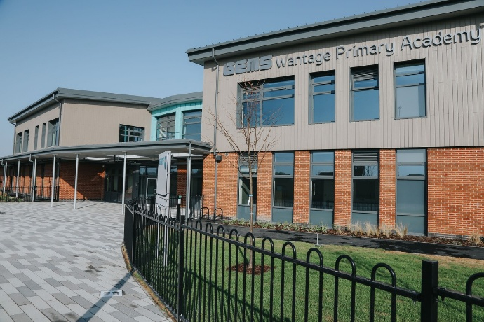

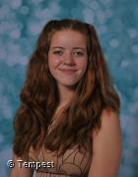


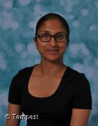

Welcome to WPA’s Reception Curriculum Event!
Mrs Slatter, Miss Brooker & Miss Allen – Reception 1
Miss Palipane & Miss Robins – Reception 2
Notes:
Rosie

Slide 2

We believe that primary school should be an exceptionally special place which gives you lifelong skills and memories.
Learning is accelerated when pupils and staff are in a positive and happy environment.
Anything is possible if you are kind, do your best and work hard.
Notes:
Meg

Slide 3
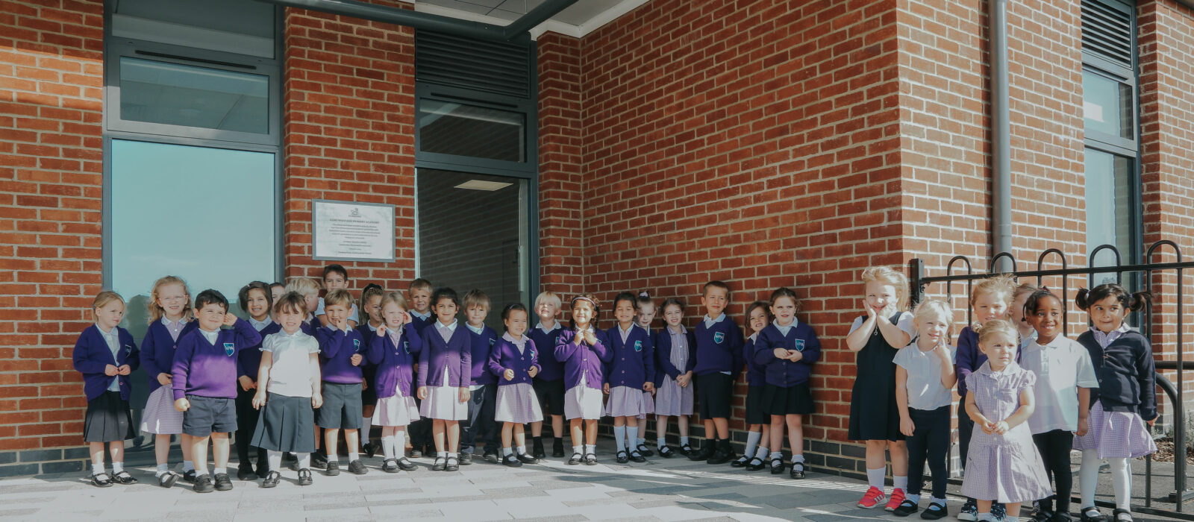
The WPA Way
Notes:
Meg

Slide 4

The Early Years Curriculum and What to Expect in Reception
Notes:
Rosie

Slide 5
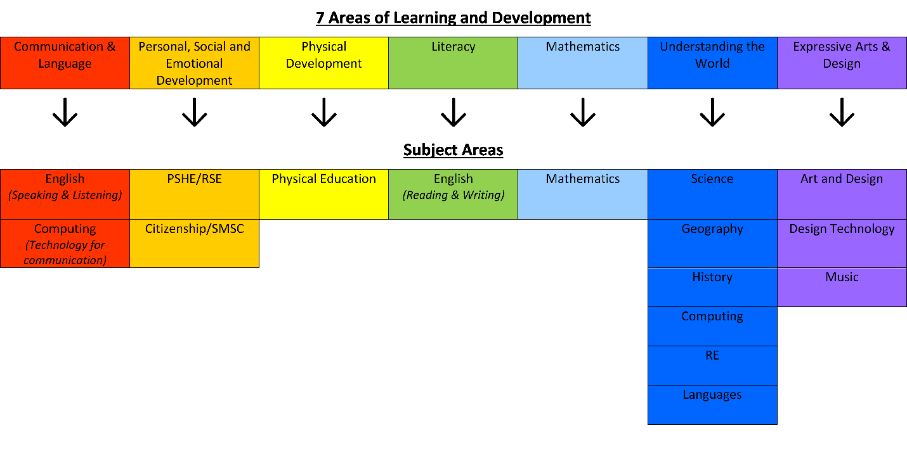
What subjects are taught?
The national curriculum starts from Y1. However, we ensure our EYFS curriculum (Nursery and Reception) feeds directly into the next steps. See below:
Gaining understanding and skills in these areas also provides the foundations necessary for pupils to progress to subject-specific study when they are ready to do so. The following image illustrates how the seven areas of learning and development link to subject areas:
EYFS
Y1 - Y6
Notes:
Rosie

Slide 6
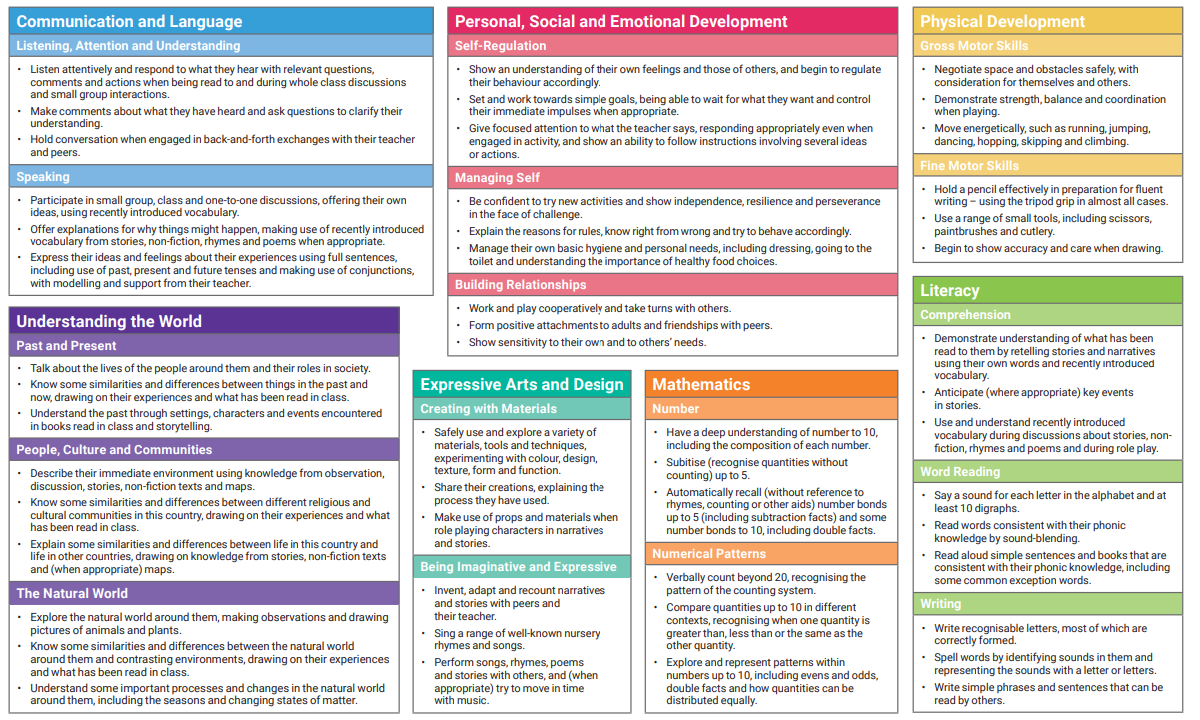
What are the Early Learning Goals?
Notes:
Rosie

Slide 7
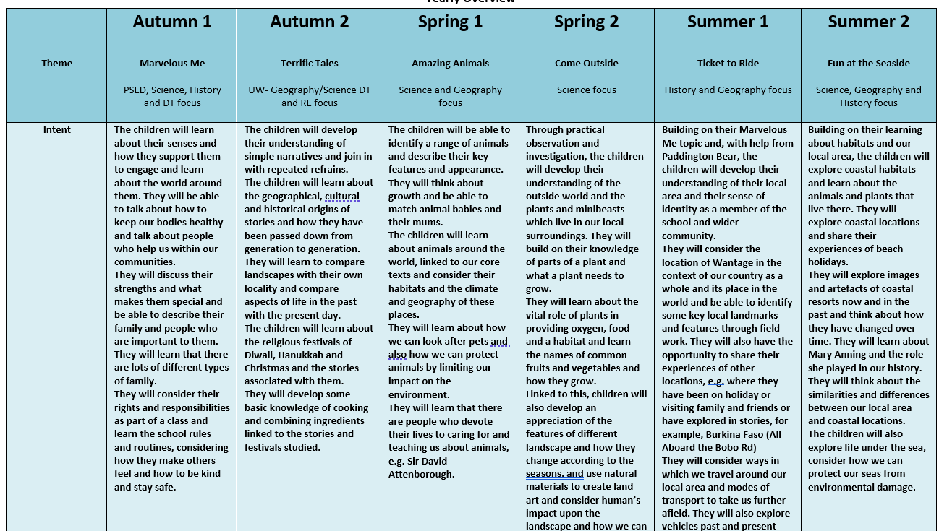
Yearly Overview
Notes:
Rosie

Slide 8
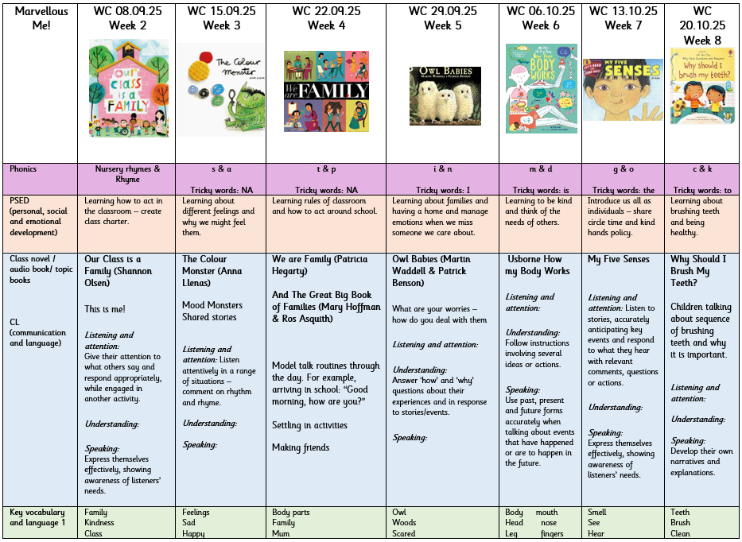
Termly Overview
Notes:
Rosie

Slide 9
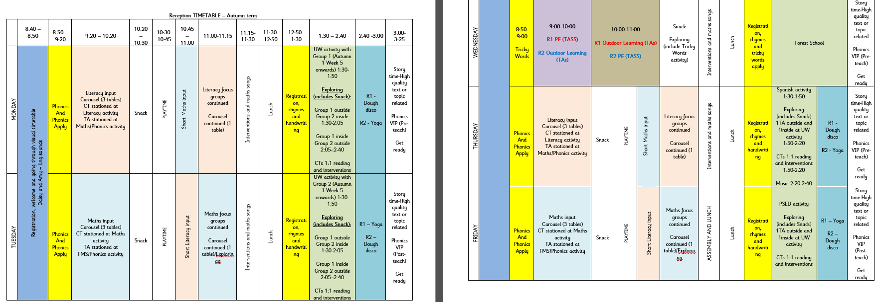
Our Day
Notes:
Meg

Slide 10

How will we know how your child is progressing?
Statutory Assessment- Reception Baseline
Informal Assessments all the time!
Notes:
Rosie

Slide 11

Reception Baseline Assessment
This assessment takes place in the first 6 weeks of Reception and the focus is on Communication, Language and Literacy and Maths. It takes 30-45 minutes per child and is completed by the practitioner who best knows the child.
The data will be used to judge how much progress children have made by the end of KS2.
Notes:
Rosie

Slide 12
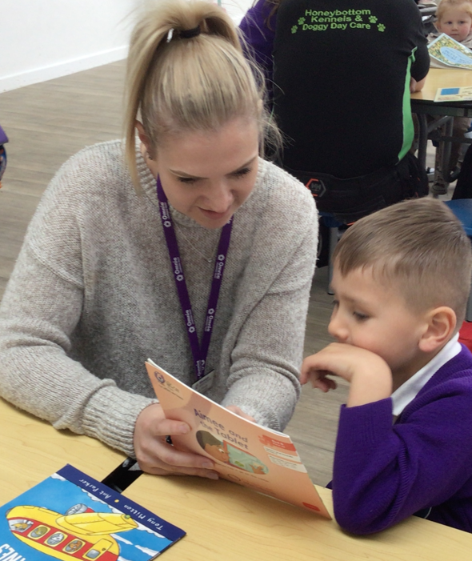


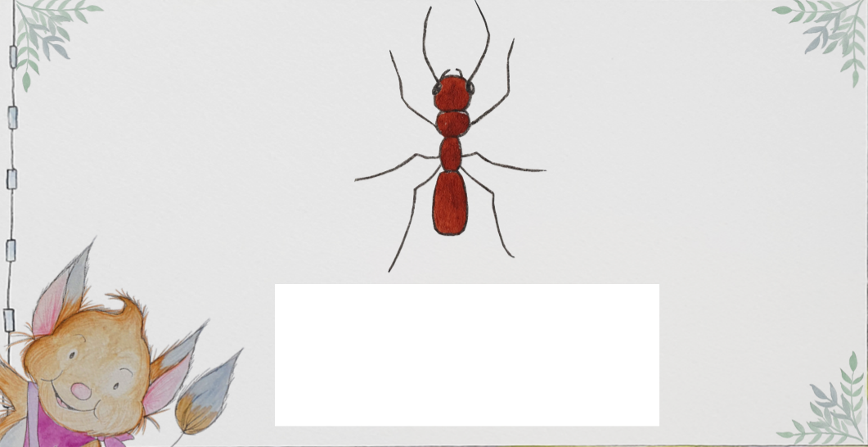
Phonics and Reading
Notes:
Jess/Rosie

Slide 13
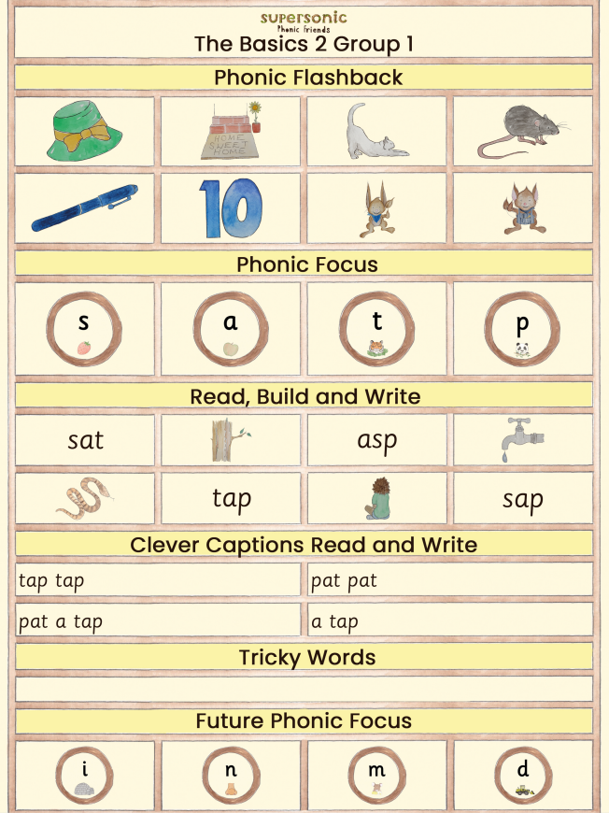
Phonics and Reading
A phonics newsletter will sent home in Homework books each week so that you know the sounds the children are learning and can support them at home.
In Reception, we learn two sounds a week, focusing on one sound over two days. Therefore, the newsletter will give the sounds for two weeks.
Notes:
Jess/Rosie

Slide 14
What is phonics?
Different schemes schools adopt
We use the DFE Letters and Sounds programme
Phased 1 – 5 systematic approach
The ability to be able to listen to sounds in words
Recognising the spelling for the sounds in words
Remembering the spelling for the sounds in words
Building words
Reading words – flash cards and decodable text
Writing words
Notes:
Ellie

Slide 15
Key terminology
Phoneme- this is the sound e.g. c, m, ch, ou. There are 44 in our English language.
Grapheme- this is a way of writing down a sound. This may consist of one or more letters e.g. ie as in pie, igh as in high.
Segment- this is when children pull words apart by saying the sounds e.g. c-a-t m-oo-n f-ar-m-er
Notes:
Ellie

Slide 16
Key terminology
Blend- this is when sounds are put together to make a word
Digraph- a grapheme containing two letters that make one sound e.g. sh, th or vowel digraphs such as oa, ee
Trigraph- a grapheme containing three letters that make one sound e.g. igh, ear and air
Split digraph- when a vowel digraph is split by a consonant e.g. a_e lake or i_e bike
Notes:
Jess

Slide 17
Pure sounds
It is vital that sounds are pronounced in a pure way. For example ‘f’ not ‘fuh’ and ‘s’ not ‘suh’. The reason for this is so that children can segment and blend correctly and do not add extra sounds when reading.
e.g. b-a-t-u instead of b-a-t
Notes:
Jess

Slide 18
SSPF- The will and the thrill
Can do ethos
Books
Rhymes
Poems
Songs
Clever conversations
Vocabulary
Story making and telling
Bringing books to life
Love, joy and laughter
Systematic Synthetic
Phonics.
Notes:
Jess

Slide 19
SSPF- The bigger picture
NC KS1
Phase 4 & 5
Phase 2 & 3
Phonological awareness Phase 1
General Sound Discrimination Phase 1
Stories, Songs, Rhymes and Non-Fiction
Listen
Language Development
Understand and Speak
Notes:
Jess

Slide 20
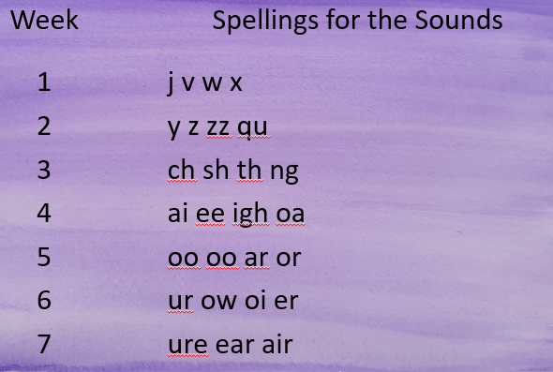
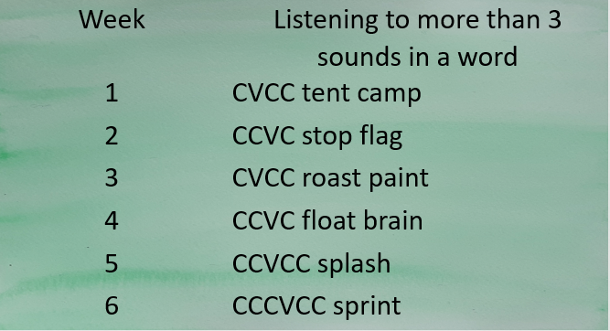
The basics 3
The basics 4
Listen, Recognise, Build, Read, Write
3 sounds only
Listen, Recognise, Build, Read, Write
4 and more sounds only. No new spellings to remember
Notes:
Jess

Slide 21
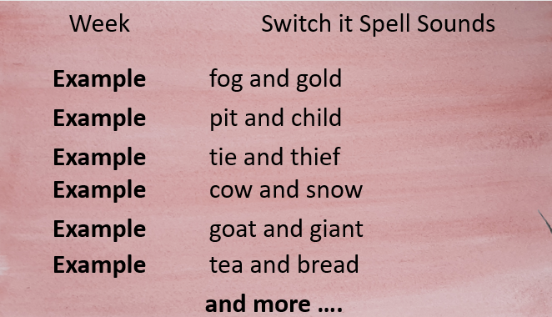
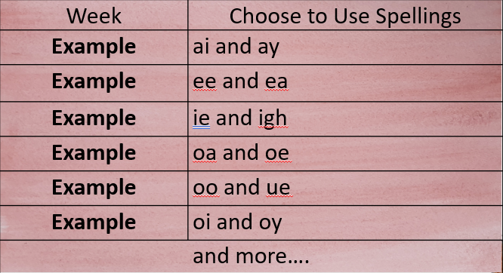
The basics 5
Choose to use
Switch it with Mitch
Notes:
Jess

Slide 22
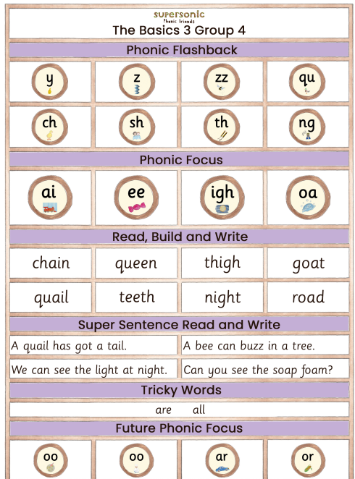
Weekly parent phonics newsletters
Notes:
Jess

Slide 23
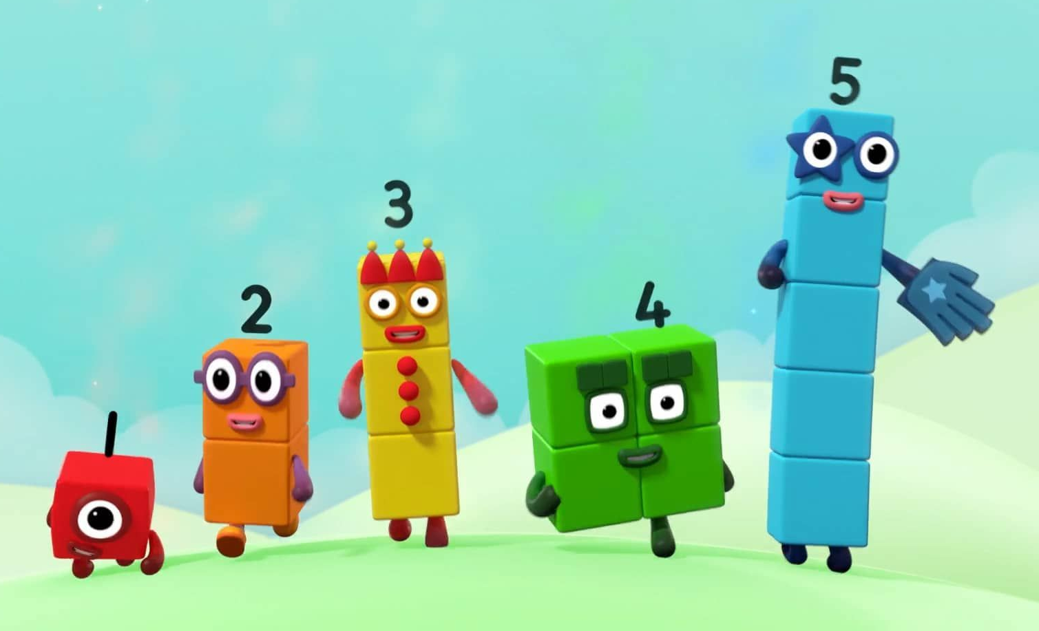
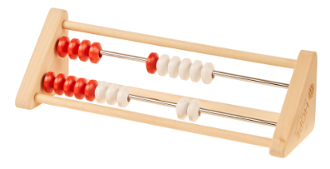

Maths
From next week, we will begin to use Mastering Number from NCETM, which focuses on number sense.
We will supplement this with Mastering the Curriculum, which will focus on number patterns and geometry too.
Notes:
Meg

Slide 24
Homework
Homework will be sent home every Monday in a green book.
There will be phonics and Maths, linked to what we are learning that week.
Please complete these (if you can, as we know you have busy lives outside of school) and return them the following Monday.
Notes:
Meg

Slide 25
Want to know more about our curriculum and what your child will learn?
https://www.wantageprimaryacademy.org.uk/curriculum/
Ensure you regularly access GOOGLE CLASSROOM (Reception upwards) and read the fortnightly NEWSLETTER (whole-school)!
How can I communicate with my child’s teacher?
You can speak to them at pick up or drop off. If you need more time, email the office to arrange this.
Notes:
Meg

Slide 26

Booking lunches, breakfast club, TASS
You can book lunches on FreshStart using the login credentials provided at the start of Reception.
To book Breakfast Club and TASS, contact the Office so they can provide you with the relevant information.
Notes:
Rosie

Slide 27

How can you help your child?
Wherever you are in your primary school journey, parents and school together make very successful learners.
Mutual respect and support between
parents and school
upholding school values
reading correspondence from school
professional trust
open, respectful communication
Supporting your child at home:
care and love
play
reading
talking
boundaries- make your child feel safe
co-regulation
good routines
enrichment
https://literacytrust.org.uk/resources/10-reasons-why-play-important/
Notes:
Rosie

Slide 28
School Readiness
Personal skills e.g. using the toilet and washing their hands independently
Independence and sharing e.g. taking turns and sharing with other children
Eating and drinking e.g. using cutlery or opening food containers in a lunch box
Speaking and listening e.g. following instructions from an adult, listening to stories and asking adults for help
Reading and writing e.g. holding a pencil and recognising their name
Number skills e.g. counting to ten and singing nursery rhymes.
Notes:
Rosie

Slide 29
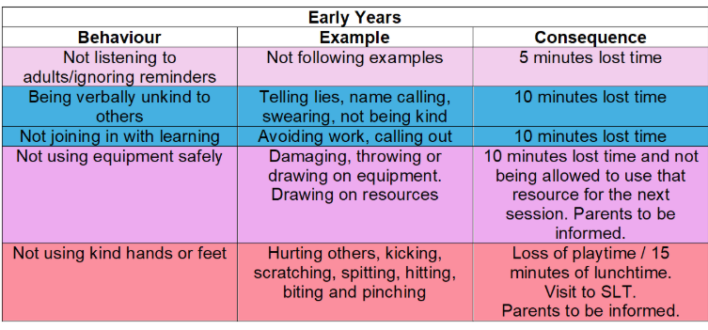
Behaviour at WPA
We have a positive behaviour management system at school.
We use restorative conversations to discuss and reflect on behaviour.
If behaviour does warrant a consequence, our behaviour policy has the following chart to follow through to ensure consistency and fairness across the school.
Notes:
Meg

Slide 30
Uniform
On non-PE days, children must wear: a white polo shirt (with or without logo), a purple sweatshirt with logo, navy shorts, trousers (not leggings), pinafore, navy grey, white or purple socks/tights, and black school shoes or plain black trainers
On PE days, children do not get changed at school and must come to school in their PE kits on these days. Children should wear: their house colour top, a plain black hoodie, a school sweatshirt or Omnia hoodie, and black shorts, tracksuit bottoms or leggings trainers (any colour)
Long hair (past shoulder length) must be fully tied back every day.
Small purple/black accessories may be worn.
No jewellery (exception of small studs but not on PE days)
Notes:
Meg

Slide 31


Reminders
Labelled spare clothes in your child’s bag
Wet clothes & coat
Label your child’s belongings (including their uniform and PE kit)
Commenting in reading journals
Hand in homework every Monday
Notes:
Rosie

Slide 32

If you have any questions, please speak to one of us at the end!

