Slide 1
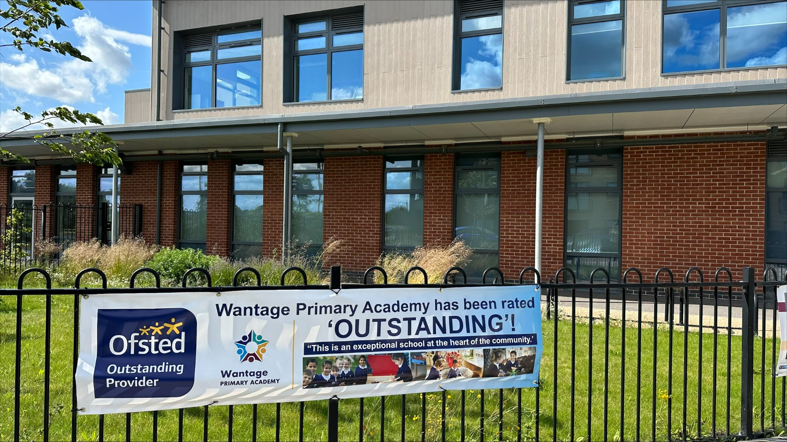
Welcome to KS1’s Curriculum and Information
2025
Notes:
Ellie

Slide 2
What we will cover:
Overview of Year 1 and Year 2
Expectations
Routines of a typical day
Topics covered over the year
Timetable
Maths and English
Assessment – how do we know how the pupils are doing?
How can parents support at home? Homework, reading etc
Notes:
Ellie

Slide 3
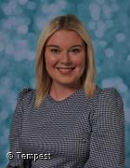
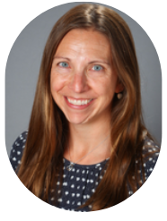
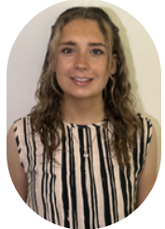

Overview of Year 1.
In year 1, staff are split into their own specific classes, however we work closely together as a year group and follow the same lessons to ensure consistency.
Staffing in year 1
Teachers: Mrs Hammond/ Mrs Perez, Miss Walker
Teaching Assistant: Mrs McDade
Notes:
Amy

Slide 4
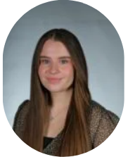
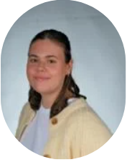
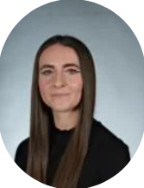
Overview of Year 2.
Staffing in year 2
Teachers: Miss Greenaway and Miss Oliver
Teaching Assistants: Miss Wall
Notes:
Ellie

Slide 5
Expectations of KS1
Motivated to learn
Engaged with their learning
Showing kindness
Everyone is respectful and listens to one another
Everyone is mindful of other peoples’ opinion
Children adhere and respect their own Class Charter
Know and take pride in our school values – Inspiring, Challenging, Nurturing and Empowering.
Notes:
Ellie

Slide 6
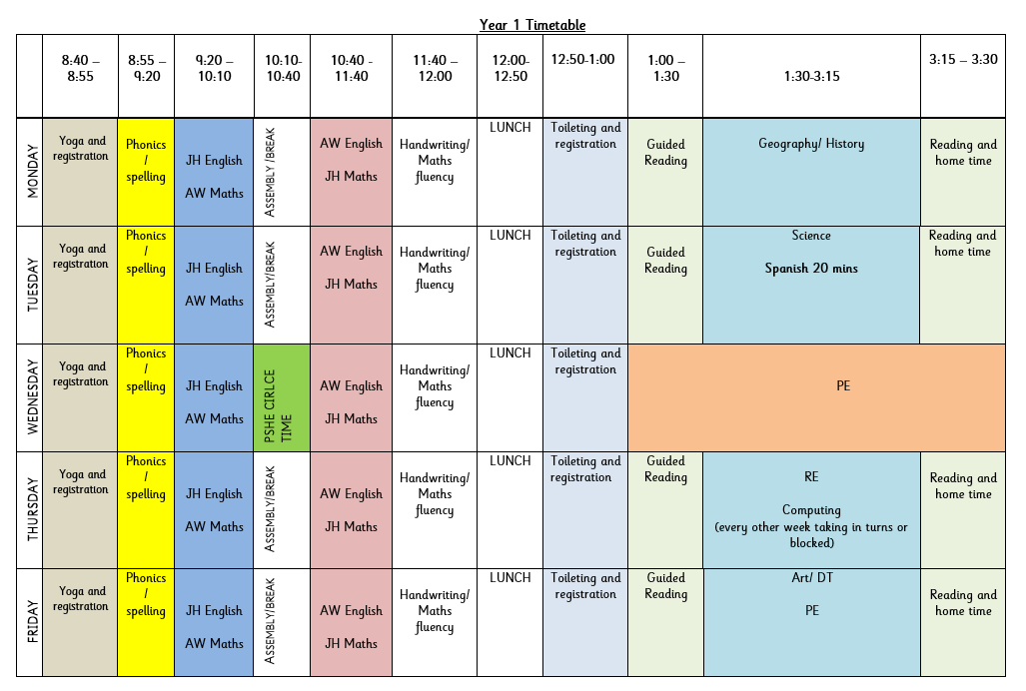
A day in Year 1
Routines of the day:
Yoga to start the day
Phonics
English
Breaktime
Maths
Assembly
Lunchtime
Guided Reading
Topic
Key information:
Books will be changed weekly – usually on a Monday or Tuesday.
Homework will go out on a Monday via homework books and be handed in on Monday.
Notes:
Amy

Slide 7
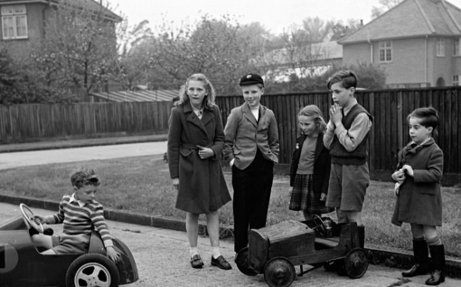
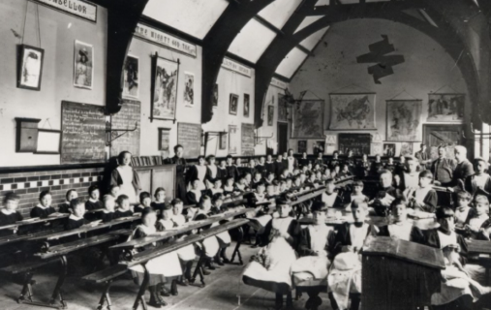
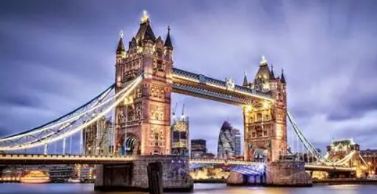

Topics covered in Year 1
Autumn Term | Spring Term | Summer Term 5 and 6
Childhood:This project teaches children about everyday life and families today, including comparisons with childhood in the 1950s, using artefacts and a range of different sources. Our wonderful world: This essential skills and knowledge project teaches children about physical and human features, maps, cardinal compass points, and positional and directional language. They learn about the equator, hemispheres and continents and are introduced to the countries, capital cities and settlements of the United Kingdom. The children carry out simple fieldwork to find out about local physical and human features. | Bright lights, big city! This project teaches children about the physical and human characteristics of the United Kingdom, including a detailed exploration of the characteristics and features of the capital city, London. | School days: This project teaches children about their own school and locality, both today and in the past. They compare schooling in the Victorian era to their experiences today.
Notes:
Melissa

Slide 8
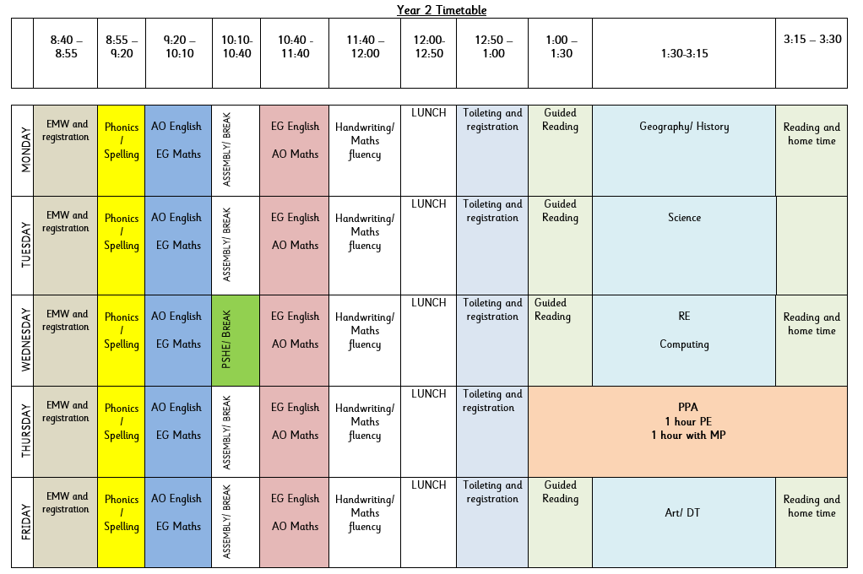
A day in Year 2
Routines of the day:
Early morning work
Phonics
English
Breaktime
Maths
Assembly
Lunchtime
Fluency to start the afternoon: grammar, Maths, Zones of Regulation, handwriting or choosing the correct spelling.
Guided Reading
Topic
Key information:
Books will be changed weekly on a Monday or Tuesday.
Homework will go out on a Monday via homework books and be handed in on Monday.
Notes:
Annabel

Slide 9
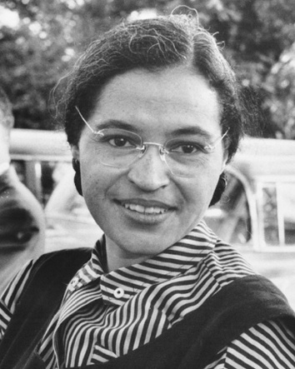
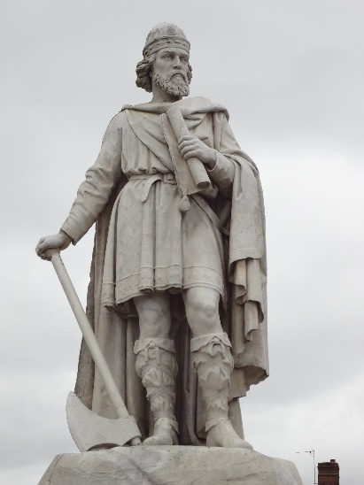
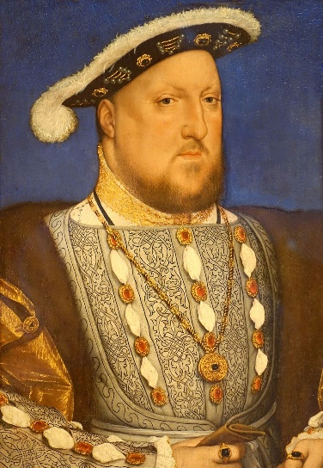
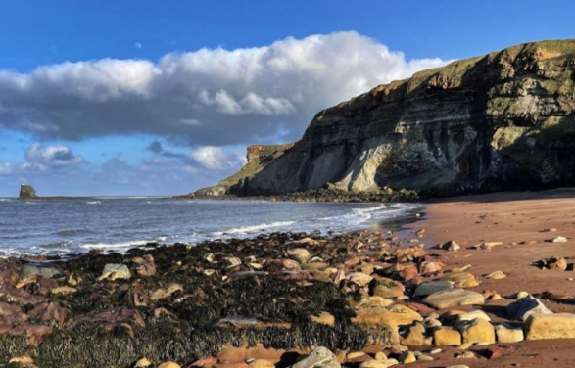

Topics covered in Year 2
Autumn Term | Spring Term | Summer Term
Movers and shakers This project teaches children about historically significant people who have had a major impact on the world. They will learn to use timelines, stories and historical sources to find out about the people featured and use historical models to explore their significance. | Magnificent Monarchs This project teaches children about the English and British monarchy from AD 871 to the present day. Using timelines, information about royal palaces, portraits and other historical sources, they build up an understanding of the monarchs and then research six of the most significant sovereigns | Coastlines This project teaches children about the physical and human features of coastal regions across the United Kingdom, including a detailed exploration of the coastal town of Whitby, in Yorkshire.
Notes:
Annabel

Slide 10

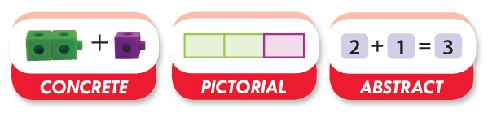
Maths at WPA
At Wantage Primary Academy, we teach Maths through a CPA approach (concrete, pictorial, abstract). The Concrete Pictorial Abstract (CPA) approach is a system of learning that uses physical and visual aids to build a child’s understanding of abstract topics.
Better understand the relationship between numbers and the real world
Notes:
Ellie

Slide 11

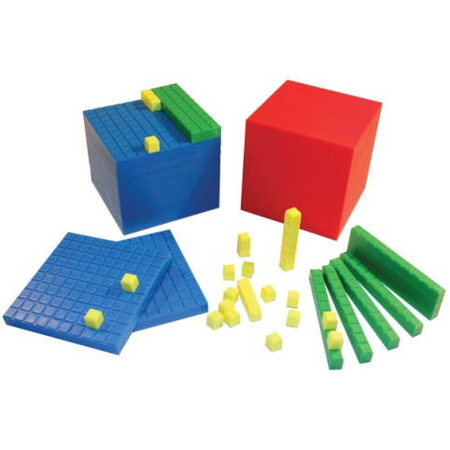
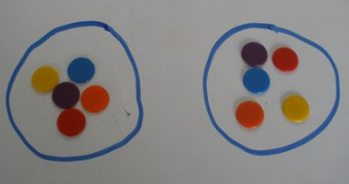
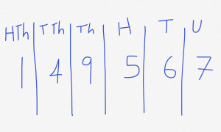
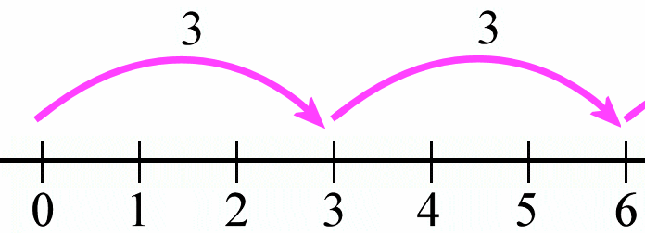
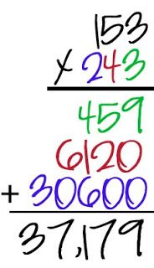

Teaching in a concrete, visual then abstract way
Concrete is the “doing” stage to bring concepts to life for children.
(demonstrated through available resources in the classroom and, where appropriate, pictures in books)
Pictorial is the “seeing stage” where children may draw/look at pictures, diagrams or models which represent the problem.
Abstract is the “symbolic” stage, where children are able to use numbers and mathematical symbols to solve calculations.
Notes:
Ellie

Slide 12
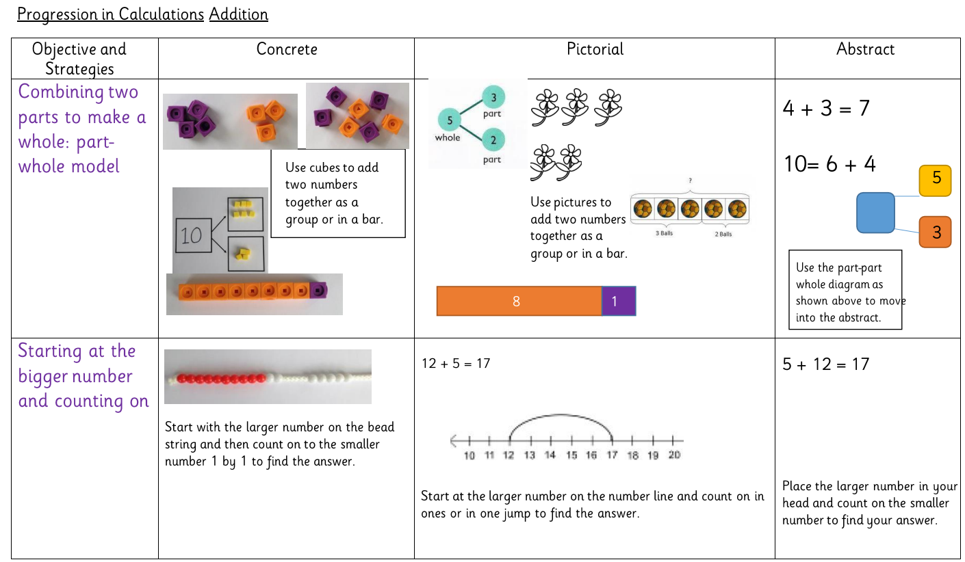
The WPA way in Maths
Notes:
Ellie

Slide 13
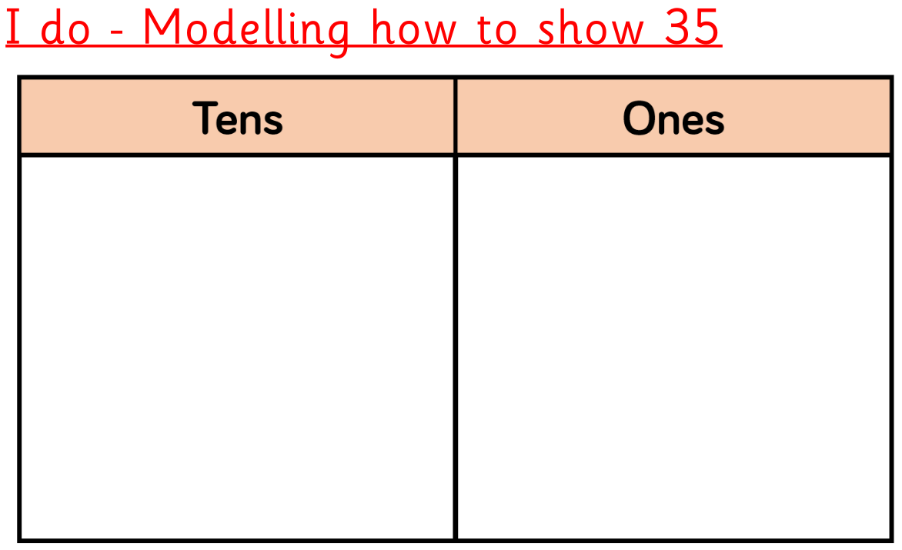
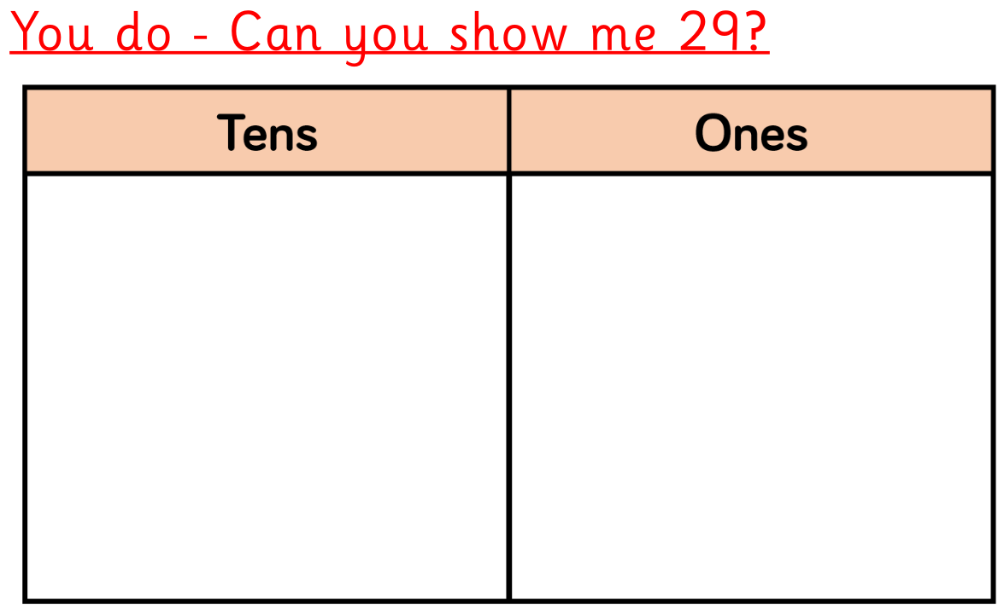
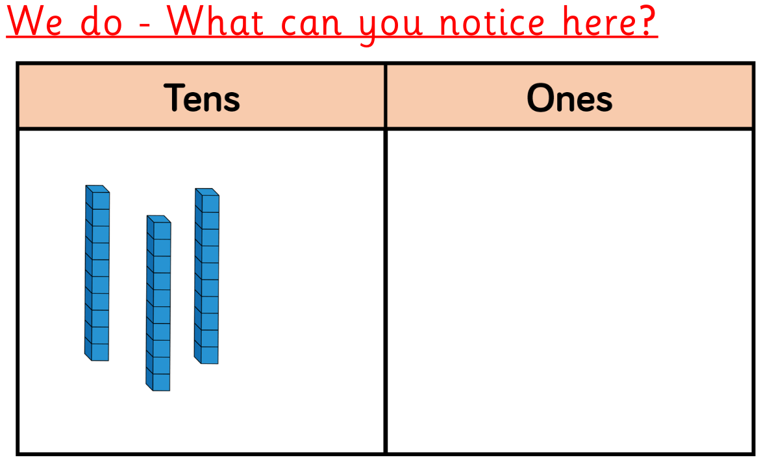
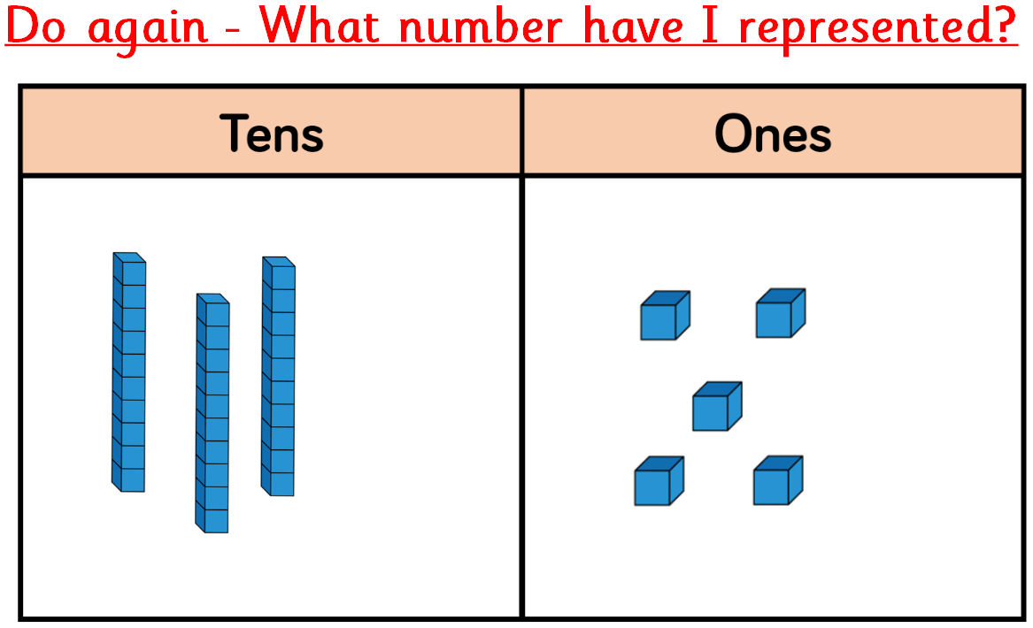
Place Value using base 10/dienes
Notes:
Ellie

Slide 14
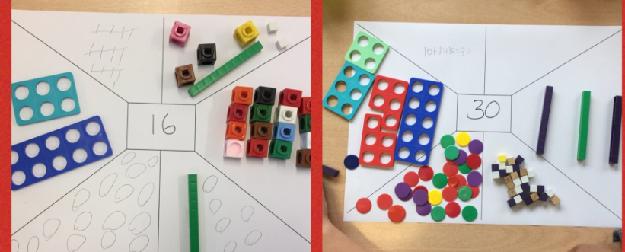
Place Value - Complete the representation tables using equipment to help you.

Slide 15
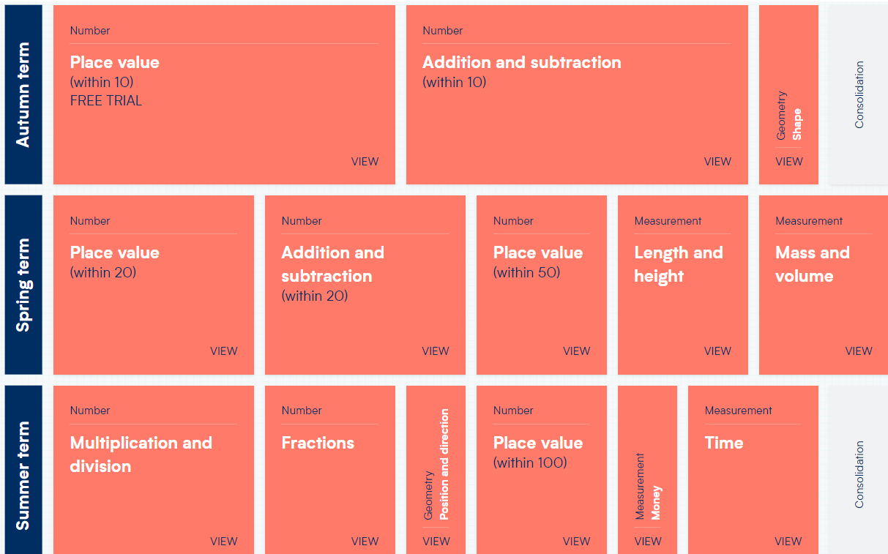
Maths in Year 1- coverage.
Notes:
Amy

Slide 16
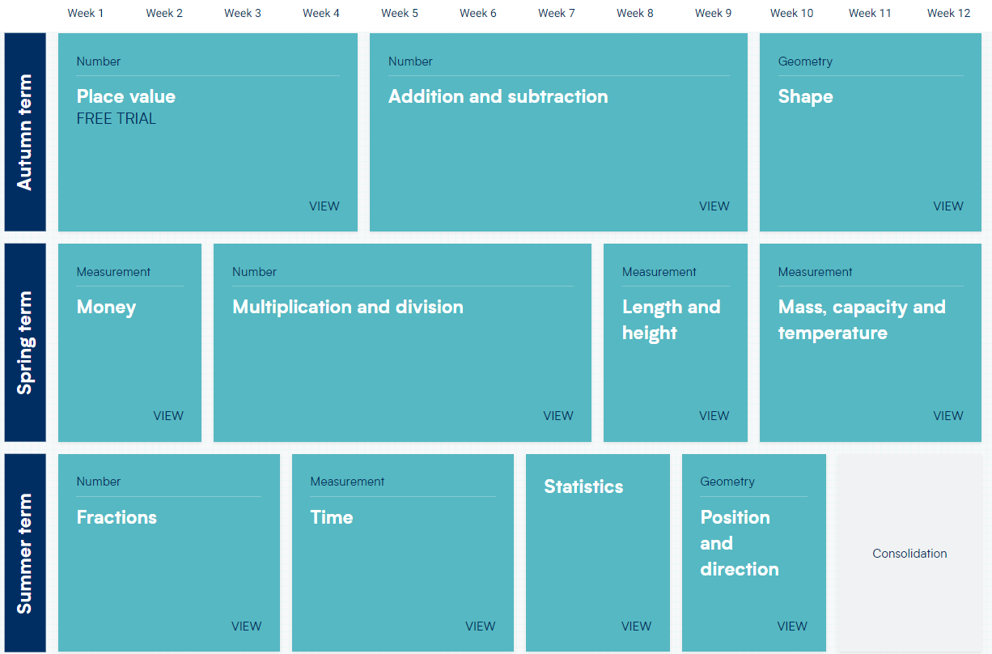
Maths in Year 2 - coverage.
Notes:
Annabel

Slide 17
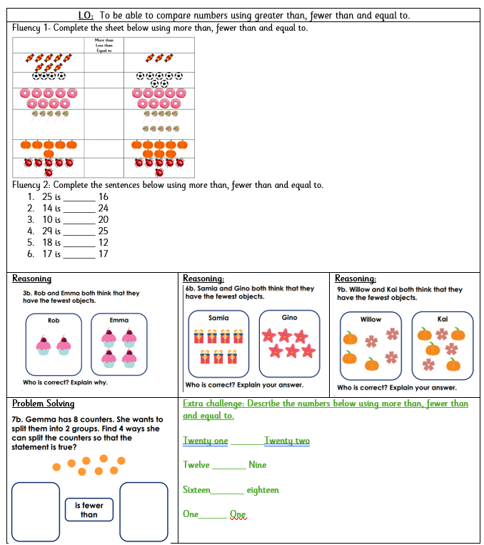
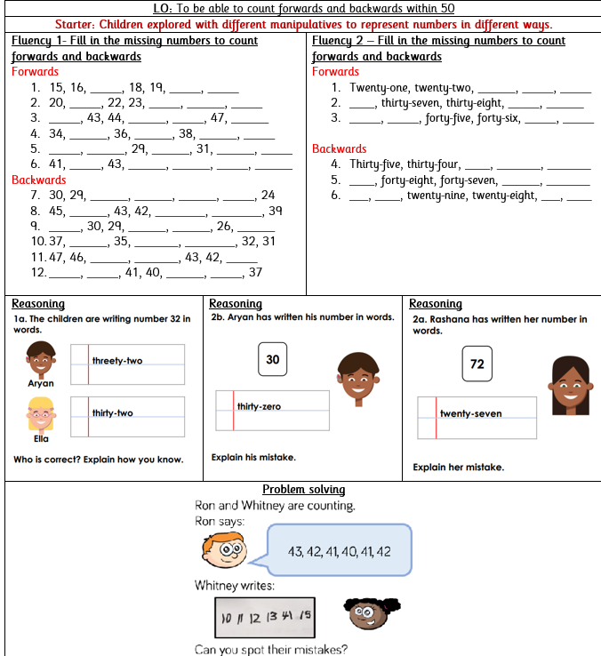
Maths in Year 1 and 2 – tasks
Notes:
Annabel

Slide 18
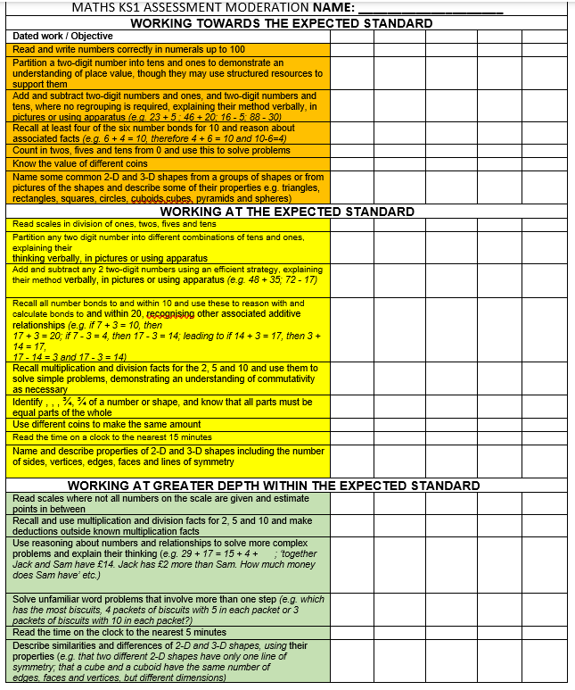
Maths in KS1 - outcomes and expectations
Notes:
Annabel

Slide 19




English
Notes:
Annabel

Slide 20
English in KS1 - how is it taught?
English includes: Reading, Writing and Speaking & Listening. English lessons take place daily.
We usually start with a grammar focus, then a Cold Write, then exposure to the text types. Finally, we write our own and work hard to edit using pink pen.
At the end of every unit we will have a hot write
Star challenges with increasing challenge, based on the task.
Working walls reinforcing our learning, vocabulary and misconceptions
In KS1, we focus on writing to entertain and inform
Notes:
Annabel

Slide 21
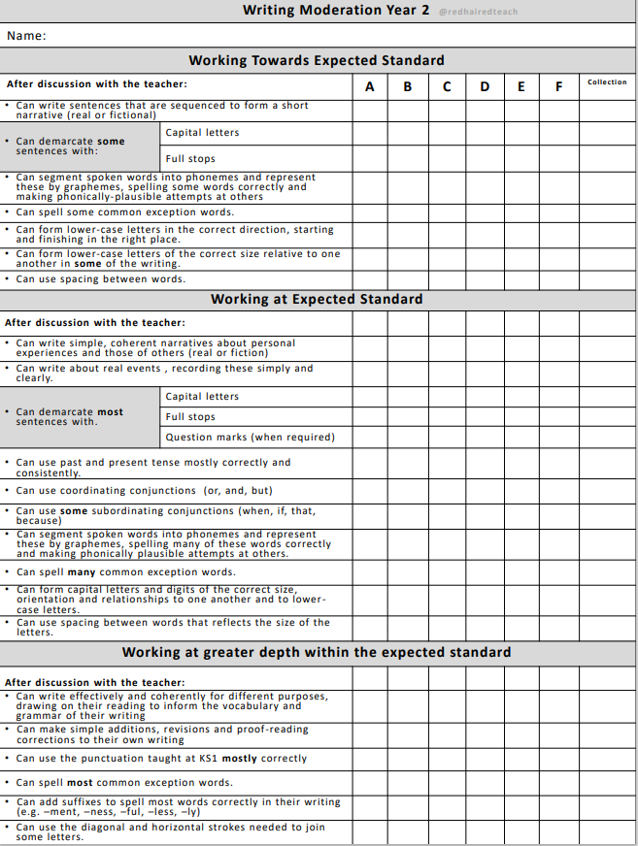
English in KS1 - outcomes and expectations – by the end of Y2
Notes:
Annabel

Slide 22
What is phonics?
Different schemes schools adopt
We use the DFE Letters and Sounds programme
Phased 1 – 5 systematic approach
The ability to be able to listen to sounds in words
Recognising the spelling for the sounds in words
Remembering the spelling for the sounds in words
Building words
Reading words – flash cards and decodable text
Writing words
Notes:
Ellie

Slide 23
Key terminology
Phoneme- this is the sound e.g. c, m, ch, ou. There are 44 in our English language.
Grapheme- this is a way of writing down a sound. This may consist of one or more letters e.g. ie as in pie, igh as in high.
Segment- this is when children pull words apart by saying the sounds e.g. c-a-t m-oo-n f-ar-m-er
Notes:
Ellie

Slide 24
Key terminology
Blend- this is when sounds are put together to make a word
Digraph- a grapheme containing two letters that make one sound e.g. sh, th or vowel digraphs such as oa, ee
Trigraph- a grapheme containing three letters that make one sound e.g. igh, ear and air
Split digraph- when a vowel digraph is split by a consonant e.g. a_e lake or i_e bike
Notes:
Jess

Slide 25
Pure sounds
It is vital that sounds are pronounced in a pure way. For example ‘f’ not ‘fuh’ and ‘s’ not ‘suh’. The reason for this is so that children can segment and blend correctly and do not add extra sounds when reading.
e.g. b-a-t-u instead of b-a-t
Notes:
Jess

Slide 26
SSPF- The will and the thrill
Can do ethos
Books
Rhymes
Poems
Songs
Clever conversations
Vocabulary
Story making and telling
Bringing books to life
Love, joy and laughter
Systematic Synthetic
Phonics.
Notes:
Jess

Slide 27
SSPF- The bigger picture
NC KS1
Phase 4 & 5
Phase 2 & 3
Phonological awareness Phase 1
General Sound Discrimination Phase 1
Stories, Songs, Rhymes and Non-Fiction
Listen
Language Development
Understand and Speak
Notes:
Jess

Slide 28
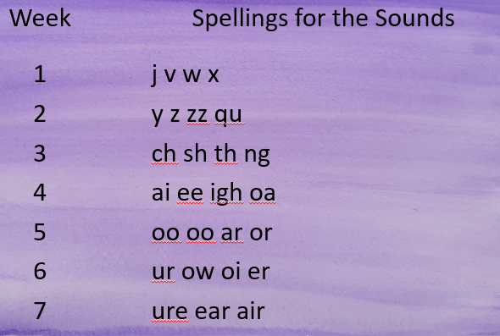
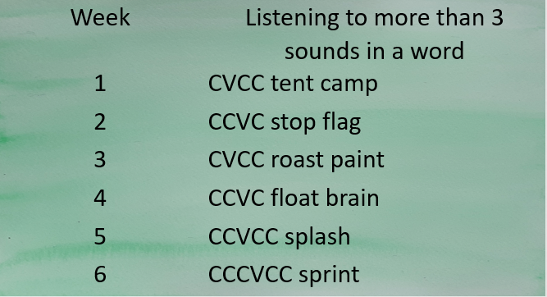
The basics 3
The basics 4
Listen, Recognise, Build, Read, Write
3 sounds only
Listen, Recognise, Build, Read, Write
4 and more sounds only. No new spellings to remember
Notes:
Jess

Slide 29
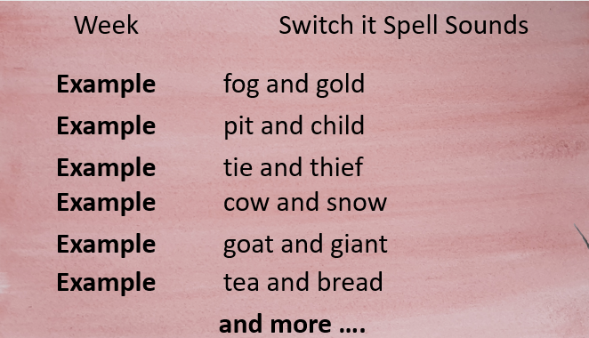
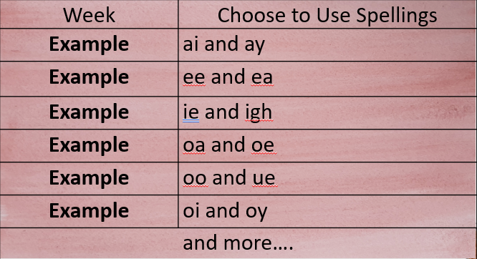
The basics 5
Choose to use
Switch it with Mitch
Notes:
Jess

Slide 30
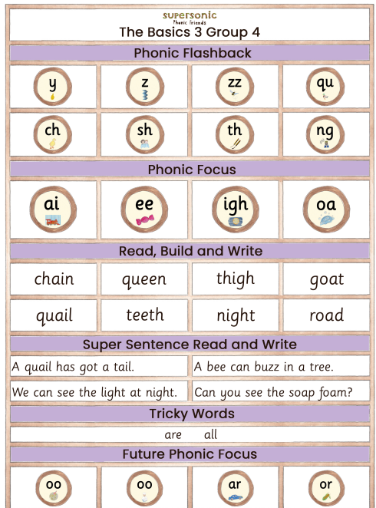
Weekly parent phonics newsletters
Notes:
Jess

Slide 31

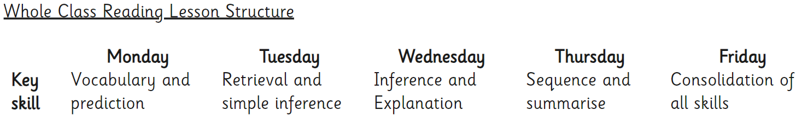
Guided Reading
At the early stages of learning to read, reading materials are closely matched to learners’ phonics knowledge using the Collins Big Cat books (Lilac – Turquoise). We use Collins Big Cat as a whole-school reading programme; the levelled readers systematically increase the level of challenge, vocabulary and stamina as children work up through the bands and have been audited to ensure they link fully with our SSP.
Daily Guided Reading sessions take place throughout the school
From the Spring Term of Year 1, all children will move onto whole class Guided Reading using Badger Guided Reading texts. During guided reading, we ensure our pupils are exposed to rich and varied text.
Notes:
Annabel

Slide 32
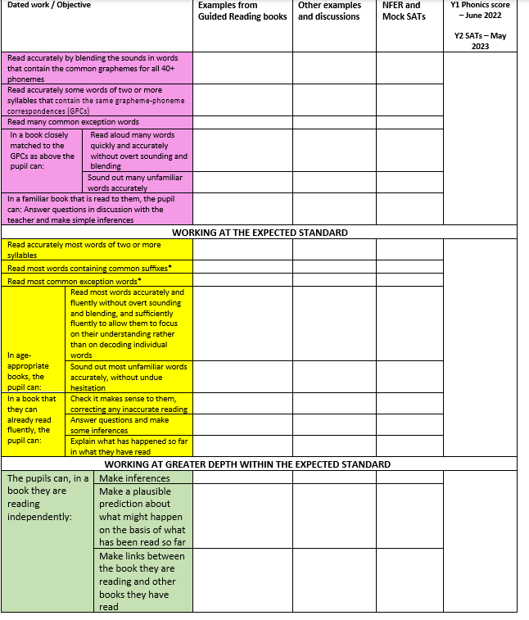
Reading end of Year 2
Notes:
Annabel

Slide 33
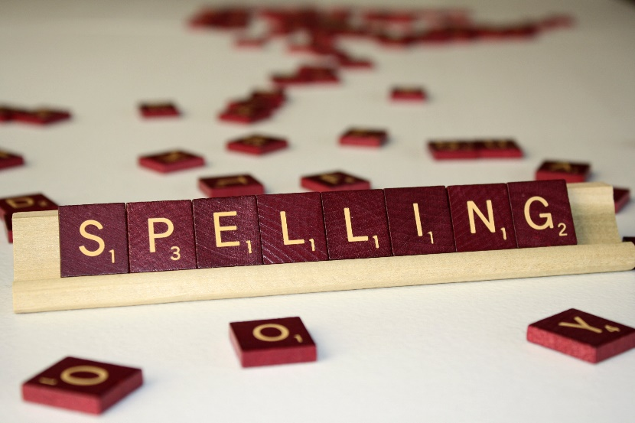

Spellings
In KS1, the children learn to spell as part of their daily phonics lessons where they learn to apply the sounds taught. In all other areas of the curriculum, the children are encouraged to apply their phonic knowledge when writing independently.
The spelling objectives are taught initially through Supersonic Phonic Friends (Nursery – Year 2). Throughout the year, Year 2, the children then move onto ‘No Nonsense spelling’ which focuses on the teaching of spelling.
Word lists and visual prompts are used in classrooms to assist children with their spelling. Children are encouraged to use different strategies to help them spell correctly including phonics, use of word lists or mats and dictionaries. When marking work teachers pick out spellings for children to correct based on spelling patterns and non-negotiables.
Notes:
Ellie

Slide 34
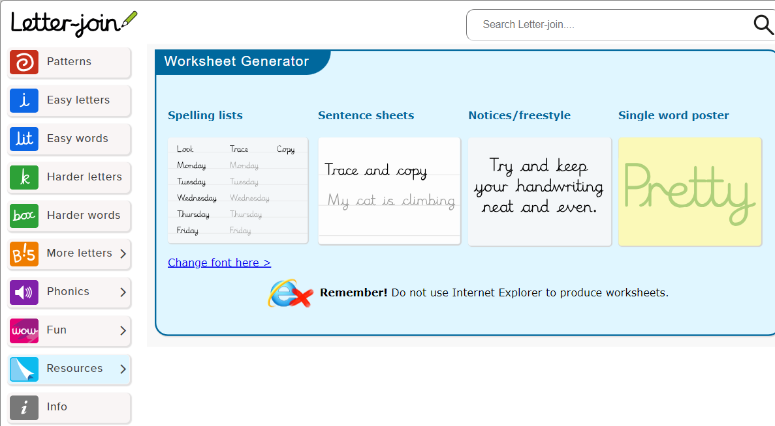
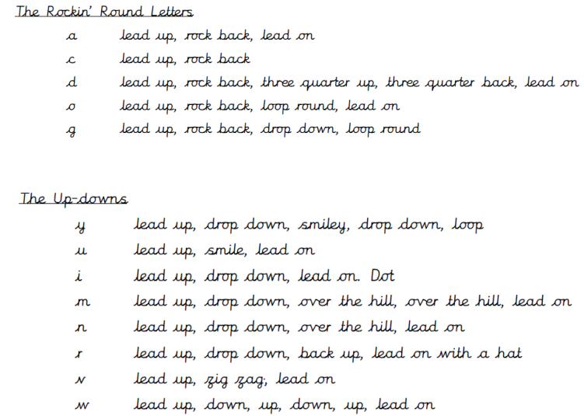
Handwriting
Our aim is to ensure that every pupil develops a neat, fluent style of handwriting using continuous cursive letters as this will lead to them producing letters and words automatically in their independent writing. For most this will happen by the end of Year 1 and for those with specific difficulties, interventions will take place.
Handwriting is taught weekly, in Year 1 and 2, through explicit teacher modelling of letter formation and building to a cursive style.
We use Letter Join script. We recognise that handwriting is closely linked with spelling, therefore, the practising of key word/rules and year group statutory and non-statutory words also occurs in the context of handwriting lessons, once children are competent in the correct individual letter formation.
Notes:
Melissa

Slide 35
Assessment – how do we know how the pupils are doing?
Throughout the school, teachers assess children daily to form the basis of planning and consecutive lessons, ensuring they meet the needs.
At the end of each half term, teachers moderate and assess the children on the objectives covered.
Once a term, children are assessed in formal ways for writing. At the start of each English topic/genre the children will carry out a cold write. A cold write is a piece of writing that the children do independently before they have had any explicit teaching or guidance in that area. At the end of the topic, the children then carry out an independent hot write. This highlights what they have learnt throughout the topic. In year 2, weekly spelling tests are delivered. This aims to aid the children in learning their year 2 spelling rules.
Within Mathematics, end of unit assessments are completed for each topic.
In other topics and subjects, we assess throughout and at the start and
end of unit assessments.
Notes:
Ellie

Slide 36
Other subjects and Enrichment
Alongside the core skills of English and Maths, we also teach a full broad curriculum and ensure lots of enrichment such as visits, trips, music, forest schools and much more.
Notes:
Amy

Slide 37

How can parents support at home?
Please provide a healthy snack! (available at school)
Support with homework and spellings to help link learning
Supersonic Phonic Friends Newsletter to help with sounds – Year 1 and this for the start of Year 2 while they recap Year 1 sounds.
Check in with the Canva overviews
Good routines (including sleep)
Only playing appropriate games and not too
much screen time. Please do not playing on devices until late
Fun Reading
Fun Writing
Fun Maths
Positive attitude and communication - Ask them what they have enjoyed and what they learnt
Notes:
Melissa

Slide 38
Thank you very much for your time!
Please do visit our website to find out more about your child’s education:https://www.wantageprimaryacademy.org.uk/curriculum/
Notes:
Jess

