Slide 1
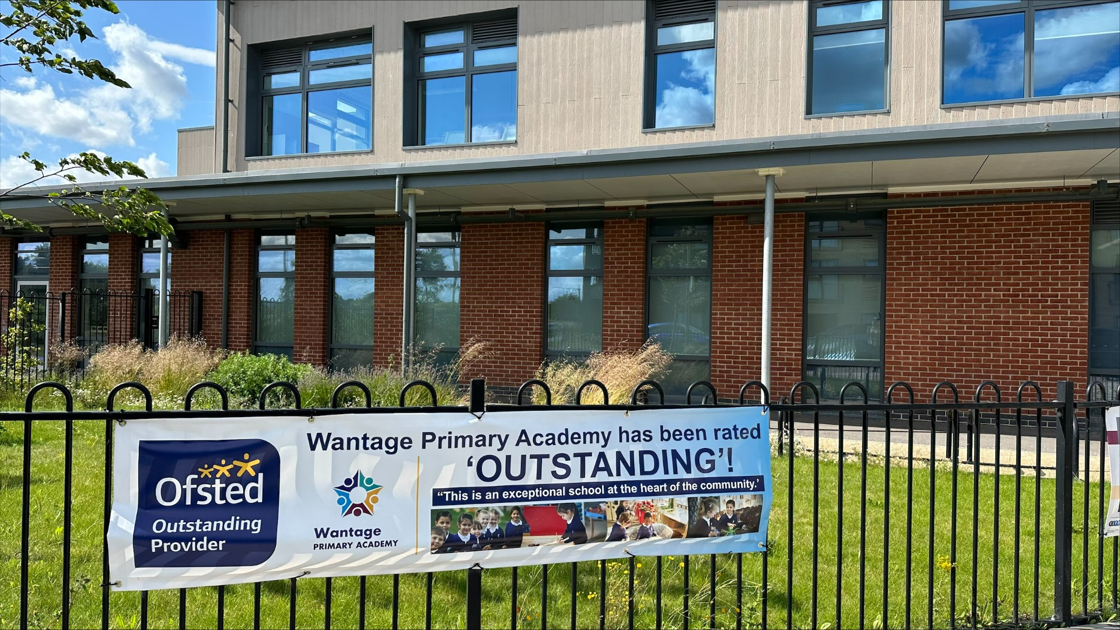
Welcome to KS2’s Curriculum and Information
2025
Notes:
Introductions: Rosella.

Slide 2
What we will cover:
Overview of Year 3, Year 4, Year 5 and Year 6
Expectations
Routines of a typical day
Timetable
Maths and English
Assessment – how do we know how the pupils are doing?
How can parents support at home? Homework, reading etc
Notes:
Rosella.

Slide 3
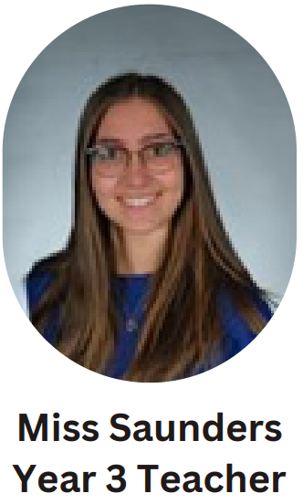
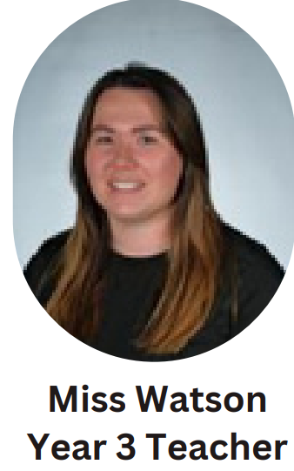
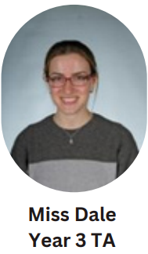
Staffing of Year 3
Teacher: Miss Watson and Miss Saunders
Teaching Assistants/1:1 support - Miss Dale and Mrs Groves
Notes:
Tia

Slide 4
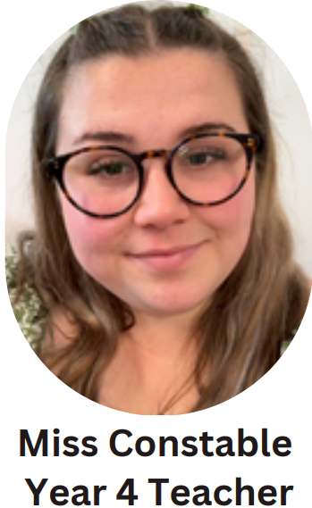
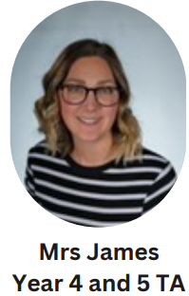
Staffing Year 4
Teacher: Miss Constable
Teaching Assistant/1:1 support – Mrs James
Notes:
Tia

Slide 5
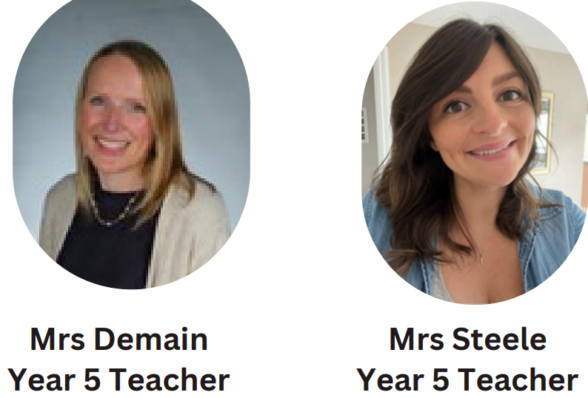
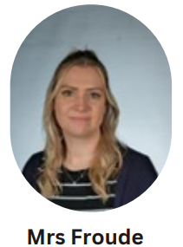
Overview of Year 5
Teacher: Mrs Mitchel and Mrs Demain
Teaching Assistant/1:1 support – Mrs Froude
Notes:
Tia

Slide 6
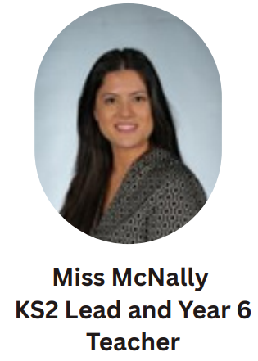
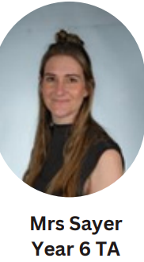
Overview of Year 6.
Teacher: Miss McNally
Teaching Assistant: Mrs Sayer
Notes:
Tia

Slide 7




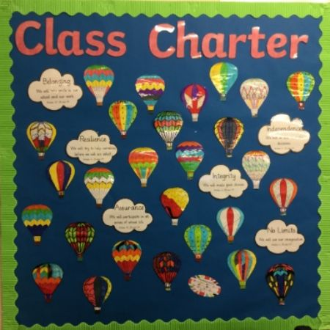

Expectations of KS2
Weekly Spelling quiz on a Monday/Friday
PE kits should be worn on PE days
https://primarysite-prod-sorted.s3.amazonaws.com/gems-wantage-primary-academy/UploadedDocument/36da8590-9139-4c5c-bb8c-48a790610a52/wpa-behaviour-policy-2025-26.pdf
Notes:
Know and take pride in our school values – Inspiring, Challenging, Nurturing and Powering.
Reading records in every day
Rosella

Slide 8
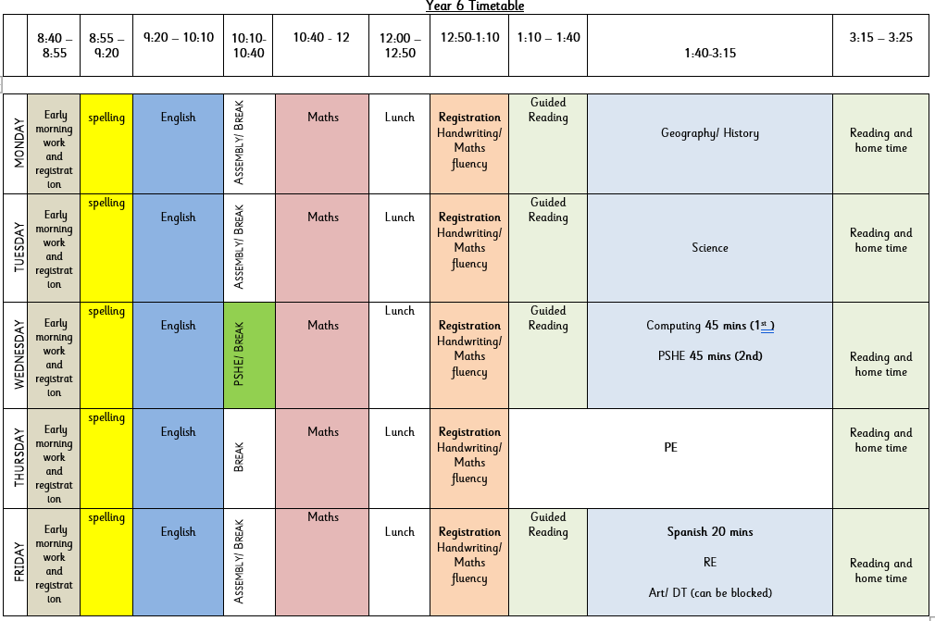
A day in KS2
Routines of the day:
EMT to start the day
Spellings
English
Assembly
Breaktime
Maths
Lunchtime
Guided Reading
Topic
Key information:
Books will be changed weekly – usually on a Monday or Tuesday.
Homework will go out on a Monday.
Notes:
Rosella

Slide 9

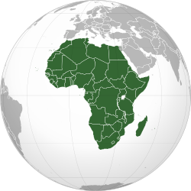

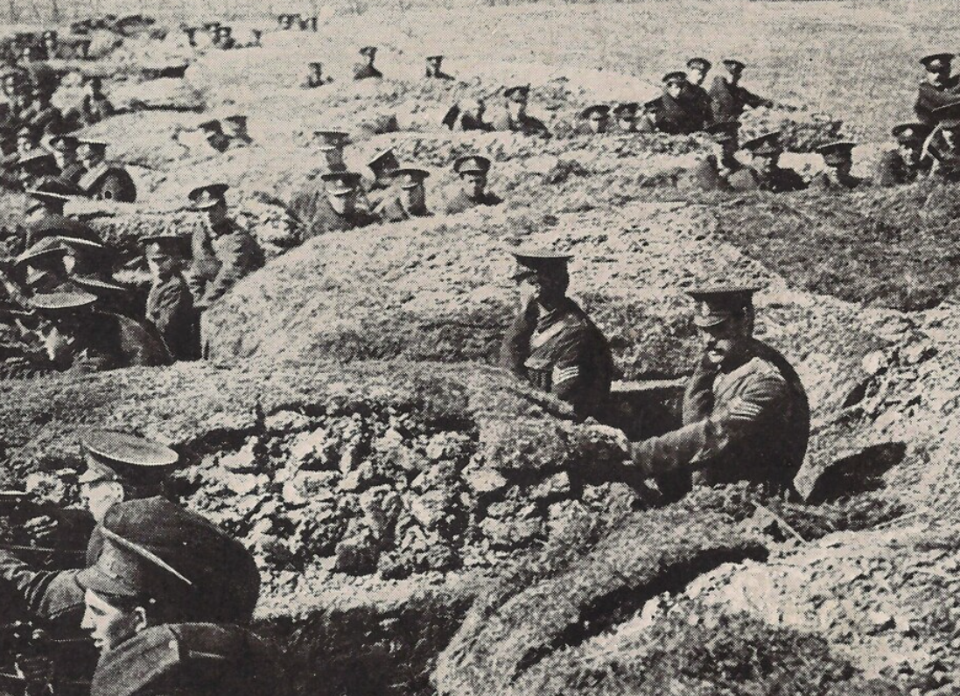
Topics covered in Year 6 – Please visit our website to view all year groups
Autumn Term 1 and 2 | Spring Term 3 and 4 | Summer Term 5 and 6
Britain at War Focus: History This project teaches children about the causes, events and consequences of the First and Second World Wars, the influence of new inventions on warfare, how life in Great Britain was affected and the legacy of the wars in the post-war period. | Frozen Kingdoms Focus: Geography This project teaches children about the characteristics and features of polar regions, including the North and South Poles, and includes a detailed exploration of the environmental factors that shape and influence them. | Maafa Focus: History This project teaches children about Africa past and present, with a particular focus on Benin. It traces the development of the slave trade and explores Britain’s role in the transatlantic slave trade, the causes and consequences of the European colonisation of Africa and the worldwide communities that make up the African diaspora.
Notes:
Rosella

Slide 10
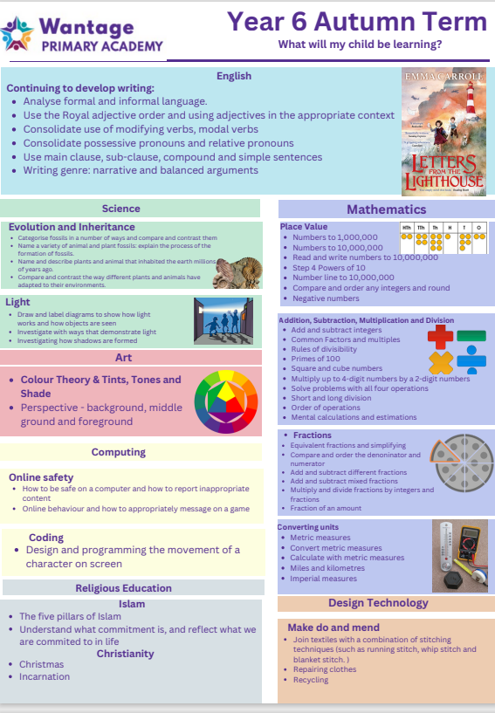
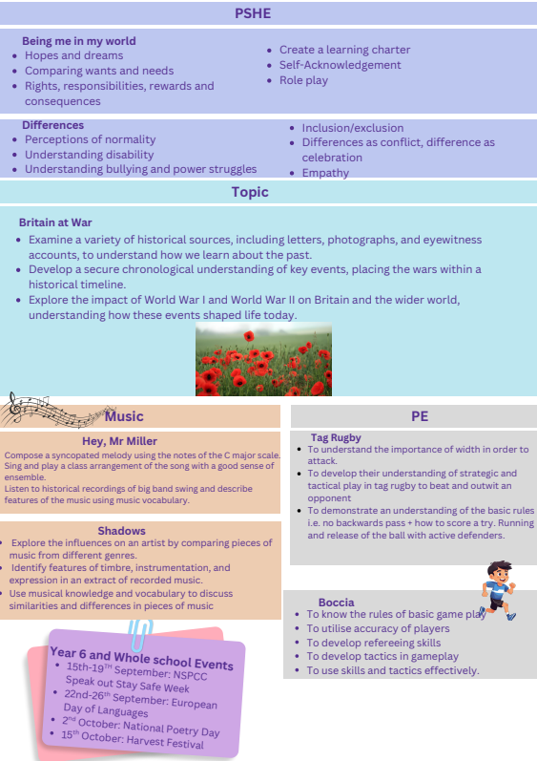
Topics covered– Please visit our website to view all year groups
Notes:
Rosella

Slide 11

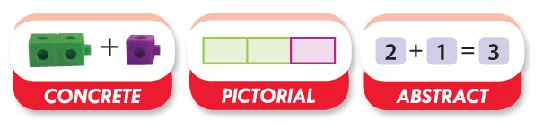
Maths at WPA
At Wantage Primary Academy, we teach Maths through a CPA approach (concrete, pictorial, abstract). The Concrete Pictorial Abstract (CPA) approach is a system of learning that uses physical and visual aids to build a child’s understanding of abstract topics.
Better understand the relationship between numbers and the real world
Notes:
Pupils are introduced to a new mathematical concept through the use of concrete resources (e.g. fruit, Dienes blocks etc). When they are comfortable solving problems with physical aids, they are given problems with pictures – usually pictorial representations of the concrete objects they were using. Then they are asked to solve problems where they only have the abstract i.e. numbers or other symbols. Building these steps across a lesson can help pupils better understand the relationship between numbers and the real world, and therefore helps secure their understanding of the mathematical concept they are learning.
Rosella

Slide 12

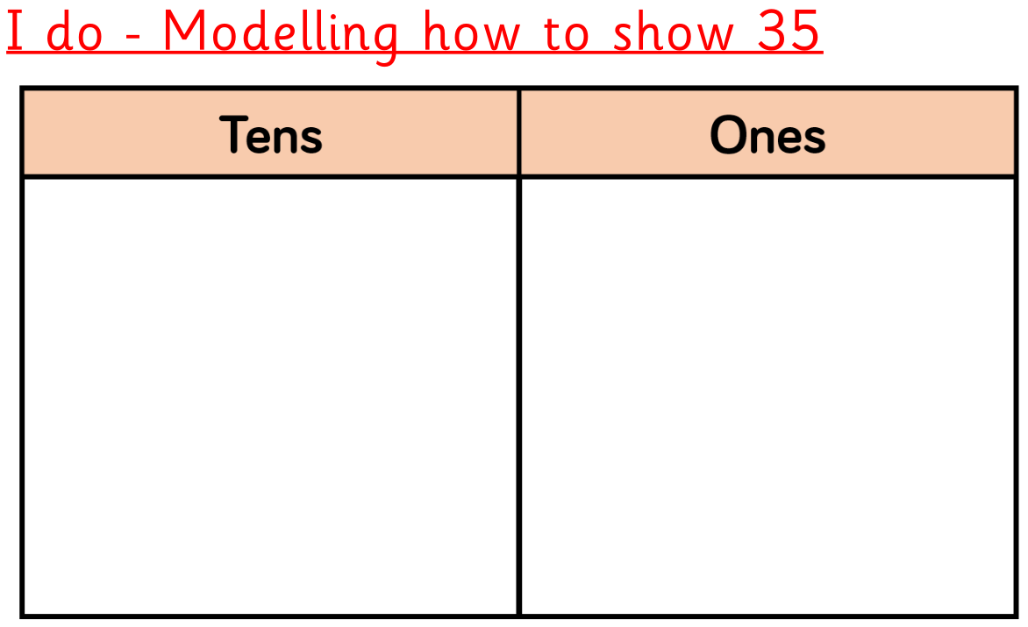
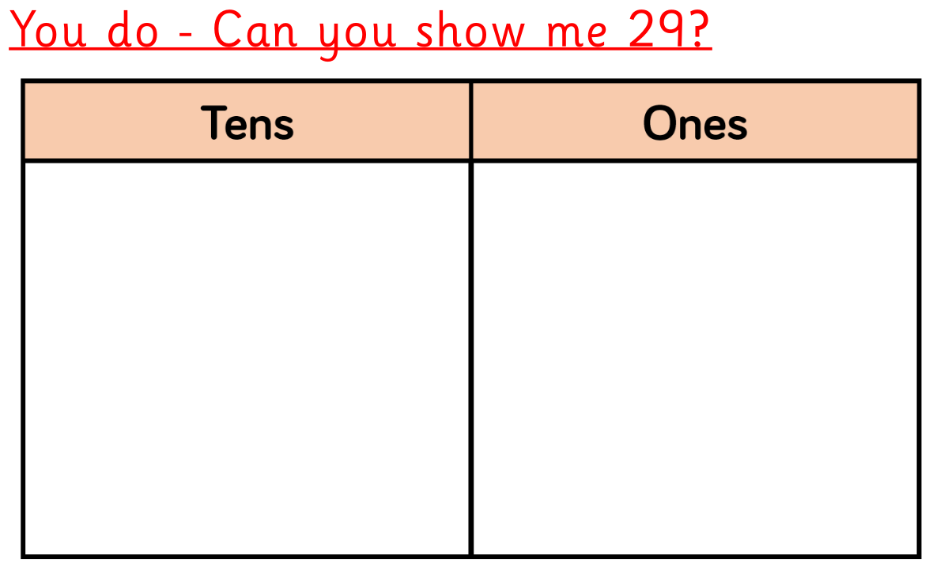
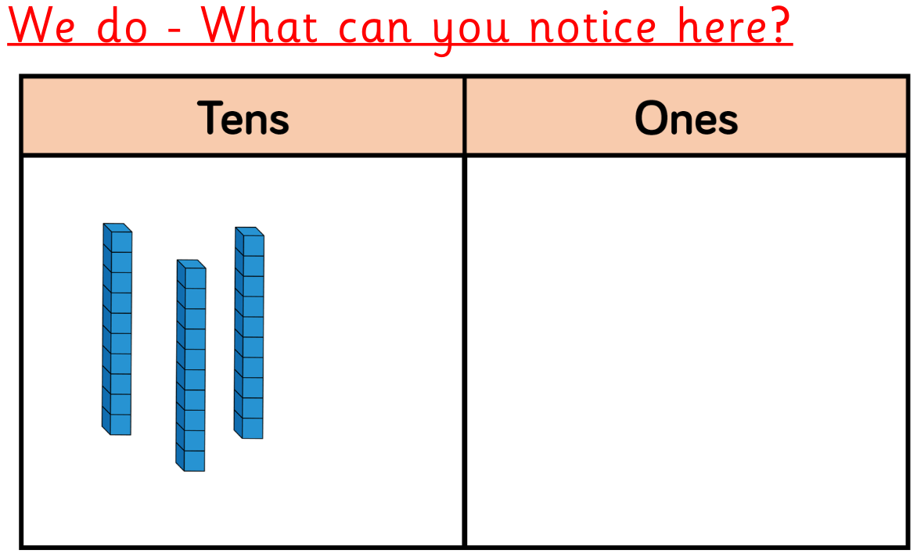
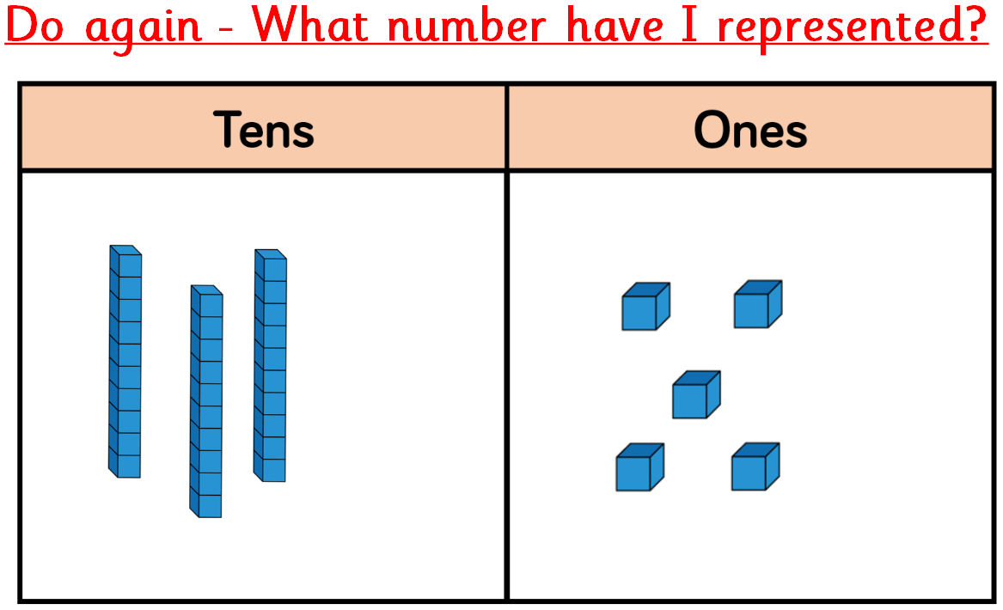
Teaching practice
Notes:
Build up pupil confidence by getting them to represent two-digit numbers using dienes blocks and a place value chart. Show them how to represent 35, for example, and model this with dienes.
Teachers should deliberately plan to create errors when modelling. For example, placing 11 ones counters into a place value chart, making that error explicit and getting the students to explain why this is not allowed.
Go through many examples with pupils using the ‘I do, we do, you do’ approach to ensure that students are able to perform what it is you are asking them to do. Once you are confident that students can do two-digit numbers, repeat the process but with three-digit numbers.
It is also important that you reverse the process. Instead of only asking students to represent a number with the dienes, show dienes and ask students to explain which digit is being represented, the value of that digit and then the number that the digits represent.
For example, this could be shown on the board, with the teacher then expertly modelling their thinking aloud.
‘I have counted 9 ones cubes. That means the digit represented in this value is 9 and because it is in the ones value means that it represents the number 9. In the tens value, there are 3 blocks. This gives me the digit 3. Because it is in tens value, it represents the number 30.
So far I have the digits 3 and 9; which represent the numbers 30 and 9. Together this is 39. There are also blocks in my hundreds value. I have 4 blocks there. This would represent the digit 4. As it is in the hundreds value, it represents the number 400. I have 400, 30 and 9. Together this makes 439.’
Once pupils are used to solving questions like the above in a whole-class setting, the work set should focus on having them try this individually. It is best to interleave between a question asking a pupil to show or draw dienes representing a number, and one using the dienes to work out what number they are representing.
Extending this further with – What is my number?
Rosella

Slide 13
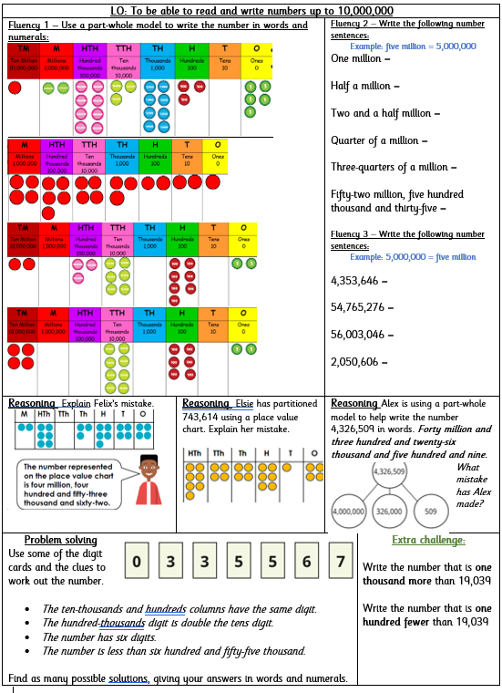
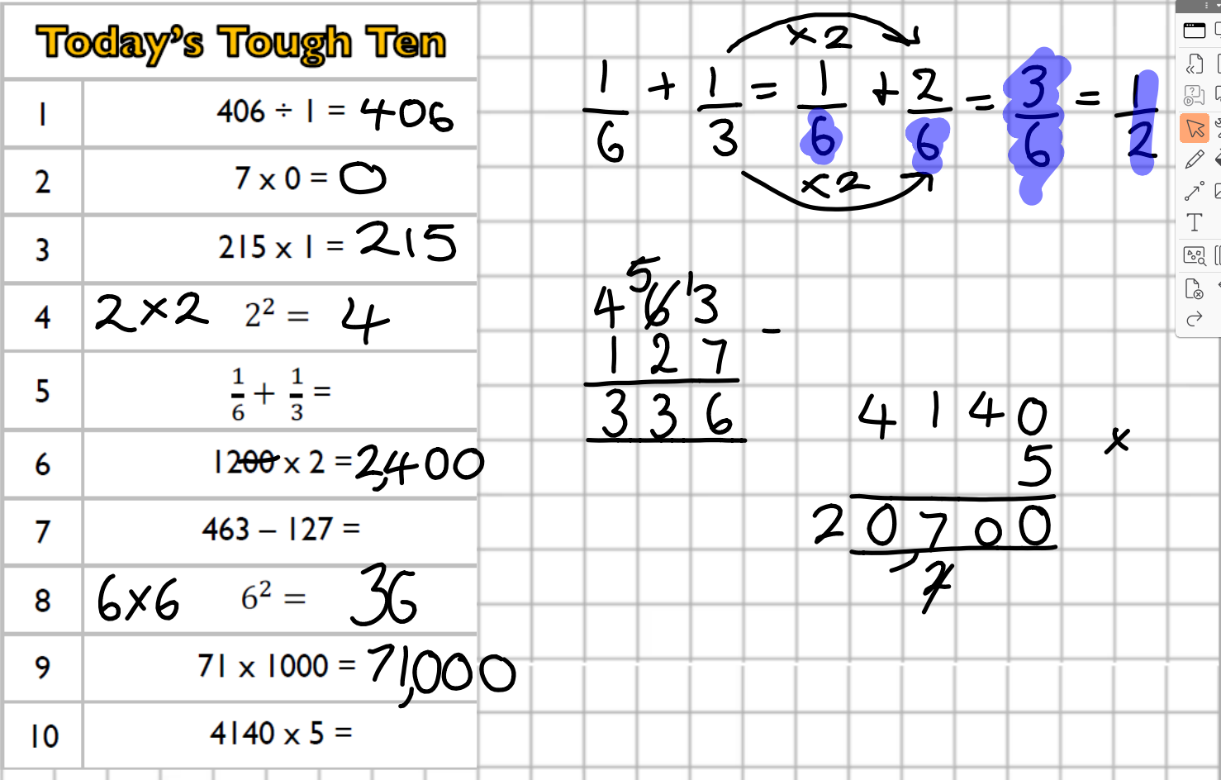
Maths challenges
Notes:
Rosella

Slide 14
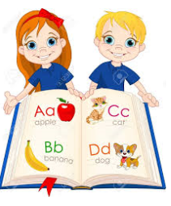

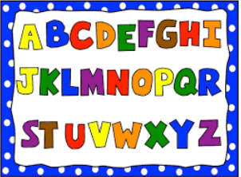

English
Notes:
Tia

Slide 15
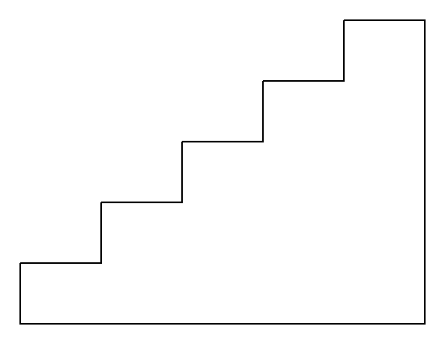
English in KS2 - how is it taught?
English includes the following: Guided Reading, Writing and Spelling. Where necessary interventions are used to provide extra support. English lessons take place daily.
L8 and on – Hot Task and editing throughout
L4 and on – Grammar or feature components followed by writing
L3 – Introduce focus book
L2 – Feature spotting
L1 – Discuss text type. Cold Task
Notes:
We usually start with a Cold Write, then exposure to the text types – learning the features and skills throughout. Finally, we write our own (called a hot write) and work hard to edit using pink pen.
Working walls reinforcing our learning, vocabulary and misconceptions.
Whole class for guided writing, each part tackled in small chunks.
1:1 reading with both teacher and TA weekly.
Daily whole class spelling sessions.
Tia

Slide 16
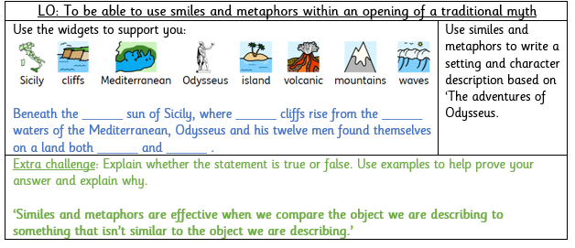
English Tasks
Notes:
Tia

Slide 17

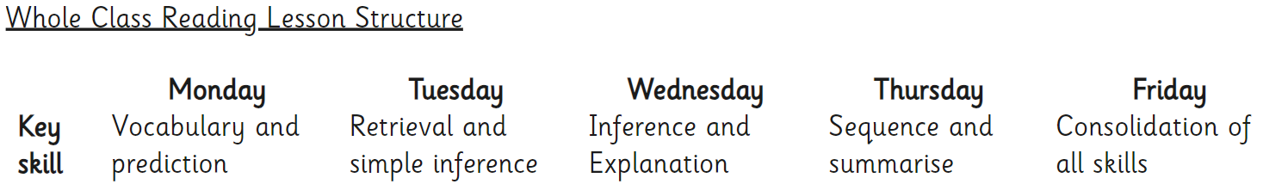
Guided Reading in KS2
This is a whole class activity where children read a text that is appropriate to their ability (Badger books scheme). They also have vocabulary, comprehension, inference, explanation and sequence and summarise tasks to complete independently linked with the book. During guided reading, we ensure our pupils are exposed to rich and varied text.
Daily Guided Reading sessions take place throughout the school
Notes:
Jo

Slide 18
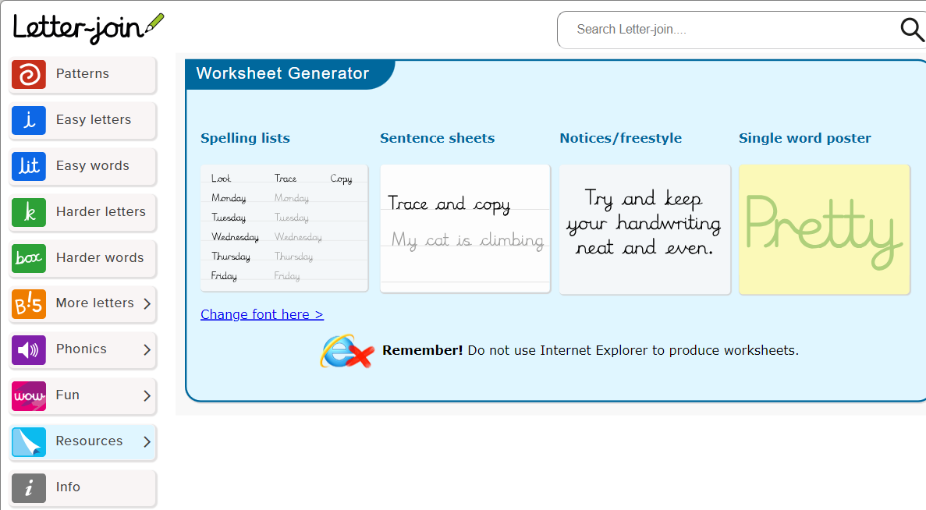
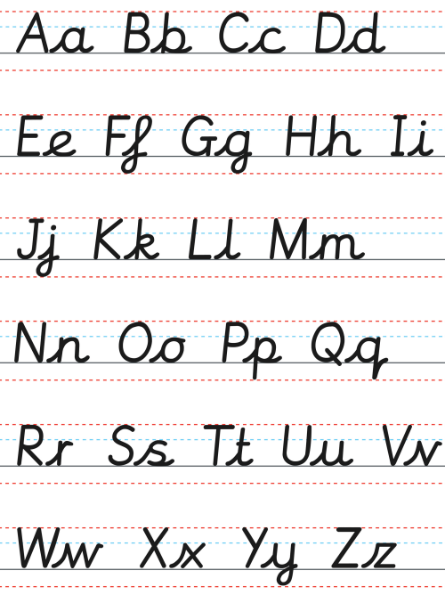
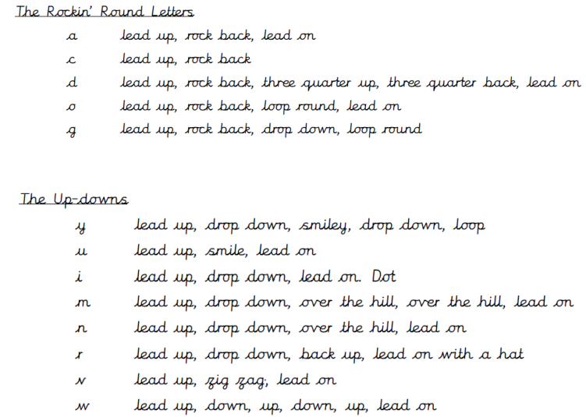
Handwriting
Notes:
Our aim is to ensure that every pupil develops a neat, fluent style of handwriting using continuous cursive letters as this will lead to them producing letters and words automatically in their independent writing. For most this will happen by the end of Year 1 and for those with specific difficulties, interventions will take place.
Handwriting is taught weekly, throughout KS2, through explicit teacher modelling of letter formation and building to a cursive style.
We use Letter Join script. We recognise that handwriting is closely linked with spelling, therefore, practising of key word/rules and year group statutory and non-statutory words also occurs in the context of handwriting lessons.
Jo

Slide 19
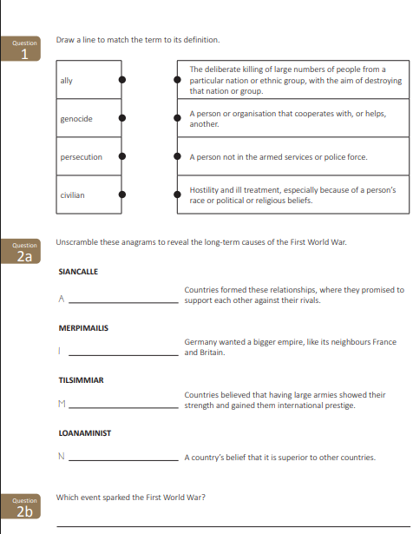

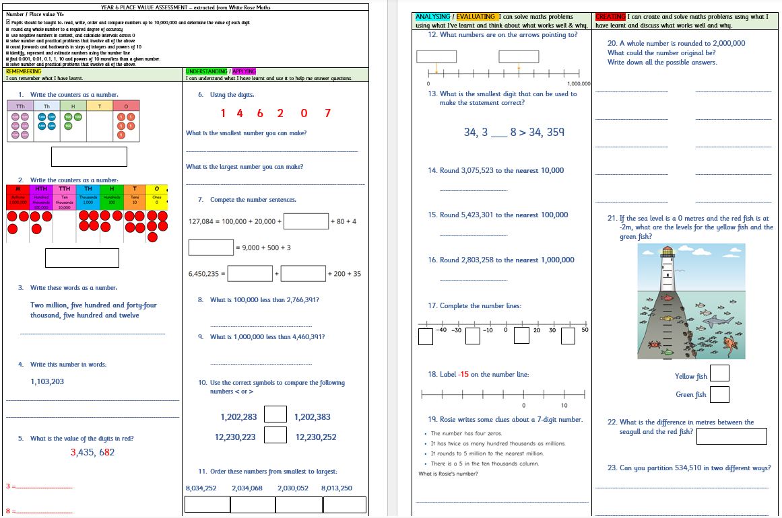
Assessment – how do we know how the pupils are doing?
.
Notes:
Throughout the school, teachers assess children daily to form the basis of planning and consecutive lessons, ensuring they meet the needs.
At the end of each half term, teachers moderate and assess the children on the objectives covered.
Once a term, children are assessed in formal ways for writing. At the start of each English topic/genre the children will carry out a cold write. A cold write is a piece of writing that the children do independently before they have had any explicit teaching or guidance in that area. At the end of the topic, the children then carry out an independent hot write. This highlights what they have learnt throughout the topic.
Within Mathematics, end of unit assessments are completed for each topic.
In other topics and subjects, we assess throughout and at the end.
Che

Slide 20
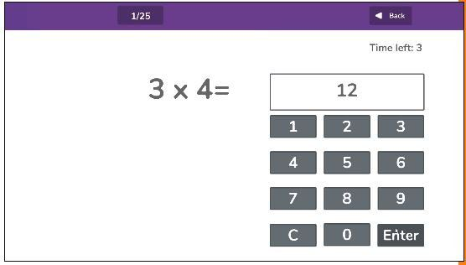
Year 4 MTC
This is a Statutory check that consists of 25 times tables questions. The questions will only be multiplication, and they will go up to 12×12.
There will be 6 seconds to answer each question.
The check will be taken online during school time (Summer term 2).
There is no pass mark.
Teachers will be able to apply for some children to be able to pause between questions.
Notes:
Che

Slide 21

How can parents support at home?
Please provide a healthy snack! (available at school)
Support with homework and spellings to help link learning
Check in with the weekly timetable within the Newsletter
Good routines (including sleep)
Only playing appropriate games and not too
much screen time. Please do not play on devices until late
Fun Reading - Research shows that reluctant readers will read 50,000 words a year, but keen readers will read up to 1,000,000 words. We need to close this gap.
Fun Writing
Fun Maths
Positive attitude and communication - Ask them what they have enjoyed and what they learnt
Notes:
Jenny

Slide 22


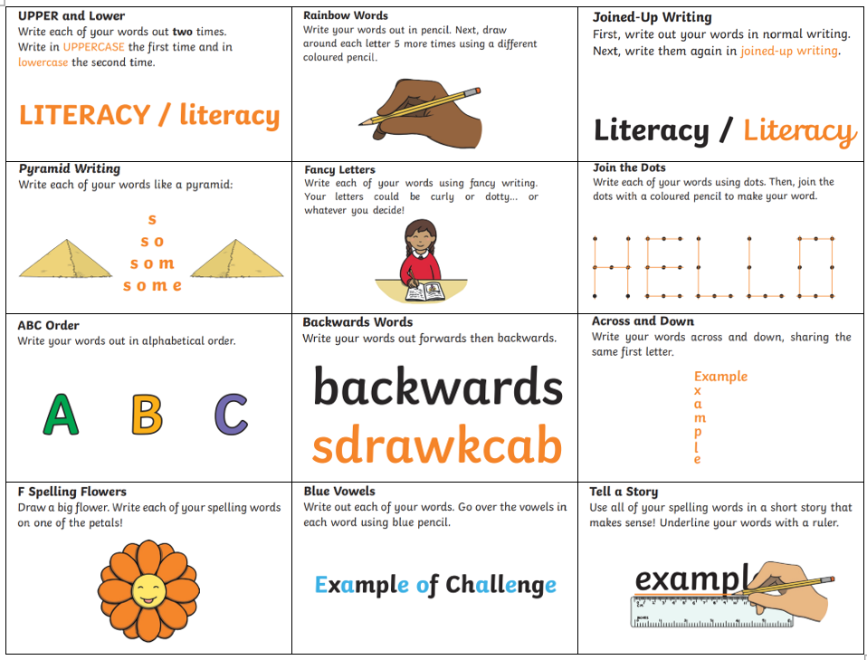
Homework
Notes:
Jenny

Slide 23
Thank you very much for your time!
Please do visit our website to find out more about your child’s education:https://www.wantageprimaryacademy.org.uk/curriculum/
Notes:
Rosella

