Slide 1
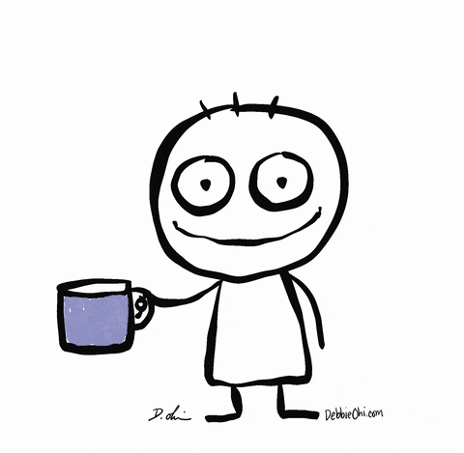
Welcome to our parent coffee morning
28th November 2023
Good wellbeing
Resilience
Independence
Behaviour - communication
Shared language and approach

Slide 2

“Cold temperatures can put stress on the body and mind. ... There is no denying cold temperature can have an adverse effect on the brain.”

Slide 3
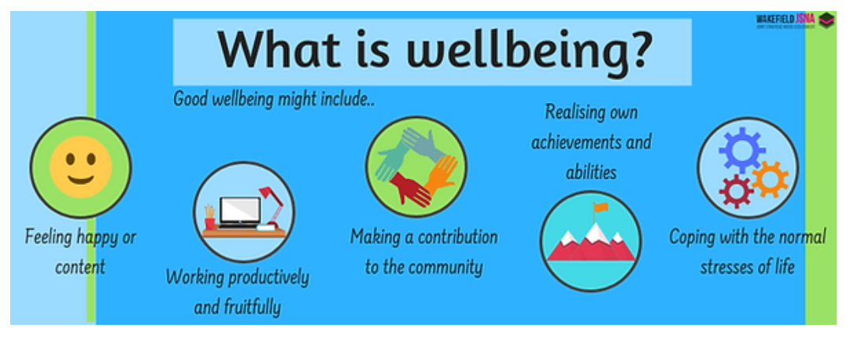
Parent emotional health and wellbeing

Slide 4

Maintaining good wellbeing
Talk to a friend
Gentle Exercise
Breathing Exercise
Healthy Diet
Sleep
Some time for yourself away from your children

Slide 5

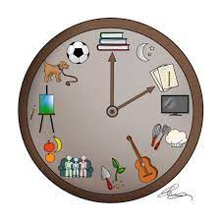

How to best support your child’s emotional wellbeing?
Relationship
Routines
Regulation

Slide 6

Relationships
A close and loving relationship between you and your child will make them feel safe and secure. Cuddle them, sit near them, give them your time to show you love them.
Encourage talk – model it but be an active listener. Make sure your child feels listened to and is able to listen to. Model conversational skills
Develop relationships for your child with other positive adults – your friends, relations, childminders, adults in school. (Model them and allow them)
Enable your child to see that it is ok not to be perfect, that we all make mistakes and sometimes don’t succeed, that you appreciate their effort.

Slide 7
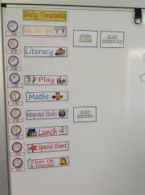
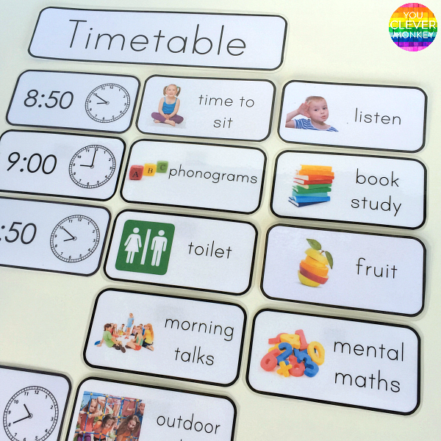
Routines
Steady and consistent routines help your child feel safe and secure. Small children like to know where they are and what is coming next.
Good diet and physical activity within their routine
Regular sleep routine with enough hours of sleep
Weekend routine- something to look forward to,
time to relax, enough to keep busy with
Fun together

Slide 8
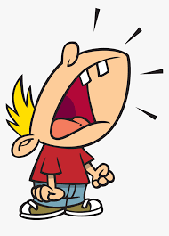

Emotional (Self) Regulation
Self-regulation is the ability to manage your emotions and behaviour in accordance with the demands of the situation.
It includes being able to resist highly emotional reactions to upsetting stimuli, to calm yourself down when you get upset, to adjust to a change in expectations, and to handle frustration without an outburst.
It is a set of skills that enables children, as they mature, to direct their own behaviour towards a goal, despite the unpredictability of the world and our own feelings.
Emotional dysregulation can look like this…

Slide 9
The key to learning self-regulation skills, is not to avoid situations that are difficult for children to handle, but to coach children through them and provide support until they can handle these challenges on their own.
If we know a trigger we can:
Isolate the difficulty, prepare for it and practise it
Simplify it, make it easier/less overwhelming
It is easy to feel cross when our child is dysregulated
Try to approach impulsive, inappropriate behaviour calmly and give them time, kids can learn to choose better ways to respond to that situation.
Children need to feel a response that is non-judgmental and non-emotional: what went wrong, and why, and how they can fix it next time.

Slide 10
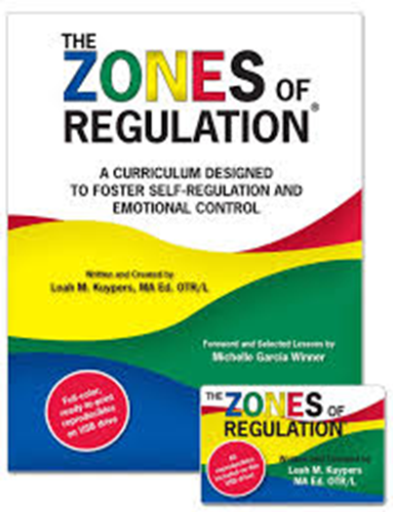
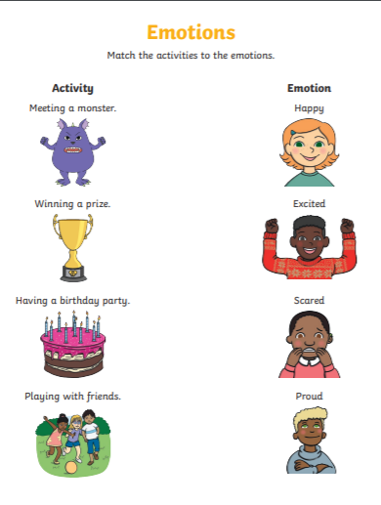
Tools and resources that can help teach and coach emotional regulation

Slide 11
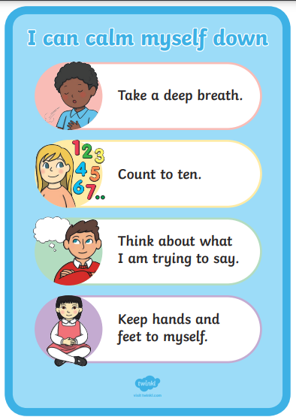
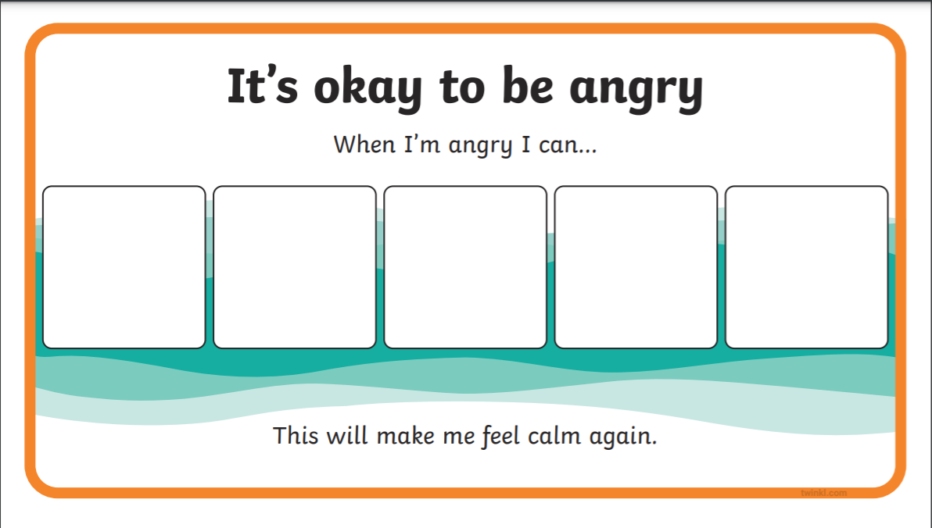
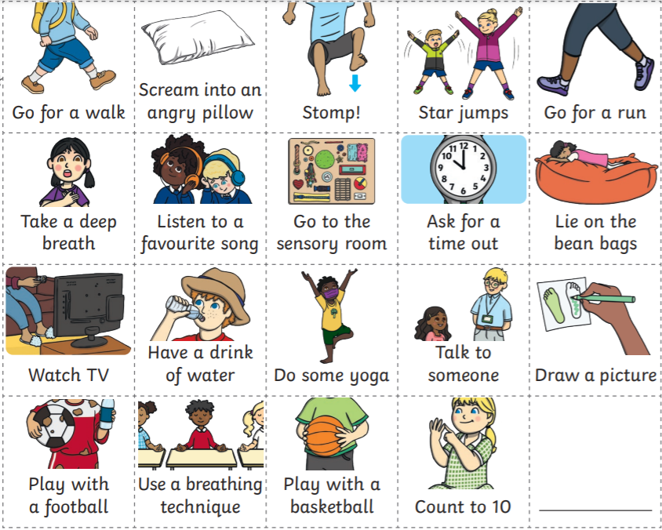

Slide 12



Breathing exercises
https://giveusashout.org/get-help/resources/breathing-exercise-stress-and-anxiety/
https://www.headspace.com/meditation/breathing-exercises
https://www.youtube.com/watch?v=5DqTuWve9t8
https://family.gonoodle.com/channels/flow
Teach children HOW to breath

Slide 13
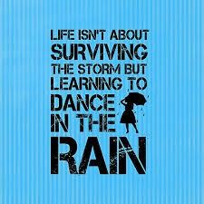
Resilience is the ability to face and overcome difficult experiences and be shaped positively by them
Explain situations ahead of time
Now and Next
Give 2 simple choices
Regulate your own emotions and reactions
Encourage independence – children packing and carrying their own bag, laying out clothes etc.
Ensure you follow through on what you say. Be consistent. Have boundaries.
Use restorative practice script

Slide 14
Restorative approach
5-Step framework
Step 1 – Hear the story
What happened? What’s happening?
Step 2 – Thoughts and feelings
What did you think when it happened?
….and how did you feel?
What are you thinking now? How are you feeling?
Step 3 – Impact
Who else has been affected? How?
What has been the hardest thing for you?
Step 4 – Needs
What do you need to feel better?
Step 5 – Next steps
What needs to happen to make things right?
3-step framework
What happened?
How do you feel about…?
What needs to happen for things to be better?

Slide 15
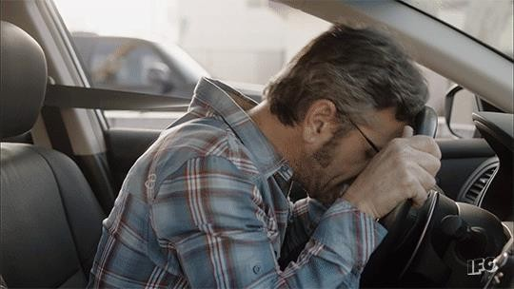
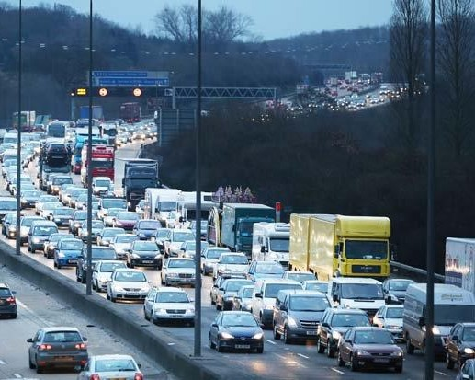
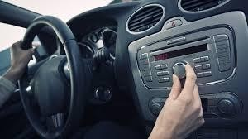
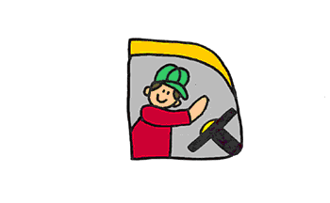
How do you react to adversity?

Slide 16
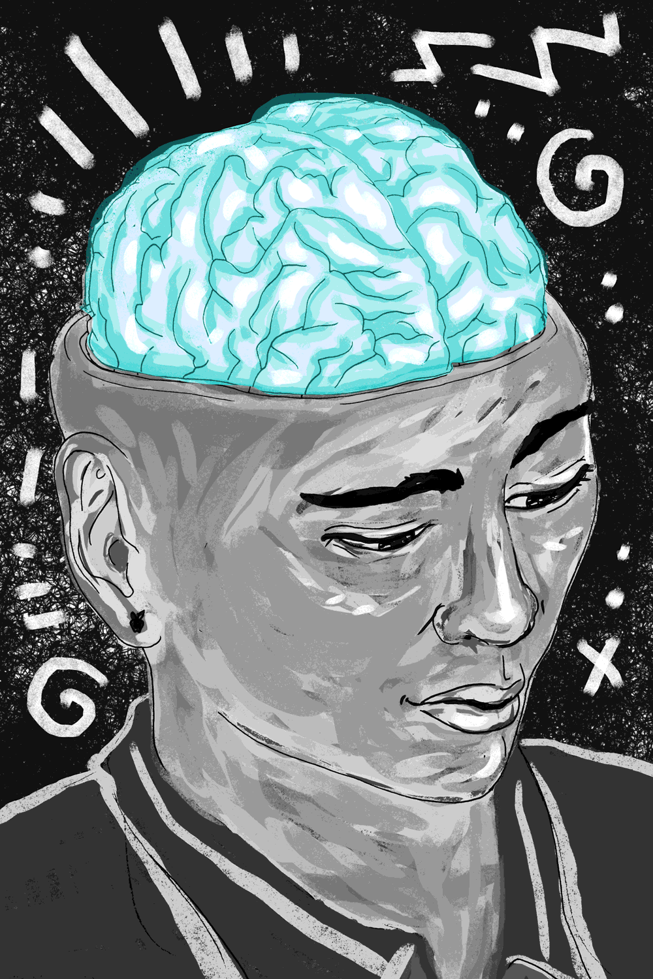
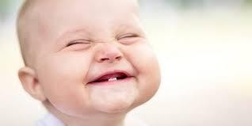
Resilience can be taught, modelled and nurtured at any age

Slide 17
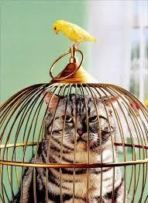
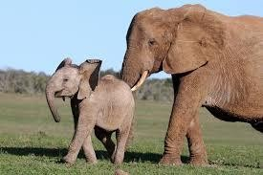
We can’t always remove challenges
We can pass on skills to help children cope better with them

Slide 18

Make some tweaks to help your children thrive

Slide 19
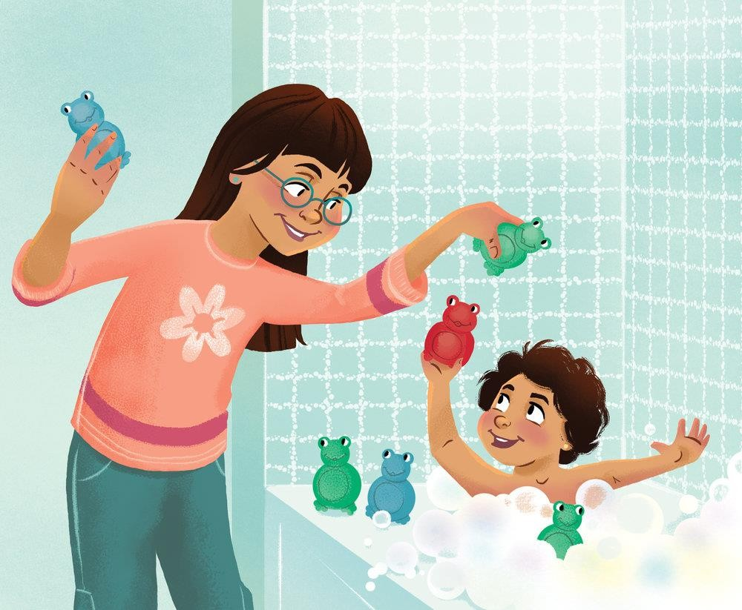

One-on-One time with each child no distraction

Slide 20

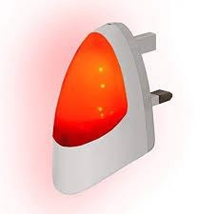

Give sleep a chance
Lack of sleep is a driver for stress
Fastest way to improve is to limit screen time before bed
Blue light – supresses production of melatonin

Slide 21

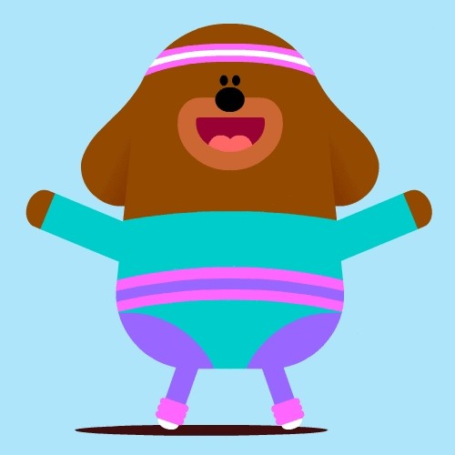
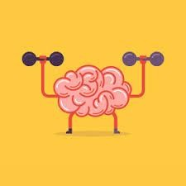
Get out and exercise

Slide 22
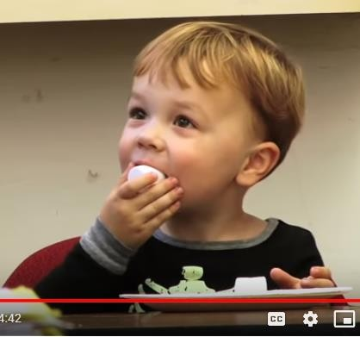




Teach delayed gratification

Slide 23

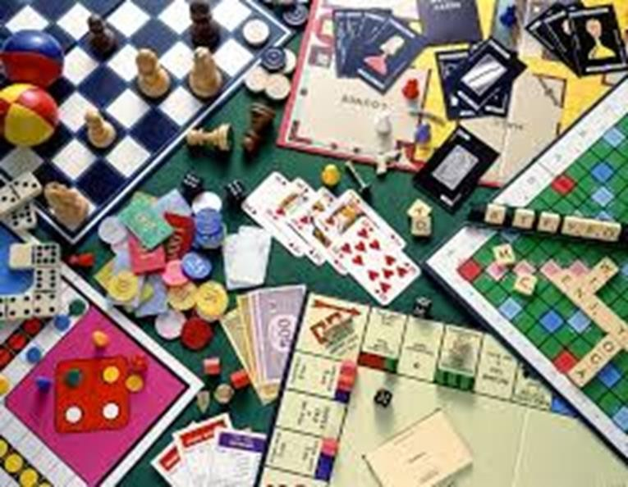


Slide 24



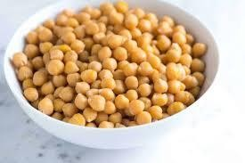

Eat the alphabet over 30 days Plant based, rich in fibre

Slide 25

Model gratitude
Reframe the day How was school? X
What did you do today? X
What did someone do today to make you happy?
What did you do today to make someone else happy?
What have you learned today that made your brain grow/ flourish?

Slide 26

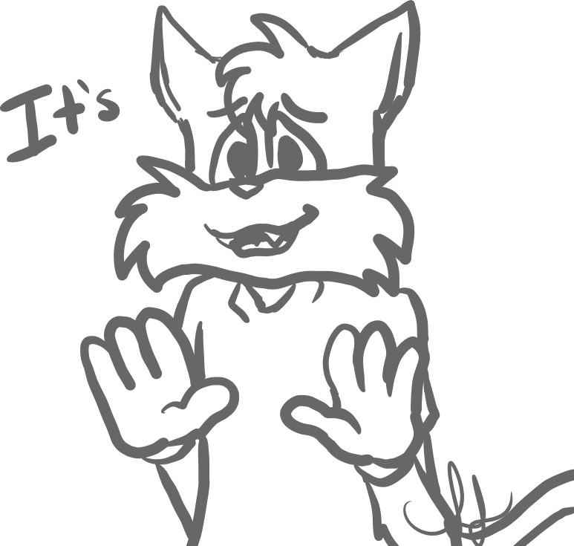
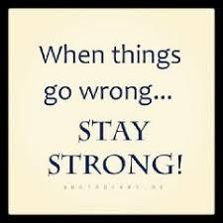
Be a model “failer” – talk about it, explain it

Slide 27


