Slide 1


SEND Coffee Morning

Slide 2

Agenda
SEND at WPA
SEND Team – Roles and Responsibilities
What is SEND?
SEND identification process at WPA
Pupil Profiles
Interventions at WPA

Slide 3

Our vision for pupils with SEND
At Wantage Primary Academy we recognise that all children have a right to a broad, balanced relevant and differentiated curriculum. We aim to create a happy, educationally exciting and positive environment in which all pupils can develop to their full potential. We recognise that children are individuals, that each one has needs special to them.

Slide 4

The WPA SEND Team
Principle – Mrs Basilone
SENCo – Sarah Gladwin
Teachers – Ms Stewart, Mrs Robinson, Miss Blaney, Mrs Hammond, Miss Greenaway, Miss McNally, Miss Seymour, Miss Palipane, Miss Murrell.
Teaching Assistants – Mrs Carey, Miss Robins, Miss Saunders, Mrs Froude, Mrs Sayer
Every member of our team is responsible for SEND.

Slide 5
SENCo
National Qualification for SENCOs passed in 2010.
SENCO in my previous school for 9 years.
As well as my SENCo responsibilities, I also teach Music to all year groups, and I teach in Reception one day a week.
I work closely with the staff at WPA to support pupils with SEND. I also liaise with external agencies to ensure the highest level of support is in place for our pupils.

Slide 6

Teachers
All teachers are responsible for monitoring the progress each child.
They plan and deliver lessons that meet the needs of the children in their class.
Alongside the SENDCo, teachers will design booster or intervention groups to fill any gaps in a child’s learning.
They will write pupil profiles for each child on the SEN register and ensure they are working towards these targets.

Slide 7

Teaching Assistants
They work with the Teachers to provide support for pupils with SEND in class and provide interventional support out of class in order to best meet the individual needs of the children.
They run nurture groups or provide mental health support to those children that might need extra support outside of the classroom.

Slide 8
What is SEND?
Some children find learning more challenging than others and may need extra support to achieve their full potential. For example, they might have difficulty with:
Expressing themselves
Interacting with others
Reading, writing and maths
Controlling their emotions
Sensory or physical mobility
These difficulties can be barriers to learning. Schools assess all children to identify their strengths and needs and how they can best be supported.
Children who need extra help with their learning may receive additional support under one of the following categories:
SEN Support (SEN register)
EHC Plan

Slide 9
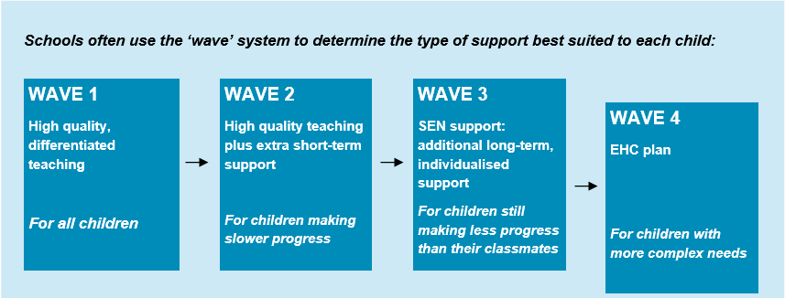
SEND Identification at WPA

Slide 10

What support is available?
SEN support
SEN support describes the additional help that assists children to access the curriculum.
This might include:
Extra help in the classroom
Small group or one-to-one learning
Support from specialists such as speech and language therapists
Schools must work with parents when agreeing what support to provide and what it will achieve.
The support your child receives will be written on the pupil profile and reviewed three times a year. The pupil profile is written by parents and teachers together to plan the support which is needed.
EHC plans
If your child has more complex needs, he or she may need to be assessed for an EHC plan. This is a legal document which specifies education, health and social care needs and provision.

Slide 11
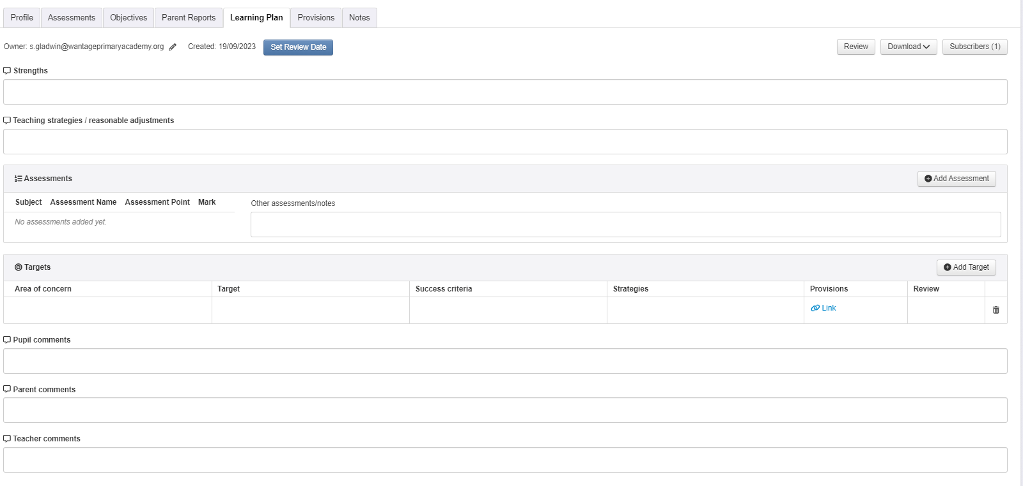
Pupil Profiles
These are documents that outline the strengths and targets for your child.
Teachers work with the children to put together these documents to help target the needs of the children and enable them to make accelerated progress.
These documents are a working document which will change over the term/year.
They are collaborative for pupils, teachers and parents to help work towards the same goals.

Slide 12
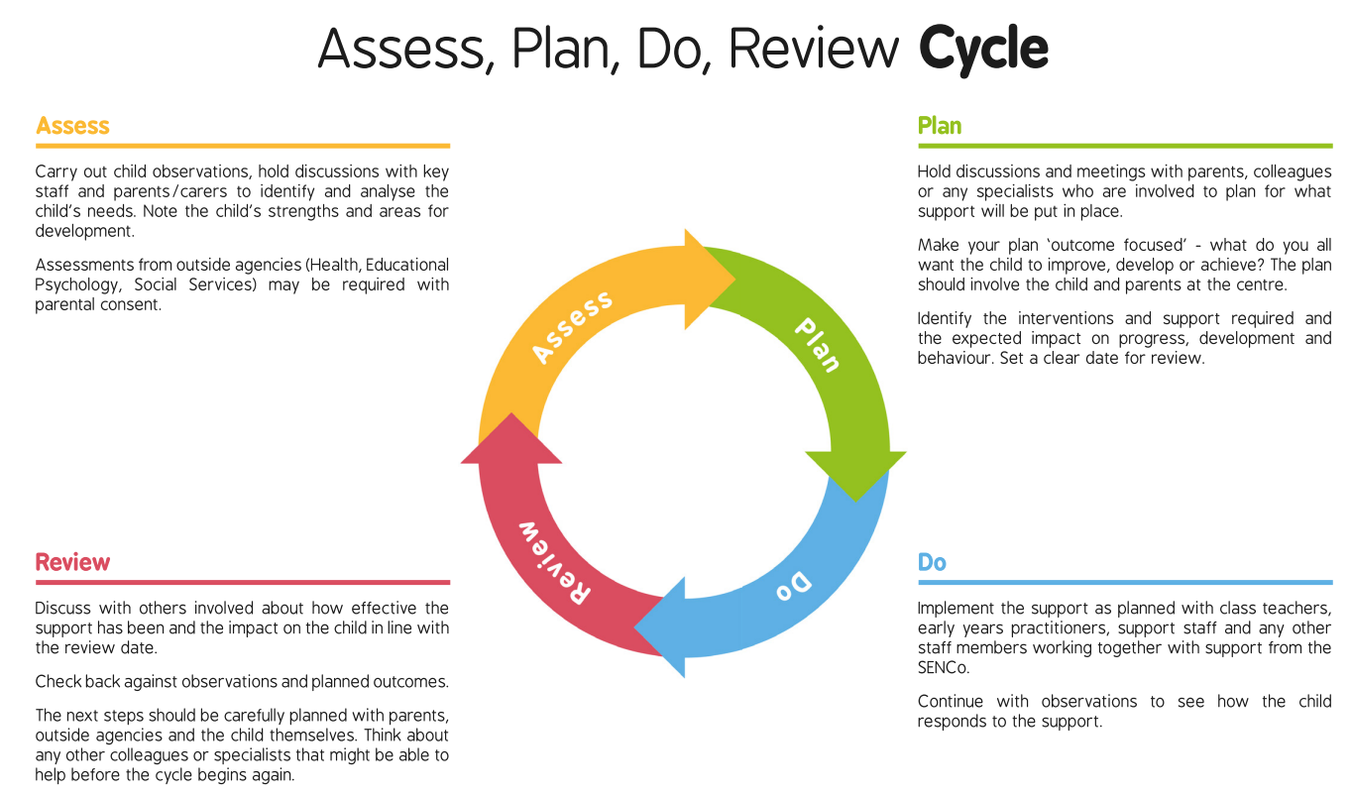

Slide 13

Interventions
English or maths support in class/ in a small group/ 1:1
Pre and post teach sessions
Social and emotional support through lunchtime mental health support or small group work.
Zones of regulation
Communication and interaction support
Speech and Language sessions
FFT reading interventions
Phonics booster groups
Daily readers
Handwriting booster groups
Precision teaching for spellings
Fine motor skills

Slide 14

Working together the possibilities are endless…

Slide 15

Next SEND Coffee morning
Please do complete the feedback sheet with what you would like further SEND coffee mornings to be about.

