Slide 1
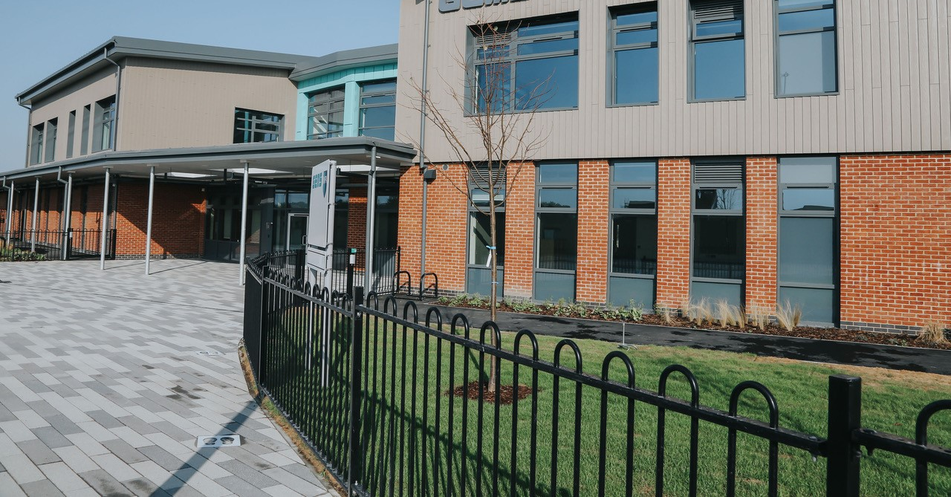

Welcome to Reception’s Curriculum and Information Morning

Slide 2
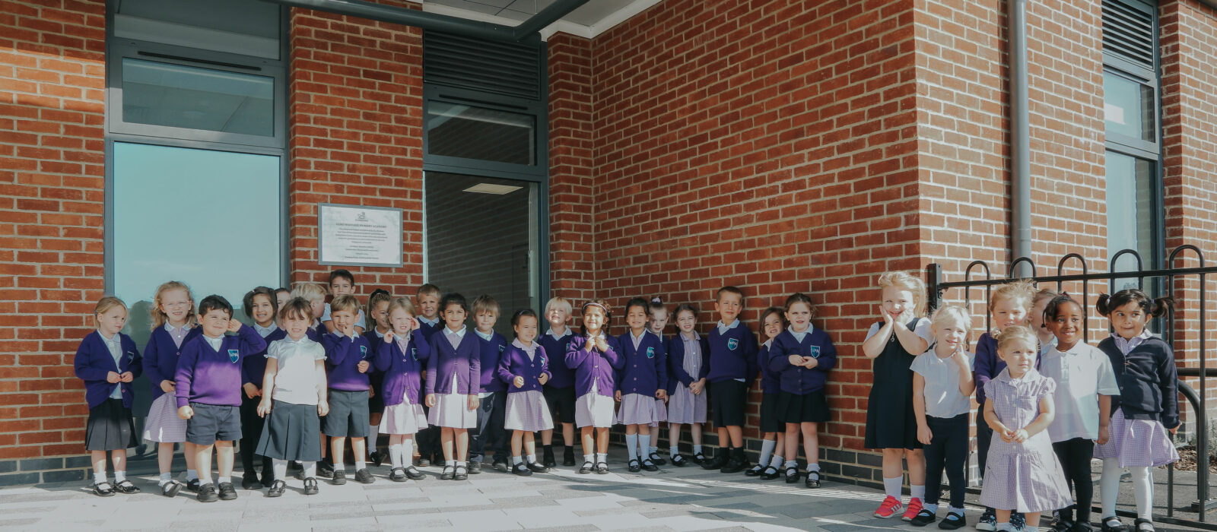
The WPA Way

Slide 3
Overview of Reception
Teachers
Mrs Robinson
Miss Blaney
Teaching Assistants & other adults
Miss Robins
Miss Jackson
Staff are split into their own specific classes, however we work closely together as a year group and follow the same lessons.

Slide 4
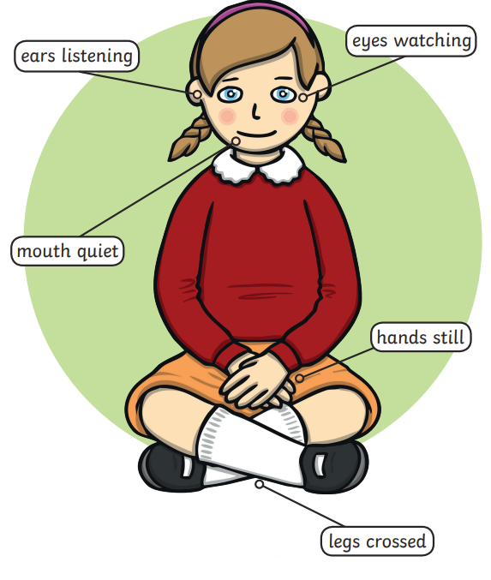
Expectations
“Give me 5”
Turn taking
Moving safely
Being able to understand other children’s point of view
Looking after our toys
Showing kindness
Tidying up
Being able to hold a pencil
Being able to hold scissors correctly and cutting paper
Counting to 5 with 1:1 correspondence
Recognising their name and copying their name when writing
Being able to go to the toilet and clean themselves up
Putting on & removing their clothing

Slide 5
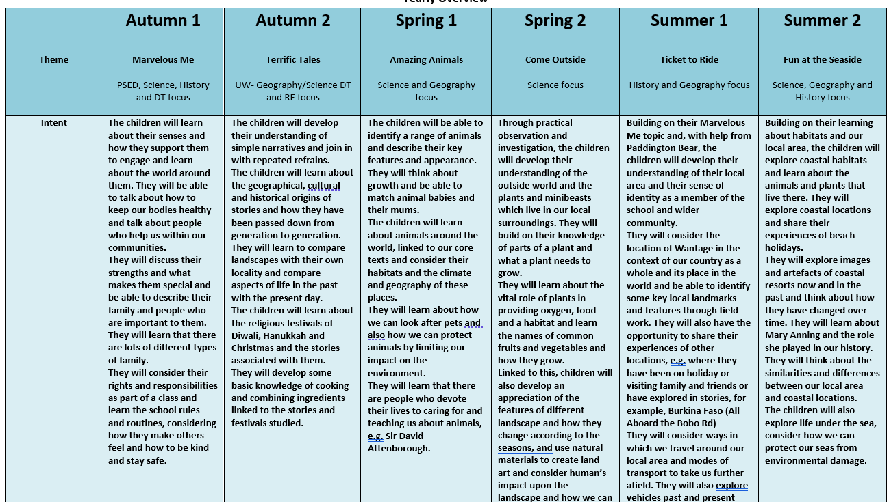
Yearly Overview

Slide 6
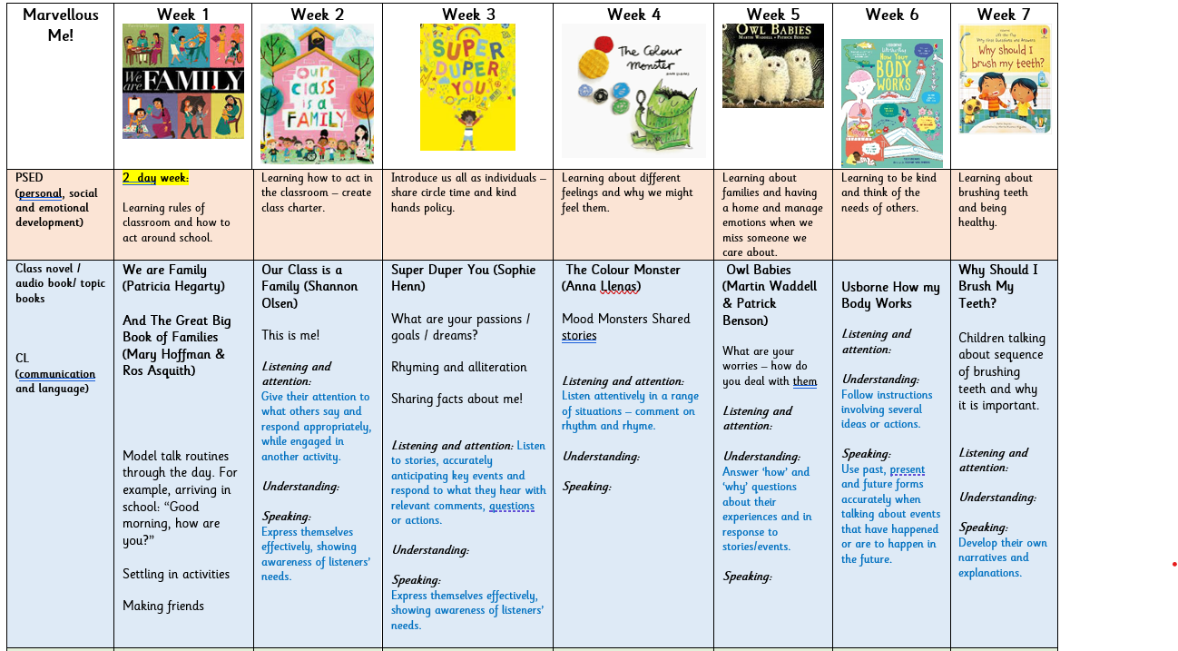
Termly Overview

Slide 7
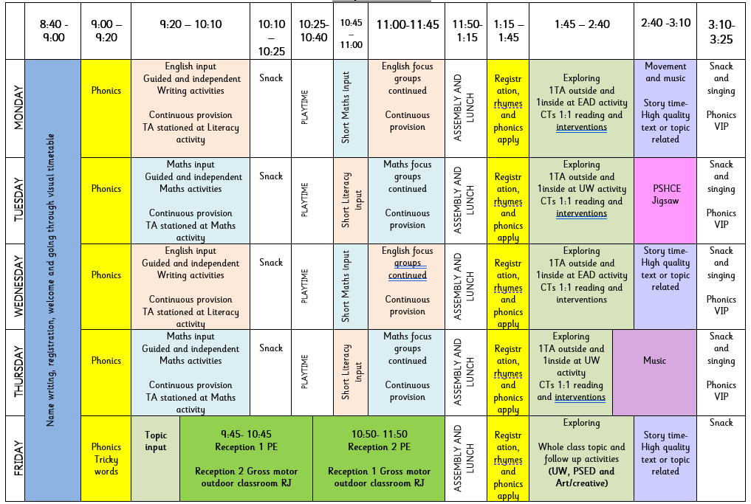
Our Day
PE will be on a Friday.
Please send your children
to school in their PE kit.
Each child is allocated into a house. This is the colour PE T-shirt they will need.

Slide 8
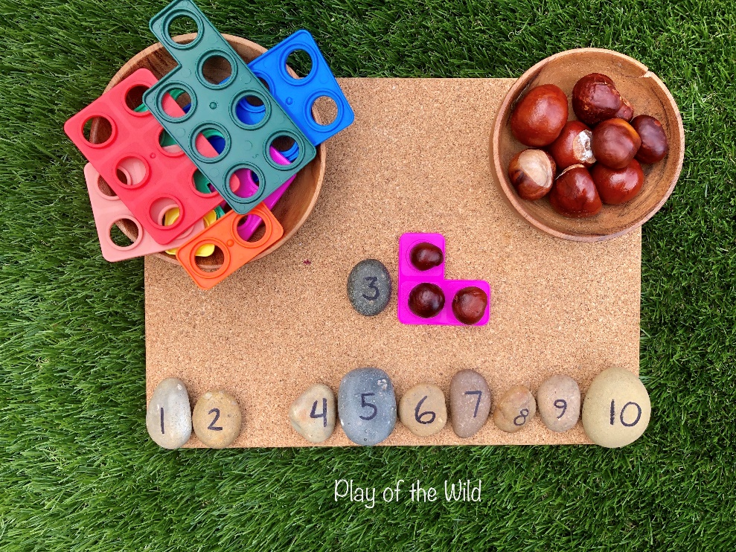
Maths in Reception - coverage
Maths is split into 7 areas
Number: Number and place value
Number: Addition and subtraction
Number: Multiplication and division
Number: Fractions
Measurement
Geometry: Properties of shapes
Geometry: Position and direction

Slide 9
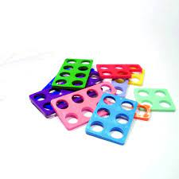

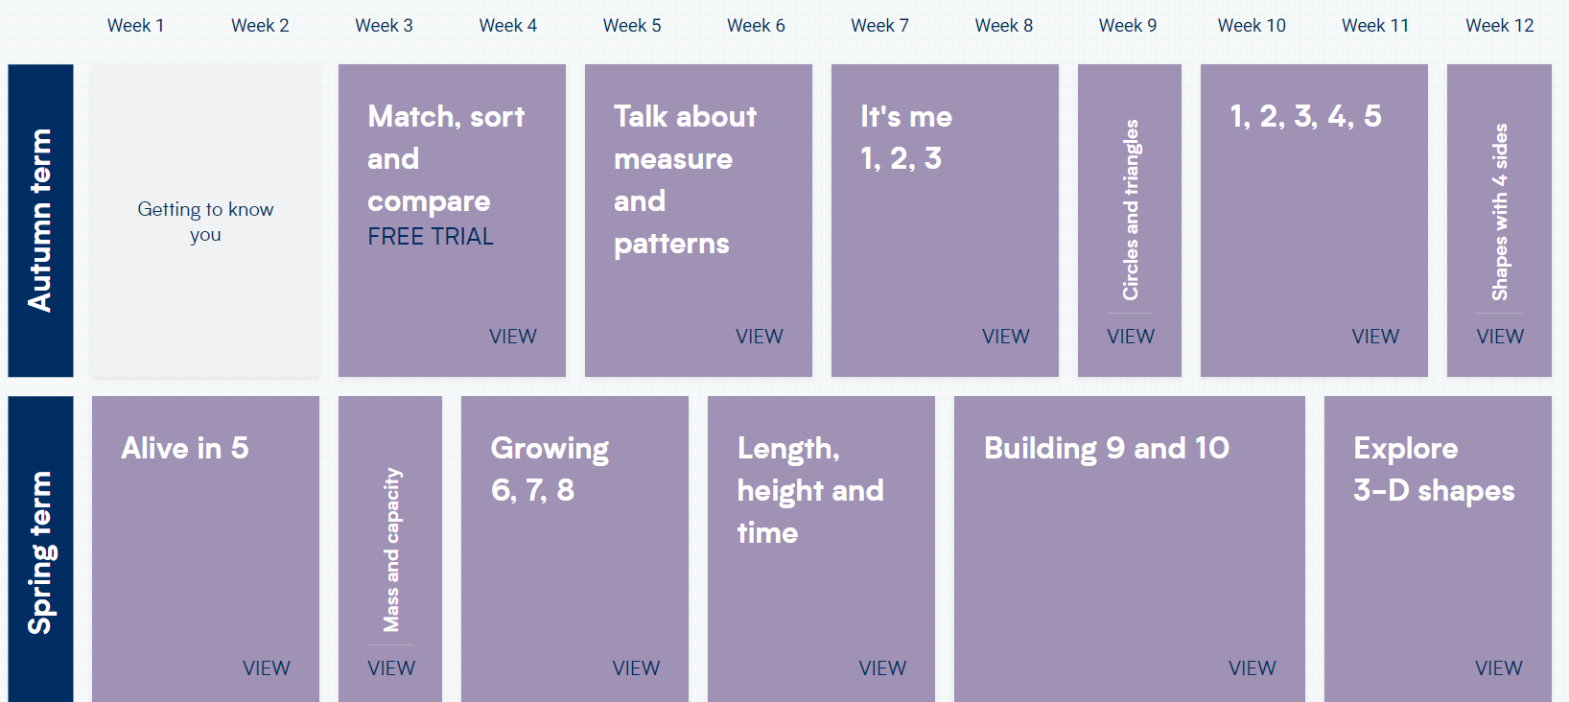
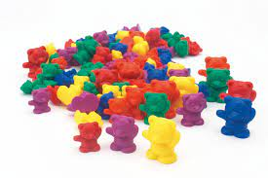
Maths
We use White Rose Maths

Slide 10
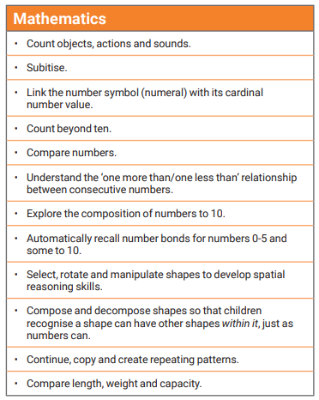
Maths in Reception – outcomes and expectations

Slide 11
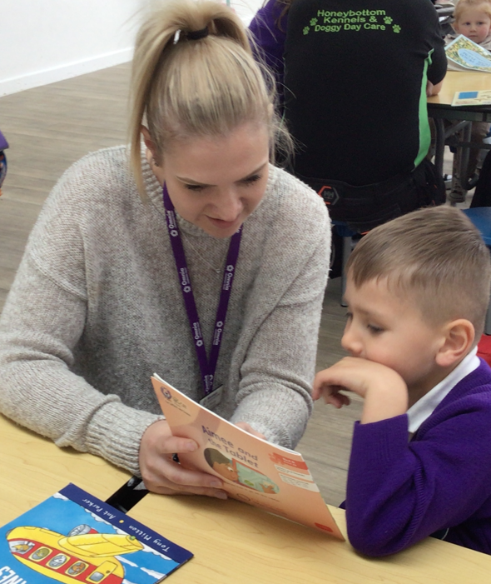


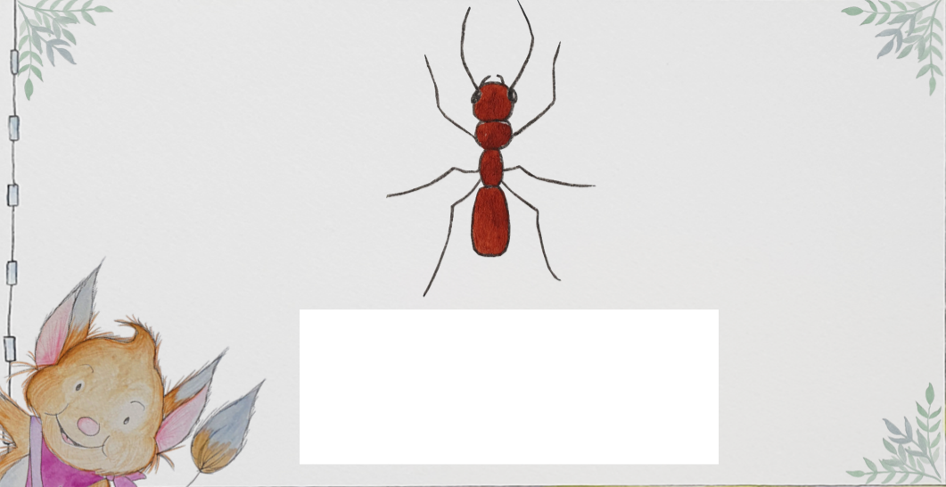
Phonics and Reading

Slide 12
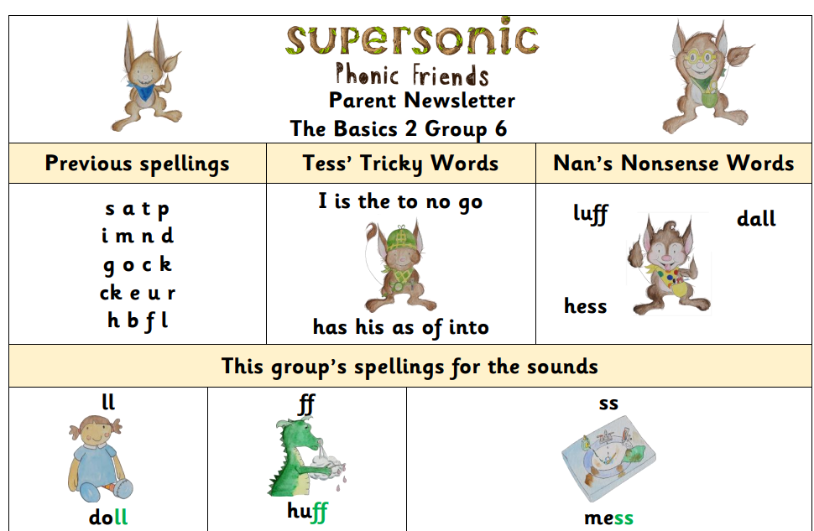
Phonics and Reading
A phonics newsletter will be uploaded to Google Classroom each week so that you know the sounds the children are learning and can support them at home.

Slide 13
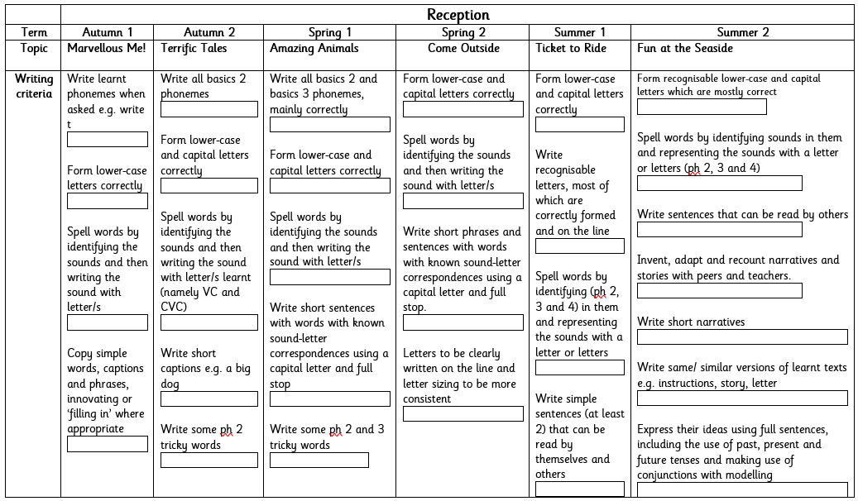
Literacy in Reception - coverage

Slide 14
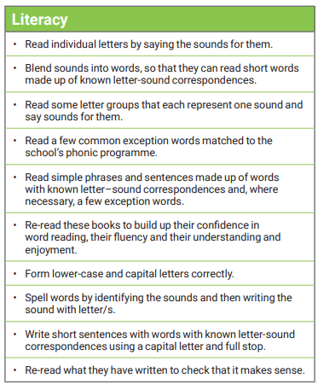
Literacy in reception – outcomes and expectations

Slide 15

How will we know how your child is progressing?
Statutory Assessment- Reception Baseline
Informal Assessments all the time!

Slide 16
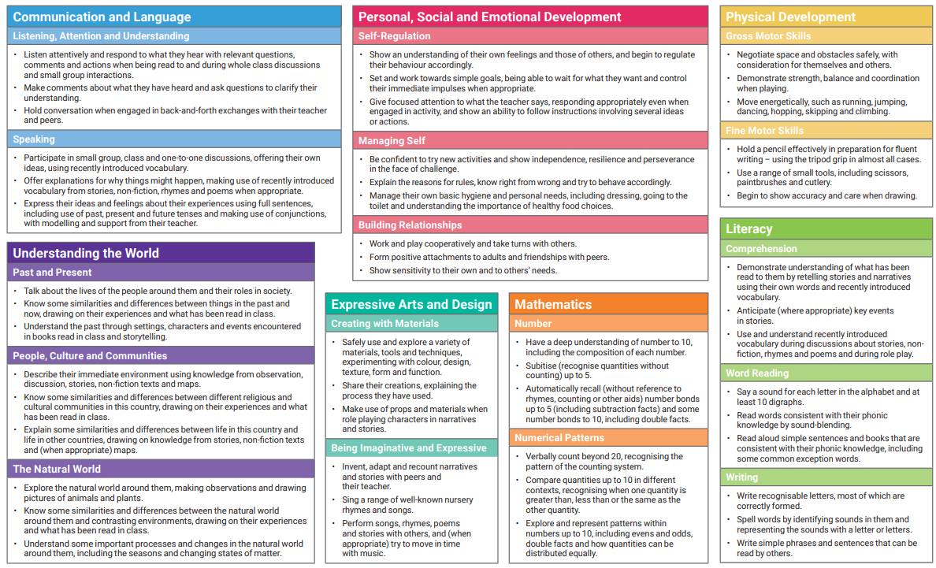
Early Learning Goals

Slide 17

Reception – Baseline Assessment
This assessment takes place in the first 6 weeks of Reception and the focus is on Communication, Language and Literacy and Maths. It takes 30-45 minutes per child and is completed by the practitioner who best knows the child
The data will be used to judge how much progress children have made by the end of KS2.

Slide 18



How can you help your child?
Adult support/guidance
Explaining back/recalling/talking
Practise and Repetition of skills
Good routines including sleep and readiness
Enrichment and new experiences
A positive attitude
Care and love
Reading information from school and keeping informed
Reading with your child
Fine motor skills and hand strengthening activities

Slide 19
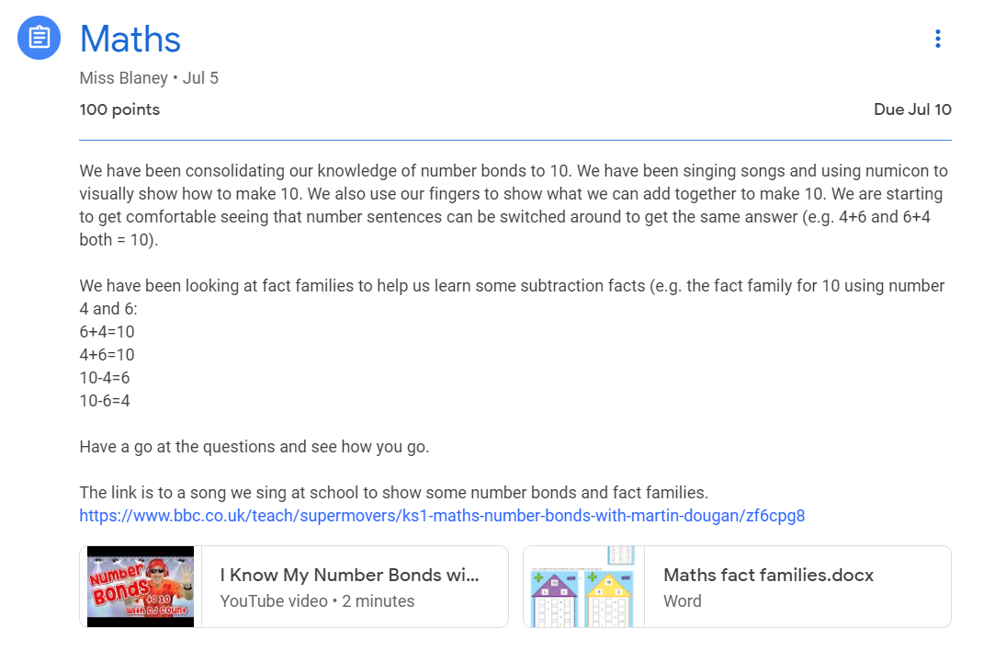
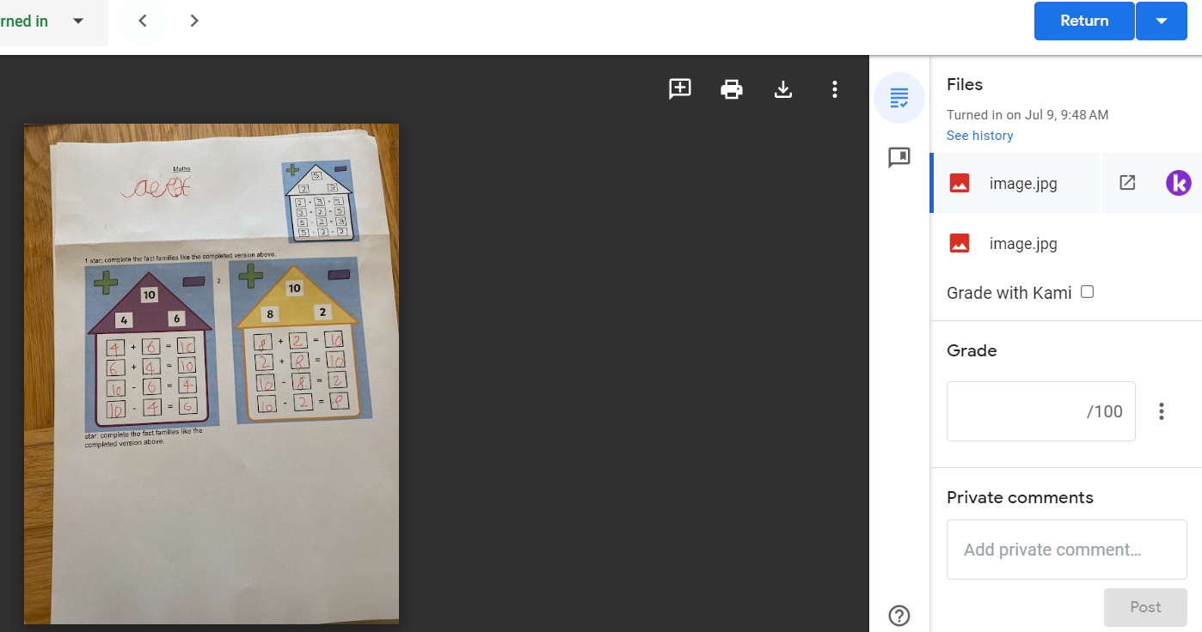
Google Classroom

Slide 20

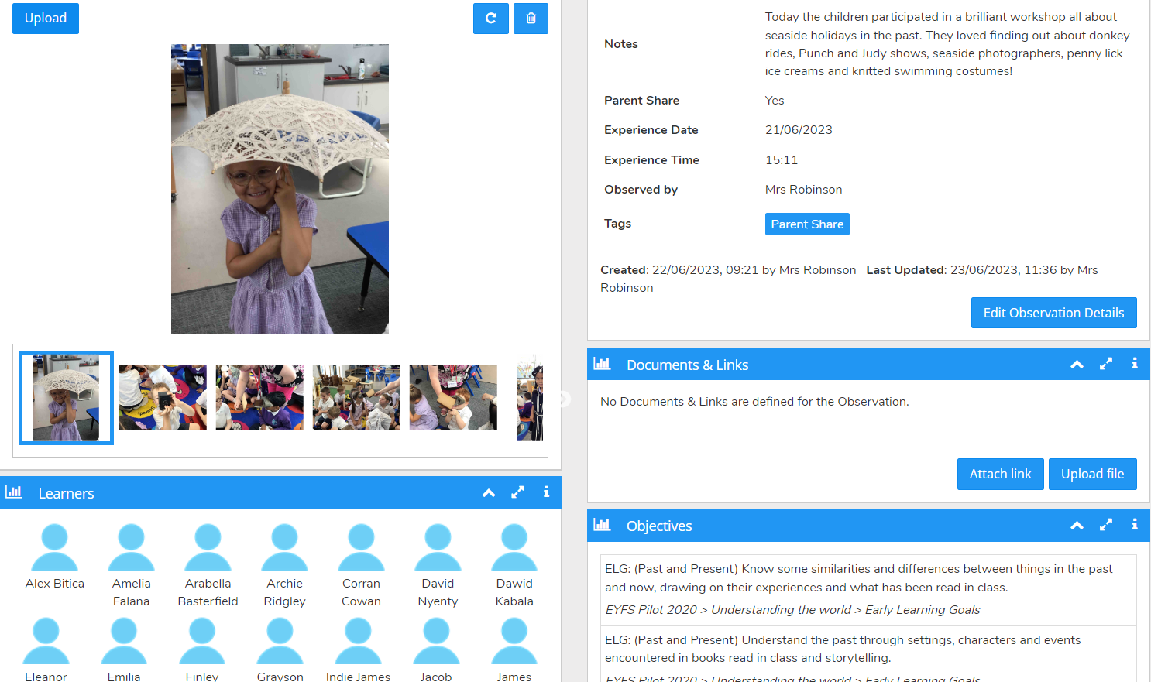
Evidence Me

Slide 21
Want to know more about our curriculum and what your child will learn?
https://www.wantageprimaryacademy.org.uk/curriculum/
Ensure you regularly access GOOGLE CLASSROOM (Reception upwards) and Evidence Me (Nursery and Reception)
How can I communicate with my child’s teacher?

Slide 22

Reminders
Spare clothes in your child’s bag
Wet clothes & coat
Label your child’s belongings
Commenting in reading journals
Thank you for coming – we have loved teaching your child these past few weeks, you should all be very proud of how well they have settled and joined in at school!

