Slide 1
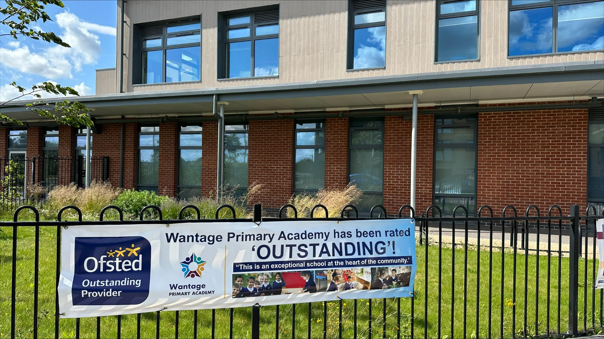
Welcome to KS1’s Curriculum and Information
2023
Notes:
Jess

Slide 2
What we will cover:
Overview of Year 1 and Year 2
Expectations
Routines of a typical day
Topics covered over the year
Timetable
Maths and English
Assessment – how do we know how the pupils are doing?
How can parents support at home? Homework, reading etc
Notes:
Jess

Slide 3
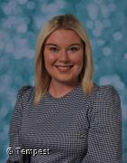
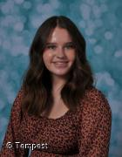
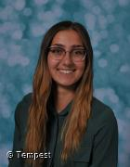
Overview of Year 1.
In year 1, staff are split into their own specific classes, however we work closely together as a year group and follow the same lessons to ensure consistency.
Staffing in year 1
Teachers: Mrs Hammond and Miss Greenaway
Teaching Assistants: Miss Saunders
Notes:
Jess

Slide 4
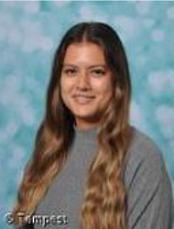
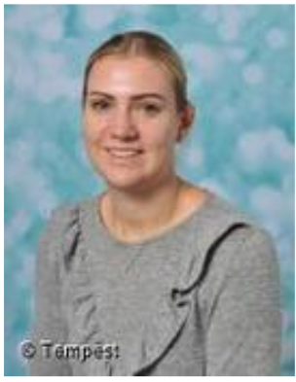
Overview of Year 2.
Staffing in year 2
Teachers: Miss McNally
Teaching Assistants: Mrs Froude (in Y2 and Y3)
Notes:
Jess

Slide 5
Expectations of KS1
Motivated to learn
Engaged with their learning
Showing kindness
Everyone is respectful and listens to one another
Everyone is mindful of other peoples’ opinion
Children adhere and respect their own Class Charter
Know and take pride in our school values – Inspiring, Challenging, Nurturing and Powering.
Notes:
Jess

Slide 6
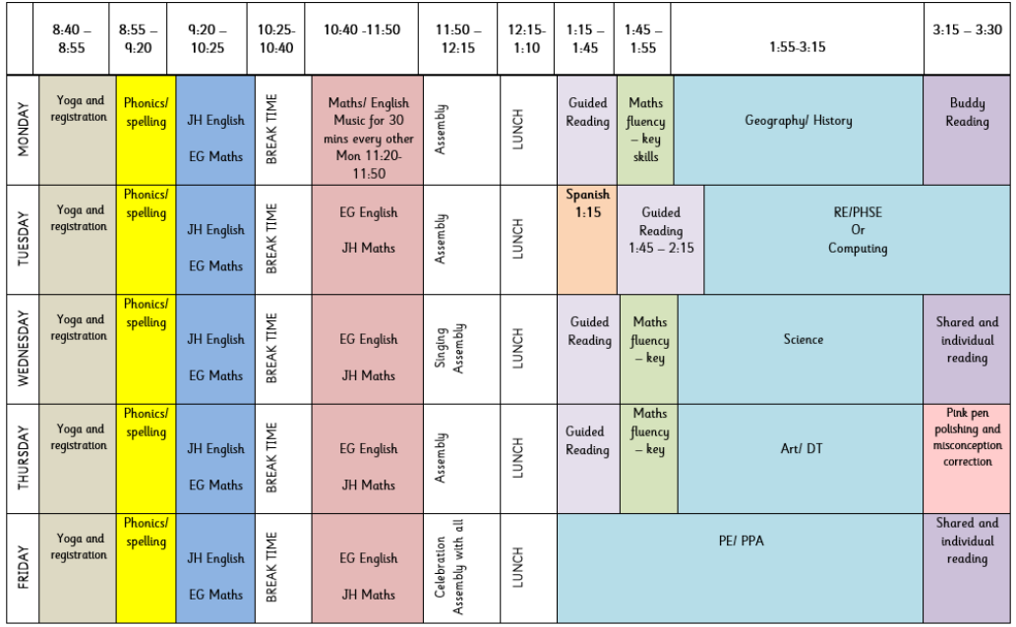
A day in Year 1
Routines of the day:
Yoga to start the day
Phonics
English
Breaktime
Maths
Assembly
Lunchtime
Guided Reading
Topic
Key information:
Books will be changed weekly – usually on a Monday or Tuesday.
Homework will go out on a Wednesday and be handed in on Monday.
Notes:
Jess

Slide 7
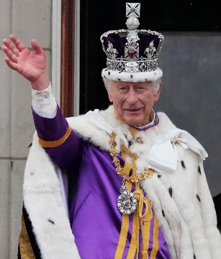
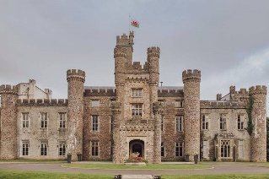
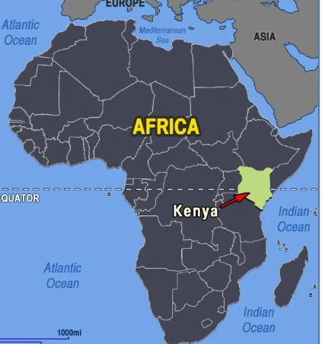

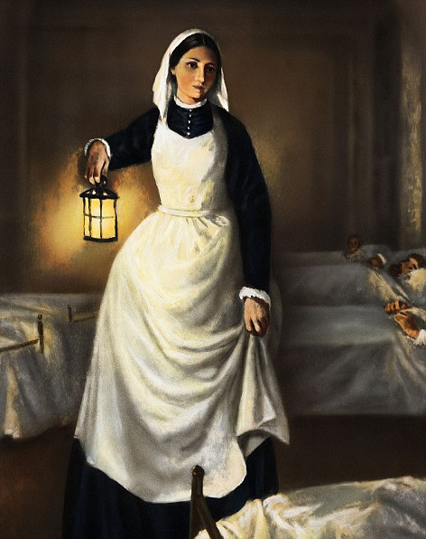
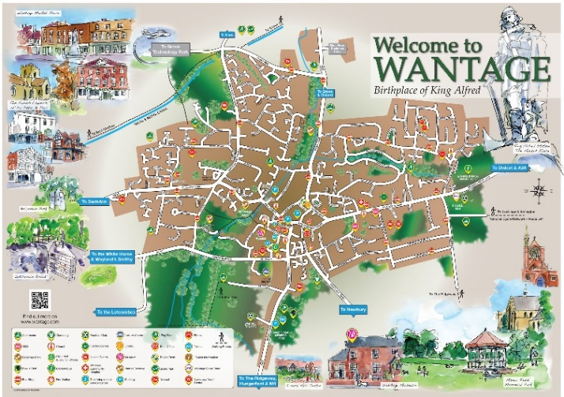
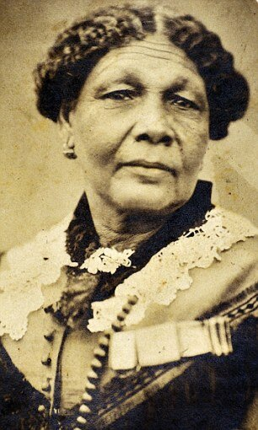
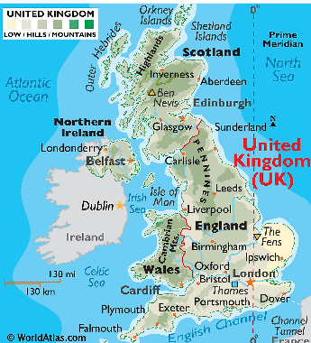
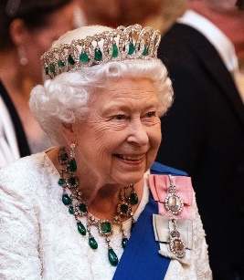
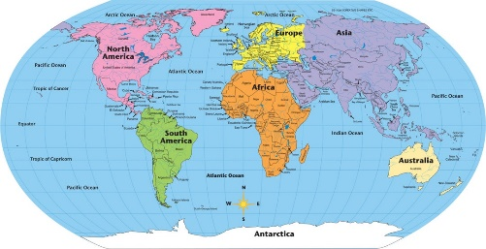
Topics covered in Year 1
Autumn Term 1 and 2 | Spring Term 3 | Spring Term 4 | Summer Term 5 and 6
This is Wantage! Focus: local Geography and History Local area study Explore environment Different types of homes Different types of buildings in Wantage Compare and contrast areas Create map of route taken Old and new buildings Compare homes and objects from the past to now | Happily ever after Focus: Geography and History London Castles Counties in UK Countries in UK Compass skills Exploring Kings and Queens of our country starting with Elizabeth II | Take a walk on the wild side Focus: World Geography Use Mama Mita to explore the African country of Kenya. Use maps and atlases to identify continents Compare Kenya to own locality. What animals would you see in Africa? | Incredible Me! Focus: PHSE and History Health and wellbeing of ourselves. How we have changed. Nurses and doctors to help look after us. Florence Nightingale and Mary Seacole –Where did she go? What did she do? What changes she made to medicine practices we see today?
Notes:
Jess

Slide 8
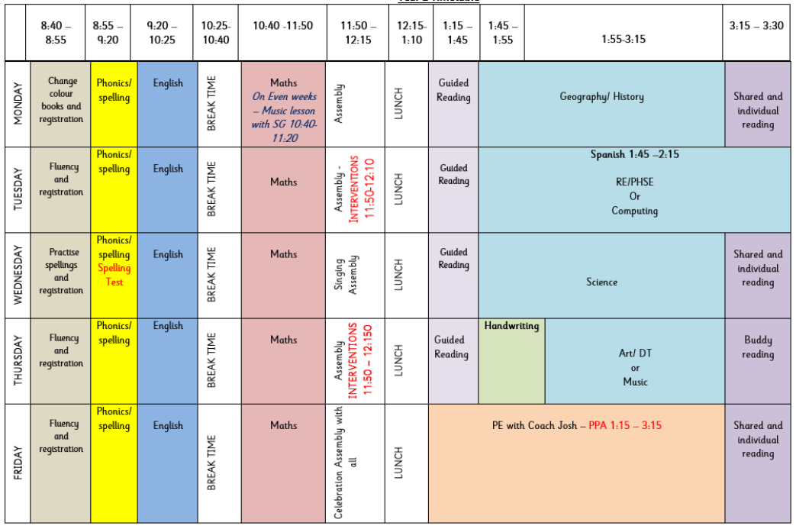
A day in Year 2
Routines of the day:
Fluency to start the day: change books, grammar, practice spellings, Maths or choosing the correct spelling.
Phonics
English
Breaktime
Maths
Assembly
Lunchtime
Guided Reading
Topic
Key information:
Books will be changed weekly on a Monday or Tuesday.
Homework will go out on a Wednesday and be handed in on Monday.
Notes:
Rosella

Slide 9



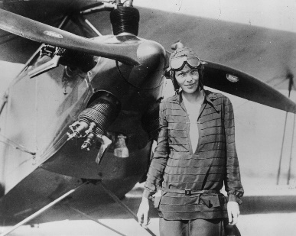
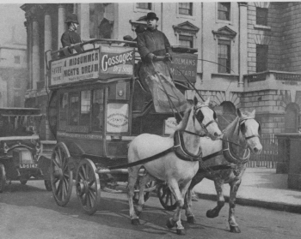
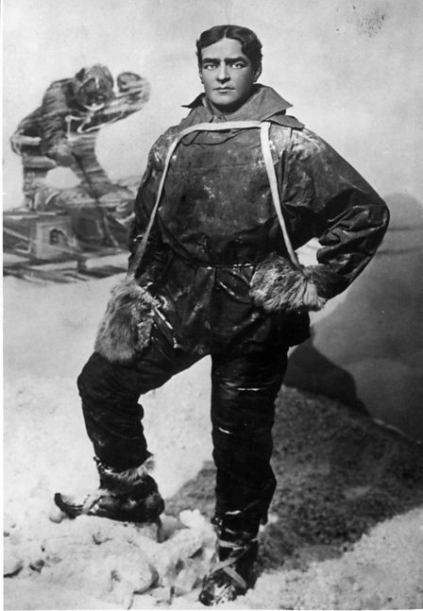
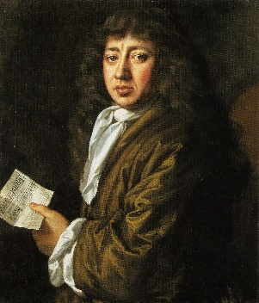
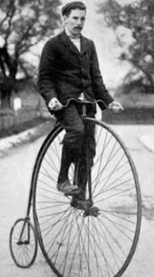


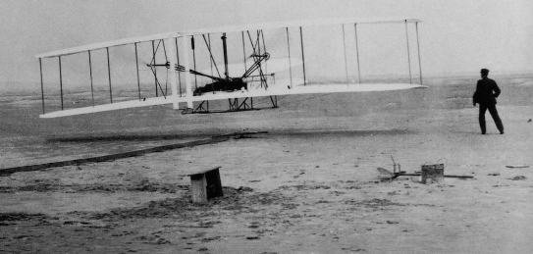
Topics covered in Year 2
Autumn Term 1 and 2 | Spring Term 3 and 4 | Summer Term 5 and 6
London’s Burning Focus: History Introduce Great Fire of London. Explore some buildings – how they differ to buildings today. Explore materials of homes. Samuel Pepys kept a diary. Why is it important to record historical events? | Frozen Planet Focus: Geography and History Exploring our own winter season. Use maps to locate Antarctic. Compare to own locality. Use sources to explore weather conditions? Which animals live there? Explore significant figures and expeditions of the polar regions. Focus on Ernest Shackleton’s expedition to the Antarctic Maps of the world to show different regions including the equator. | Marvellous Machines – the marvel of flight Focus: History Explore transport today and in the past. Look at how different modes of transport have changed e.g. bikes, trains etc Look at some local engineers e.g. Dyson Focus on the history of flight – specifically the first aeroplane flight by Wright brothers and women pioneers e.g. Amelia Earhart. Chronology
Notes:
Rosella

Slide 10

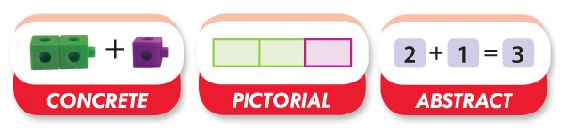
Maths at WPA
At Wantage Primary Academy, we teach Maths through a CPA approach (concrete, pictorial, abstract). The Concrete Pictorial Abstract (CPA) approach is a system of learning that uses physical and visual aids to build a child’s understanding of abstract topics.
Better understand the relationship between numbers and the real world
Notes:
Pupils are introduced to a new mathematical concept through the use of concrete resources (e.g. fruit, Dienes blocks etc). When they are comfortable solving problems with physical aids, they are given problems with pictures – usually pictorial representations of the concrete objects they were using. Then they are asked to solve problems where they only have the abstract i.e. numbers or other symbols. Building these steps across a lesson can help pupils better understand the relationship between numbers and the real world, and therefore helps secure their understanding of the mathematical concept they are learning.

Slide 11

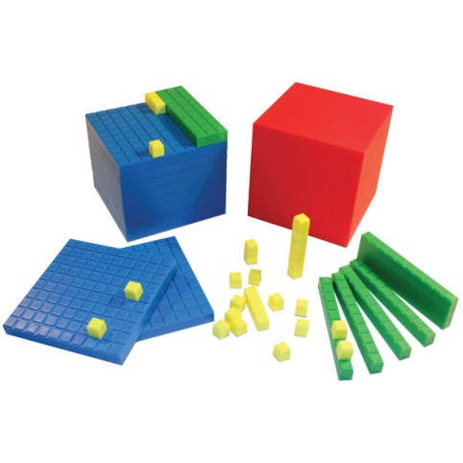
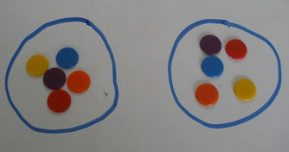
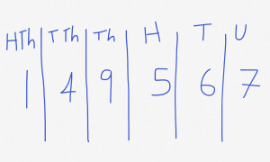
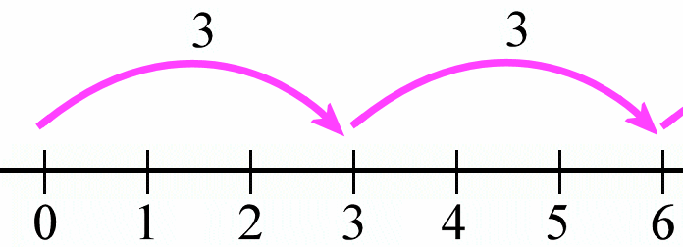
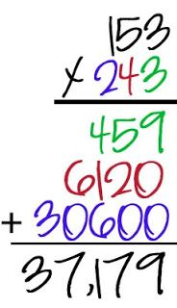

Teaching in a concrete, visual then abstract way
Concrete is the “doing” stage to bring concepts to life for children.
(demonstrated through available resources in the classroom and, where appropriate, pictures in books)
Pictorial is the “seeing stage” where children may draw/look at pictures, diagrams or models which represent the problem.
Abstract is the “symbolic” stage, where children are able to use numbers and mathematical symbols to solve calculations.

Slide 12
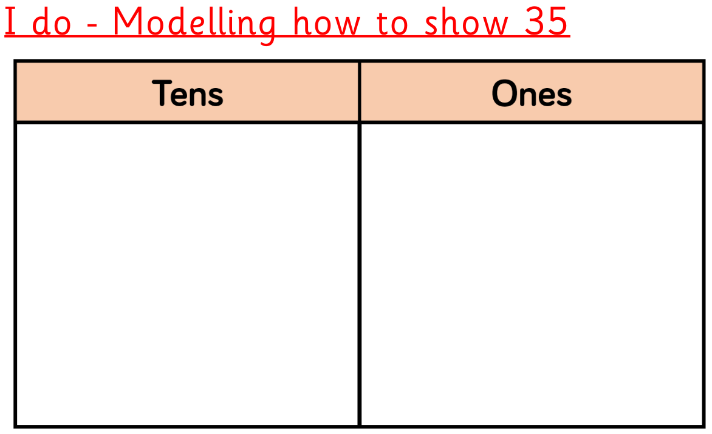
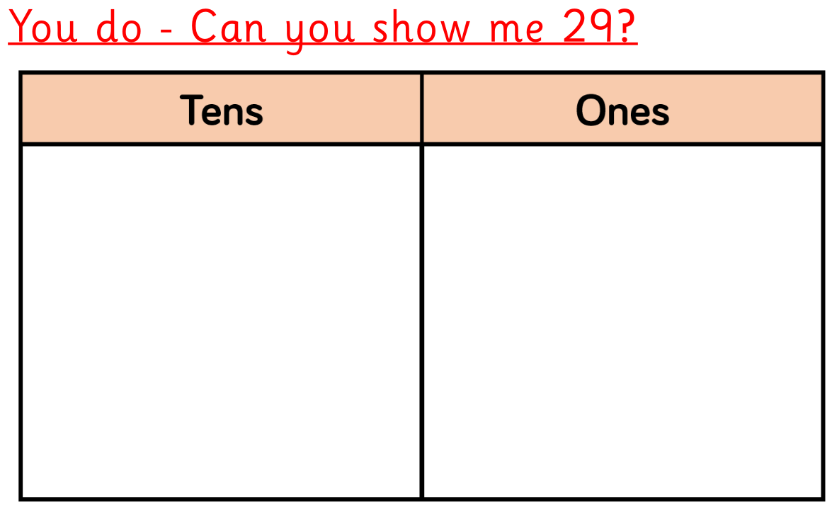
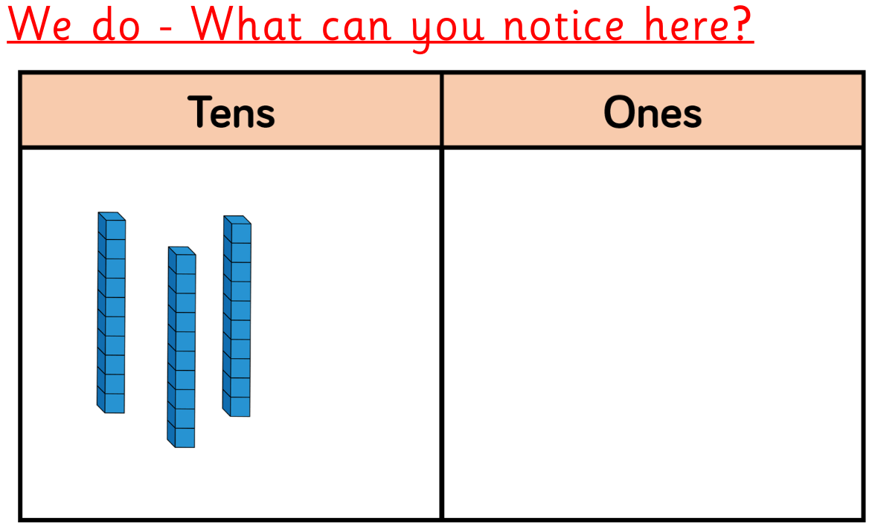
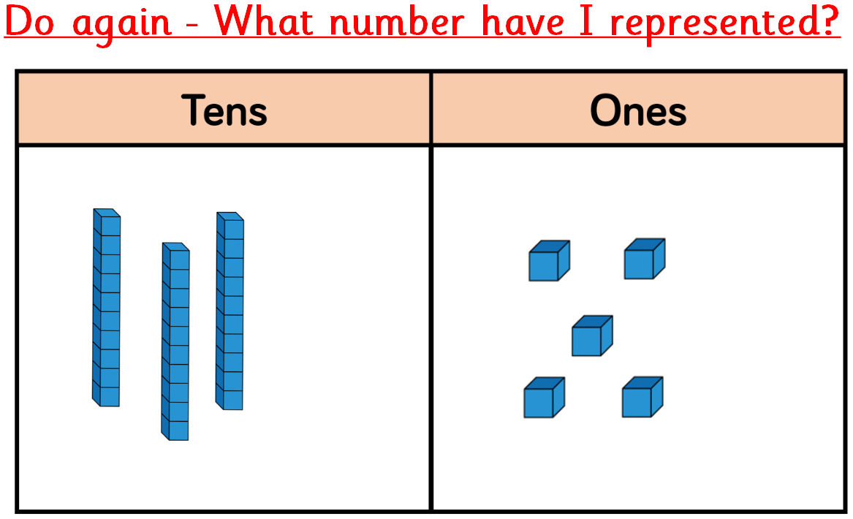
Place Value using base 10/dienes
Notes:
Build up pupil confidence by getting them to represent two-digit numbers using dienes blocks and a place value chart. Show them how to represent 35, for example, and model this with dienes.
Teachers should deliberately plan to create errors when modelling. For example, placing 11 ones counters into a place value chart, making that error explicit and getting the students to explain why this is not allowed.
Go through many examples with pupils using the ‘I do, we do, you do’ approach to ensure that students are able to perform what it is you are asking them to do. Once you are confident that students can do two-digit numbers, repeat the process but with three-digit numbers.
It is also important that you reverse the process. Instead of only asking students to represent a number with the dienes, show dienes and ask students to explain which digit is being represented, the value of that digit and then the number that the digits represent.
For example, this could be shown on the board, with the teacher then expertly modelling their thinking aloud.
‘I have counted 9 ones cubes. That means the digit represented in this value is 9 and because it is in the ones value means that it represents the number 9. In the tens value, there are 3 blocks. This gives me the digit 3. Because it is in tens value, it represents the number 30.
So far I have the digits 3 and 9; which represent the numbers 30 and 9. Together this is 39. There are also blocks in my hundreds value. I have 4 blocks there. This would represent the digit 4. As it is in the hundreds value, it represents the number 400. I have 400, 30 and 9. Together this makes 439.’
Once pupils are used to solving questions like the above in a whole-class setting, the work set should focus on having them try this individually. It is best to interleave between a question asking a pupil to show or draw dienes representing a number, and one using the dienes to work out what number they are representing.
Extending this further with – What is my number?

Slide 13
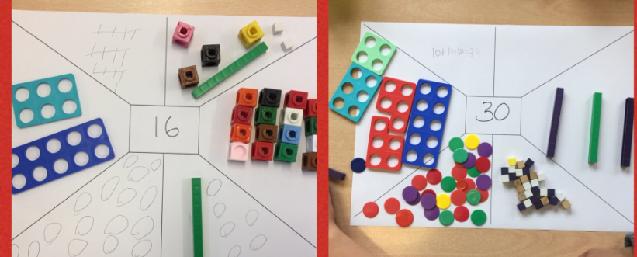
Place Value - Complete the representation tables using equipment to help you.

Slide 14
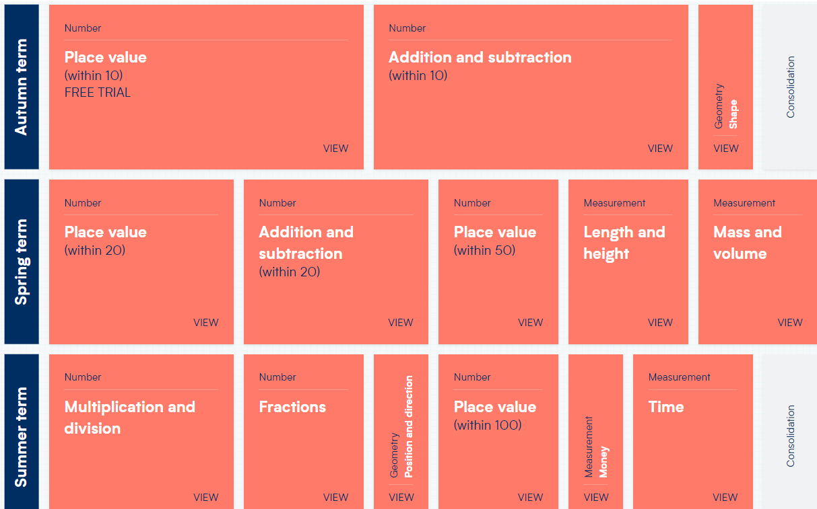
Maths in Year 1- coverage.

Slide 15
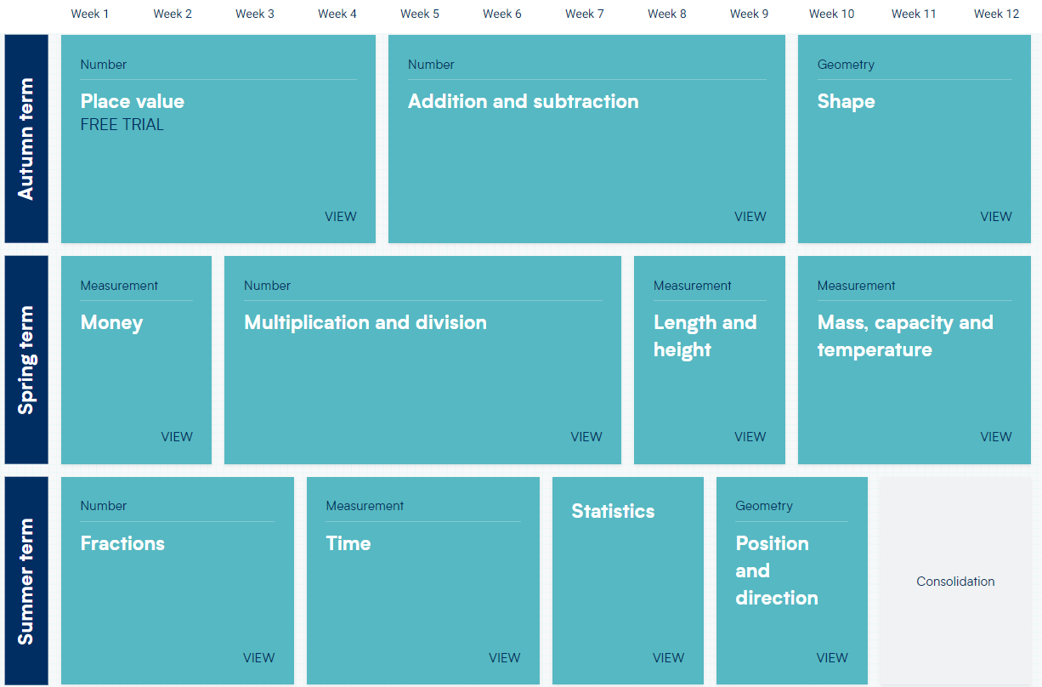
Maths in Year 2 - coverage.

Slide 16
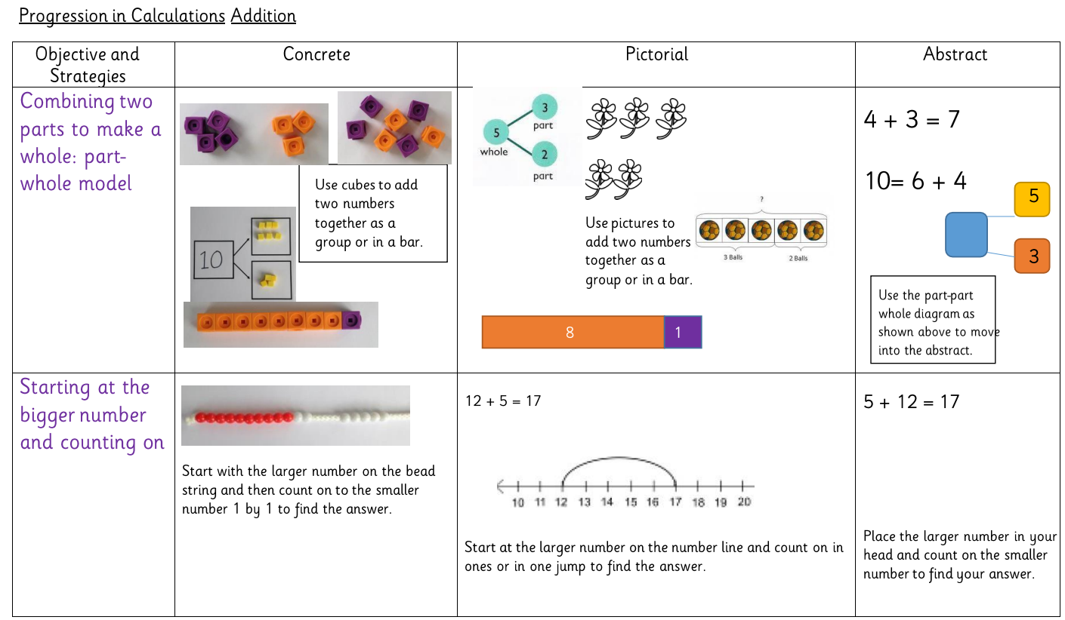
The WPA way in Maths

Slide 17
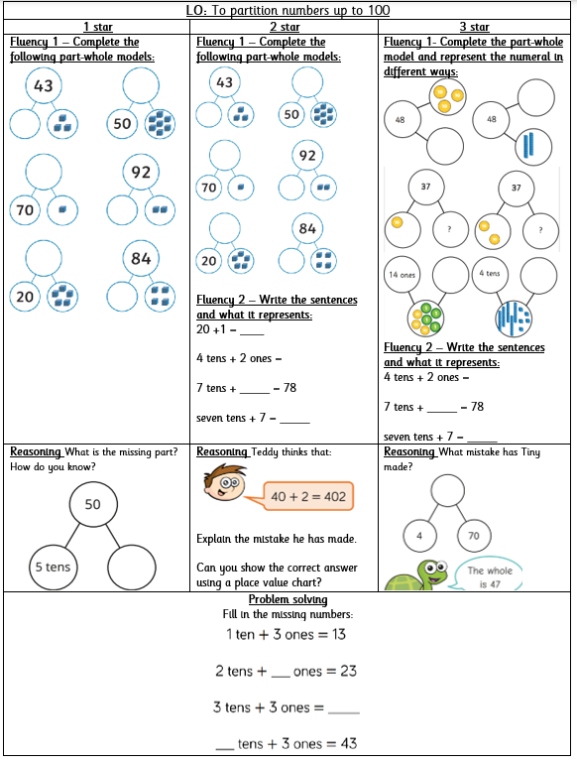
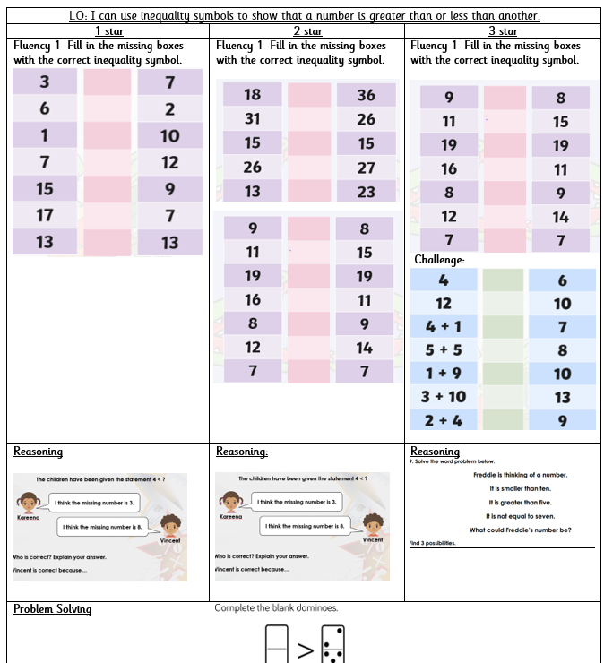
Maths in Year 1and 2 – star challenges

Slide 18
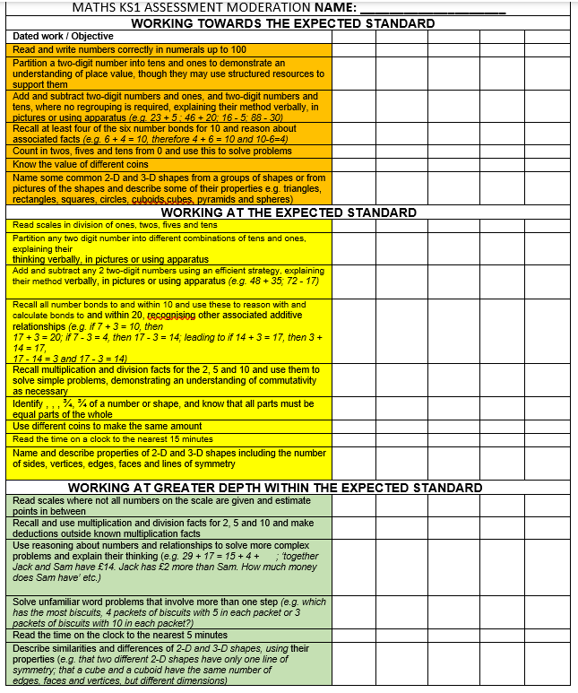
Maths in KS1 - outcomes and expectations

Slide 19




English

Slide 20
English in KS1 - how is it taught?
English includes: Reading, Writing and Speaking & Listening. English lessons take place daily.
We usually start with a grammar focus, then a Cold Write, then exposure to the text types. Finally, we write our own and work hard to edit using pink pen.
At the end of every unit we will have a hot write
Star challenges with increasing challenge, based on the task.
Working walls reinforcing our learning, vocabulary and misconceptions
In KS1, we focus on writing to entertain and inform

Slide 21
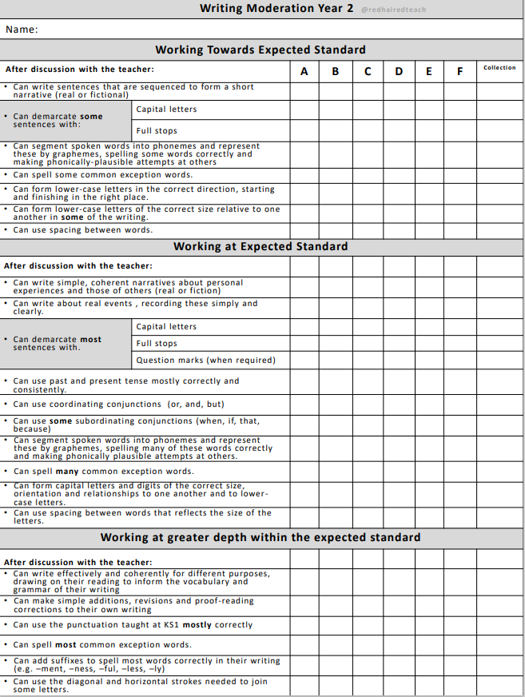
English in KS1 - outcomes and expectations – by the end of Y2

Slide 22
What is phonics?
Different schemes schools adopt
We use the DFE Letters and Sounds programme
Phased 1 – 5 systematic approach
The ability to be able to listen to sounds in words
Recognising the spelling for the sounds in words
Remembering the spelling for the sounds in words
Building words
Reading words – flash cards and decodable text
Writing words

Slide 23
Key terminology
Phoneme- this is the sound e.g. c, m, ch, ou. There are 44 in our English language.
Grapheme- this is a way of writing down a sound. This may consist of one or more letters e.g. ie as in pie, igh as in high.
Segment- this is when children pull words apart by saying the sounds e.g. c-a-t m-oo-n f-ar-m-er

Slide 24
Key terminology
Blend- this is when sounds are put together to make a word
Digraph- a grapheme containing two letters that make one sound e.g. sh, th or vowel digraphs such as oa, ee
Trigraph- a grapheme containing three letters that make one sound e.g. igh, ear and air
Split digraph- when a vowel digraph is split by a consonant e.g. a_e lake or i_e bike

Slide 25
Pure sounds
It is vital that sounds are pronounced in a pure way. For example ‘f’ not ‘fuh’ and ‘s’ not ‘suh’. The reason for this is so that children can segment and blend correctly and do not add extra sounds when reading.
e.g. b-a-t-u instead of b-a-t

Slide 26
SSPF- The will and the thrill
Can do ethos
Books
Rhymes
Poems
Songs
Clever conversations
Vocabulary
Story making and telling
Bringing books to life
Love, joy and laughter
Systematic Synthetic
Phonics.

Slide 27
SSPF- The bigger picture
NC KS1
Phase 4 & 5
Phase 2 & 3
Phonological awareness Phase 1
General Sound Discrimination Phase 1
Stories, Songs, Rhymes and Non-Fiction
Listen
Language Development
Understand and Speak

Slide 28
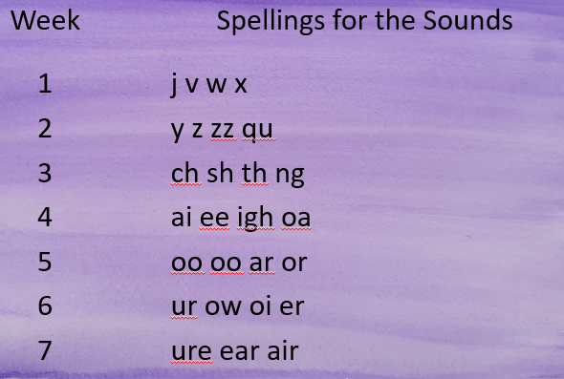
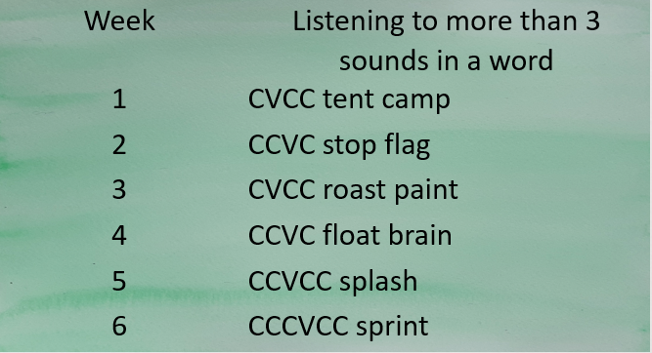
The basics 3
The basics 4
Listen, Recognise, Build, Read, Write
3 sounds only
Listen, Recognise, Build, Read, Write
4 and more sounds only. No new spellings to remember

Slide 29
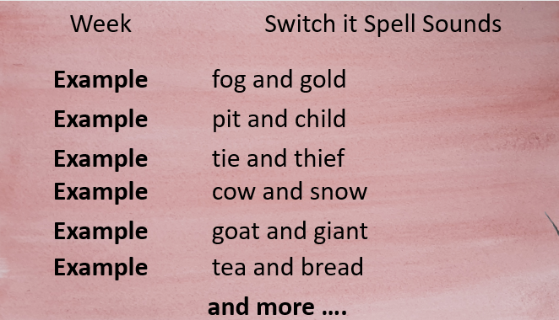
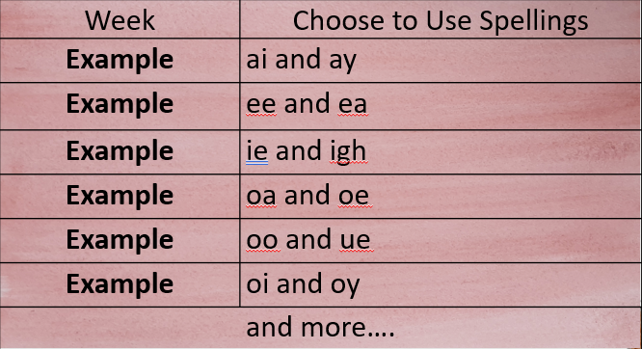
The basics 5
Choose to use
Switch it with Mitch

Slide 30
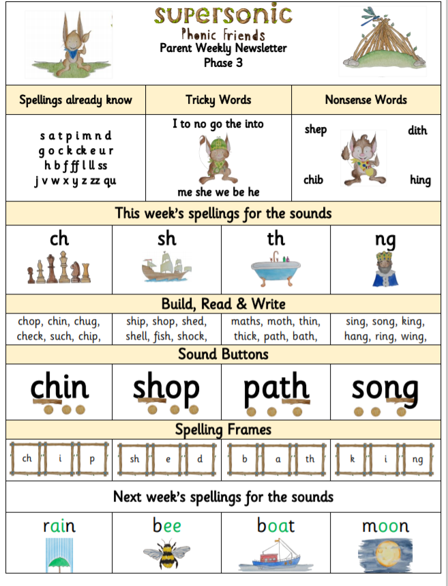
Weekly parent phonics newsletters

Slide 31

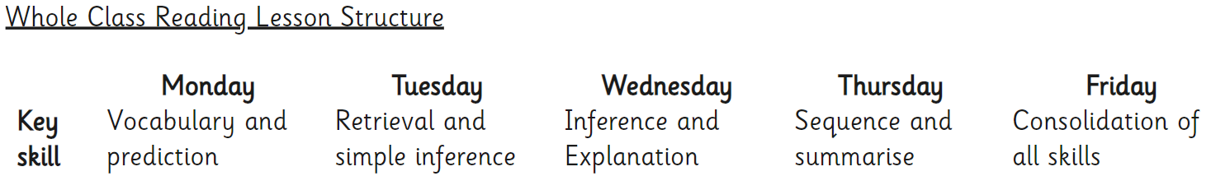
Guided Reading
At the early stages of learning to read, reading materials are closely matched to learners’ phonics knowledge using the Collins Big Cat books (Lilac – Turquoise). We use Collins Big Cat as a whole-school reading programme; the levelled readers systematically increase the level of challenge, vocabulary and stamina as children work up through the bands and have been audited to ensure they link fully with our SSP.
Daily Guided Reading sessions take place throughout the school
From the Spring Term of Year 1, all children will move onto whole class Guided Reading using Badger Guided Reading texts. During guided reading, we ensure our pupils are exposed to rich and varied text.
Notes:
Rosella

Slide 32
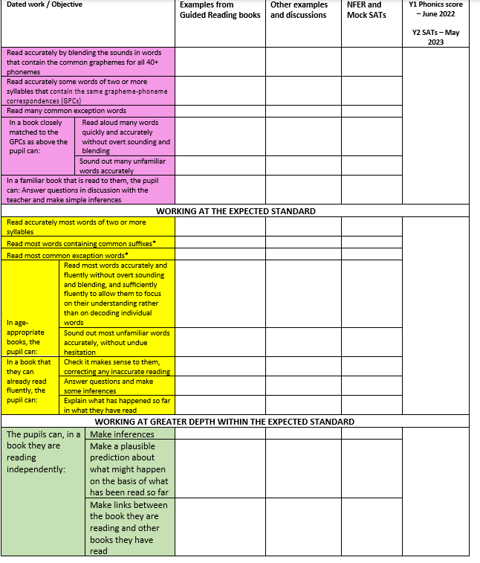
Reading end of Year 2
Notes:
Rosella

Slide 33
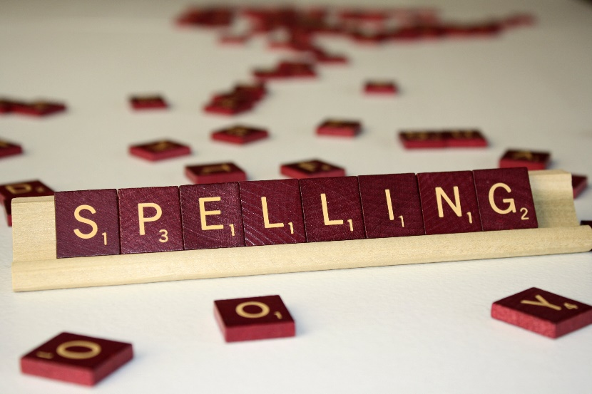

Spellings
In KS1, the children learn to spell as part of their daily phonics lessons where they learn to apply the sounds taught. In all other areas of the curriculum, the children are encouraged to apply their phonic knowledge when writing independently.
The spelling objectives are taught initially through Supersonic Phonic Friends (Nursery – Year 2). Throughout the year, Year 2, the children then move onto ‘No Nonsense spelling’ which focuses on the teaching of spelling. Each week, the children will complete a weekly spelling test.
Word lists and visual prompts are used in classrooms to assist children with their spelling. Children are encouraged to use different strategies to help them spell correctly including phonics, use of word lists or mats and dictionaries. When marking work teachers pick out spellings for children to correct based on spelling patterns and non-negotiables.
Notes:
Rosella

Slide 34
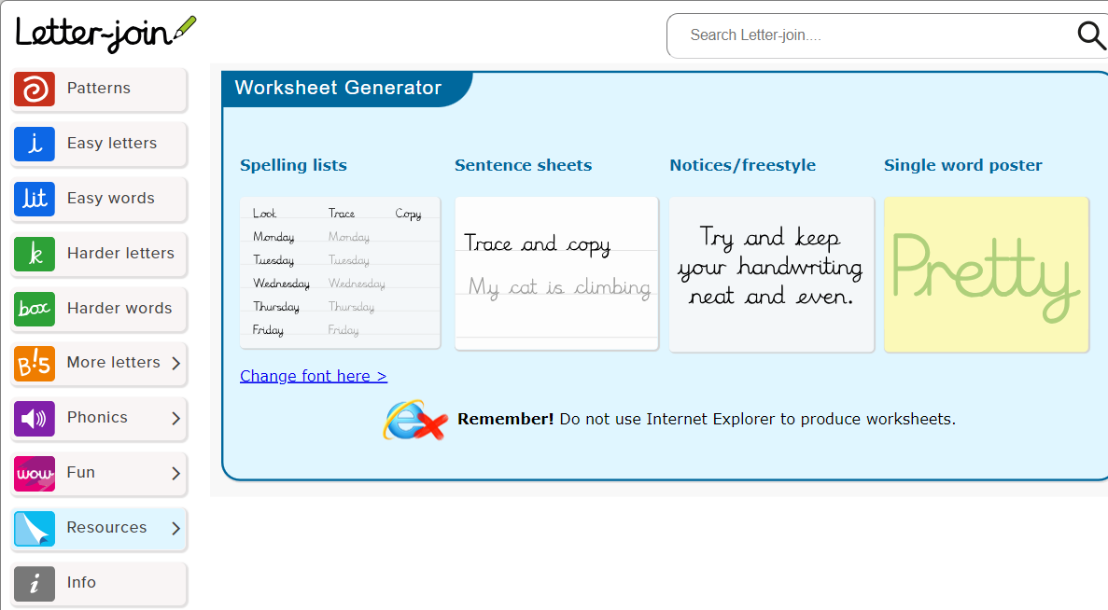

Handwriting
Our aim is to ensure that every pupil develops a neat, fluent style of handwriting using continuous cursive letters as this will lead to them producing letters and words automatically in their independent writing. For most this will happen by the end of Year 1 and for those with specific difficulties, interventions will take place.
Handwriting is taught weekly, in Year 1 and 2, through explicit teacher modelling of letter formation and building to a cursive style.
We use Letter Join script. We recognise that handwriting is closely linked with spelling, therefore, the practising of key word/rules and year group statutory and non-statutory words also occurs in the context of handwriting lessons, once children are competent in the correct individual letter formation.
Notes:
Rosella

Slide 35
Assessment – how do we know how the pupils are doing?
Throughout the school, teachers assess children daily to form the basis of planning and consecutive lessons, ensuring they meet the needs.
At the end of each half term, teachers moderate and assess the children on the objectives covered.
Once a term, children are assessed in formal ways for writing. At the start of each English topic/genre the children will carry out a cold write. A cold write is a piece of writing that the children do independently before they have had any explicit teaching or guidance in that area. At the end of the topic, the children then carry out an independent hot write. This highlights what they have learnt throughout the topic. In year 2, weekly spelling tests are delivered. This aims to aid the children in learning their year 2 spelling rules.
Within Mathematics, end of unit assessments are completed for each topic.
In other topics and subjects, we assess throughout and at the start and end of unit assessments.
Notes:
Ellie

Slide 36
Other subjects and Enrichment
Alongside the core skills of English and Maths, we also teach a full broad curriculum and ensure lots of enrichment such as visits, trips, music, forest schools and much more.
Notes:
Ellie

Slide 37

How can parents support at home?
Please provide a healthy snack! (available at school)
Support with homework and spellings to help link learning
Supersonic Phonic Friends Newsletter to help with sounds – Year 1 and this for the start of Year 2 while they recap Year 1 sounds.
Check in with the weekly timetable within the Newsletter
Good routines (including sleep)
Only playing appropriate games and not too
much screen time. Please do not playing on devices until late
Fun Reading
Fun Writing
Fun Maths
Positive attitude and communication - Ask them what they have enjoyed and what they learnt
Notes:
Ellie

Slide 38
Thank you very much for your time!
Please do visit our website to find out more about your child’s education:https://www.wantageprimaryacademy.org.uk/curriculum/
Notes:
Rosella

