Slide 1

Welcome to WPA’s coffee morning. Help yourself and find a seat.
https://www.wantageprimaryacademy.org.uk/parent-coffee-mornings/

Slide 2
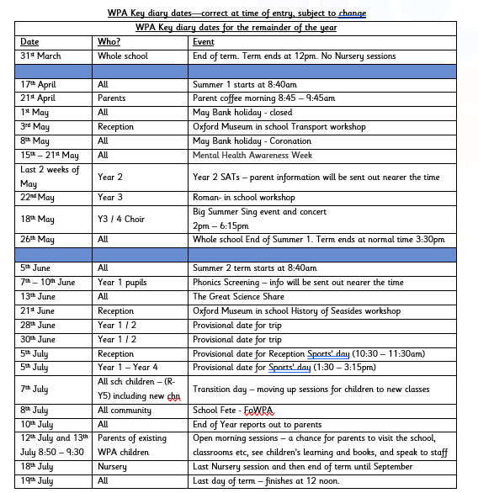
WPA news, community news and events.

Slide 3

The National Curriculum and What to Expect as your child goes through Primary School

Slide 4

We believe that primary school should be an exceptionally special place which gives you lifelong skills and memories.
Learning is accelerated when pupils and staff are in an exceptionally positive and happy environment.
Anything is possible if you are kind, do your best and work hard.

Slide 5
The Journey Through Primary School
1. EYFS – Early Years Foundation Stage
Nursery
Reception
2. Key Stage 1 (KS1)
Year 1
Year 2
3. Lower Key Stage 2 (LKS2)
Year 3
Year 4
4. Upper Key Stage 2 (UKS2)
Year 5
Year 6

Slide 6
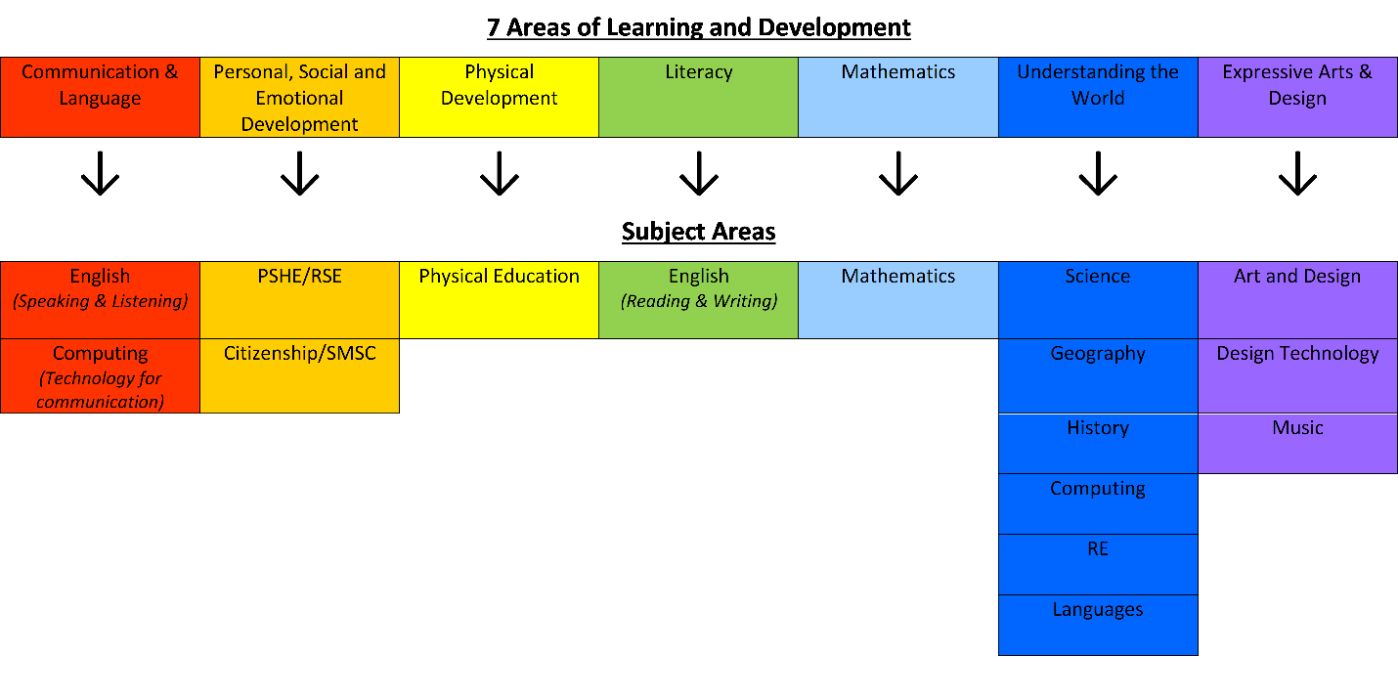
What subjects are taught?
The national curriculum starts from Y1. However, we ensure our EYFS curriculum (Nursery and Reception) feeds directly into the next steps. See below:
Gaining understanding and skills in these areas also provides the foundations necessary for pupils to progress to subject-specific study when they are ready to do so. The following image illustrates how the seven areas of learning and development link to subject areas:
EYFS
Y1 - Y6

Slide 7
RSE – Relationships and Sex Education
Since 2021 the R in RSE has become statutory in UK school the S is at parent’s discretion
Overlaps with the Science and PSHE curriculum
RSE consultation takes place each year (and is available on our website)for parents who want to find out more and ask questions

Slide 8
Want to know more about our curriculum and what your child will learn?
https://www.wantageprimaryacademy.org.uk/curriculum/
Ensure you regularly access GOOGLE CLASSROOM (Reception upwards) and Evidence Me (Nursery and Reception)

Slide 9
Tests and assessments
Throughout their time within primary school, pupils regularly take part in formal and informal assessment. This includes low stakes quizzes, times table texts, NFER end of term assessments, White Rose end of unit assessments and many more.
We don’t call these tests and we don’t make a big deal out of them. We call them assessments and instead, we ensure the children feel well prepared and well supported.
In addition to the daily, weekly, termly assessments, there are also DfE produced papers known as SATS.

Slide 10

We call them assessments and it is part of normal school practice
Statutory Assessments
EYFS – Start of Reception Baseline Assessment
End of Y1 – Phonics Screening
End of Y2 – KS1 SATS
End of Y4 – Times Tables Screening
End of Y6 – KS2 SATS
Informal Assessments all the time!

Slide 11

Reception – Baseline Assessment
This assessment takes place in the first 6 weeks of Reception and the focus is on Communication, Language and Literacy and Maths. It takes 30-45 minutes per child and is completed by the practitioner who best knows the child
The data will be used to judge how much progress children have made by the end of KS2.

Slide 12
Y1 Phonics Screening Week (from June 5th)
Teachers take children one at a time and children have a task to decode 40 words on word cards.
Some words are real words and some are nonsense words.
They need to use the phonic sounds they have learnt throughout Reception and Y1 to decode the words

Slide 13
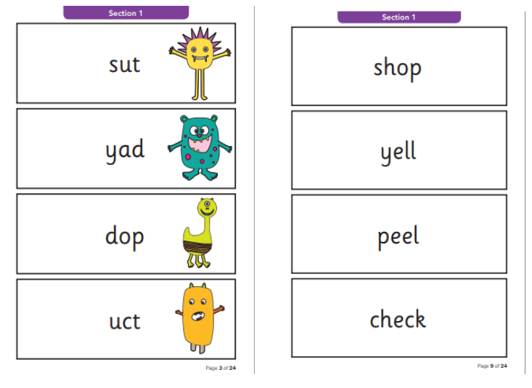

Slide 14
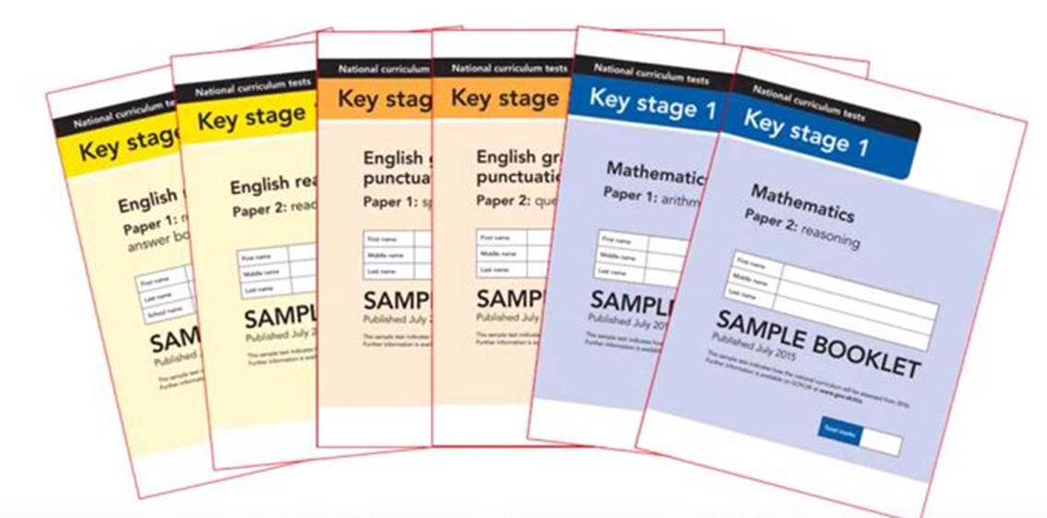
KS1 SATs
KS1 tests are assessed and marked by their teachers.
Children are tested in maths (arithmetic) and English (reading, spelling, punctuation and grammar).

Slide 15
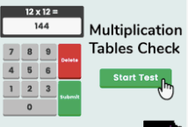
Y4 Multiplication Tables Check – 3 weeks in June
The Year 4 Times Tables Test is an online test with 25 questions; children must answer each question within a 6 seconds time limit so the whole test will take less than 5 minutes.

Slide 16
KS2 SATs
Pupils sit their second set of SATs in Year 6. These tests are more formal and have set exam days as well as external marking - they are packed up and marked by markers. Children will take tests in English reading comprehension, grammar, punctuation, spelling, mathematical reasoning, and arithmetic.
SATs week for Year 6 - 2nd week in May
Results come in July

Slide 17

Are school tests stressful for children?
The children are very well prepared for the tests.
They do lots of practice so they are familiar with
the format of them.
The test then looks very familiar to them
In KS1 children often work in small groups with a teacher.
In KS1 tests can be completed over several days.
Year 6 have a SATs breakfast every morning at school – hotel style!
Tests in Y6 are only in the morning

Slide 18

Wherever you are in your primary school journey, parents and school together make very successful learners

Slide 19



How you can help your child
Adult support/guidance
Explaining back/recalling/talking
Practise and Repetition
Good routines
Enrichment and new experiences
A positive attitude
Care and love
Reading information from school and keeping informed

Slide 20
Personal development and enrichment at WPA
The Personal Development Curriculum at WPA encompasses the following areas:
· Fundamental British Values and Citizenship education
· Social, Moral, Spiritual and Cultural education
· Personal, Social, Health and Economic and Sex and Relationship Education
· Living in and protecting the Wider World education
Our school mission statement ‘BELONG-BELIEVE-ACHIEVE’ embodies our attitude and intentions towards the importance of the development of all aspects of the Personal Development curriculum. At WPA, Personal Development is not an ‘add on’ but instead, is the underpinning of our offer.
Personal development is both a subject and a school ethos. It is reflected in our school motto and in our school values. We want to each child to leave the school feeling confident, unique and proud. Our aim is to teach children how to navigate through life safely, happily and healthily.
At WPA, we recognise that our children are growing up in a world that is constantly changing and it is the duty of all the staff at school in partnership with the parents teach the children transferable life skills. We teach children about the world around them, relationships, emotions, reproduction and health, as well as transferable skills to help with life. We consistently promote the British values, diversity, community and citizenship and our school and wider values.
Personal Development forms a vital part of our curriculum. This is split into different areas - some of which are taught as lessons, for example, our PSHE sessions, where we use a scheme called Jigsaw. Other elements will be offered through clubs, assemblies and other activities. Please visit our website to find out more about the Personal Development offer at Wantage Primary Academy.

Slide 21
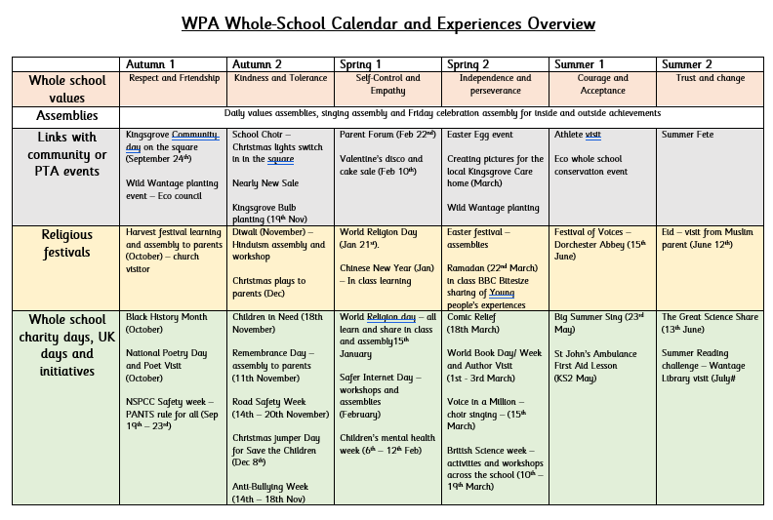
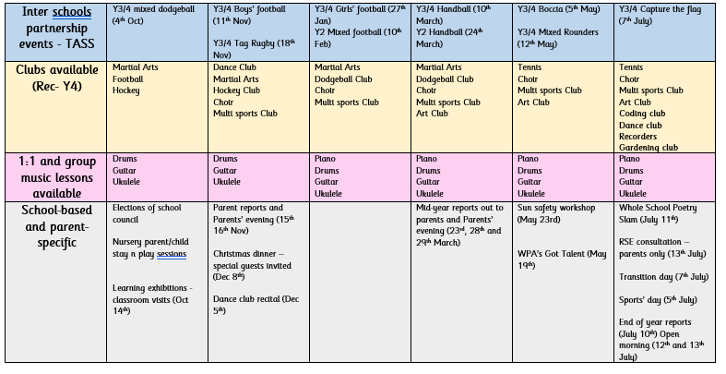
There are so many experiences and enrichment opportunities available and added across the days and events across the year!
Some will be new and some will be traditions the children love. We will also continue to look at special people and places

Slide 22


