Slide 1

Children’s Mental Health
Anxiety
Notes:
Introduce yourself to each other and acknowledge we are all here for the same reason.

Slide 2

What is mental health?
Mental health includes our emotional, psychological, and social well-being.
It affects how we think, feel, and act. It also helps determine how we handle stress, relate to others, and make choices.
Mental health is important at every stage of life, from childhood and adolescence through adulthood.

Slide 3
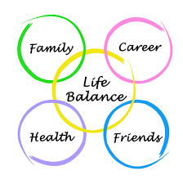
Positive mental health and wellness allows us to
Realize our full potential
Cope with the stresses of life
Work productively
Make meaningful contributions to our communities

Slide 4
I wonder…..
How do you feel when you are anxious?
Notes:
How do you feel when you are anxious?

Slide 5
I wonder…..
What does my child have to be anxious about?
If we talk about his/ her worries they’ll get bigger. Isn’t it better to ignore them?
Isn’t it better to just jump in the deep end – toughen them up?
Is this fear or are they trying to manipulate me?
Is this just a phase?
Notes:
What does my child have to be anxious about?
If we talk about his/ her worries they’ll get bigger. Isn’t it better to ignore them?
Isn’t it better to just jump in the deep end – toughen them up?
Is this fear or are they trying to manipulate me?
Is this just a phase?

Slide 6
What happens if a child is anxious?
Can often feel like to the family that they have been high-jacked.
  Plans can often need to be changed. Often at the last minute.
  Can cause anxiety or frustration in the parents / carer
  Often parents can experience extreme sadness as a result.
  We often may question our parenting.

Slide 7
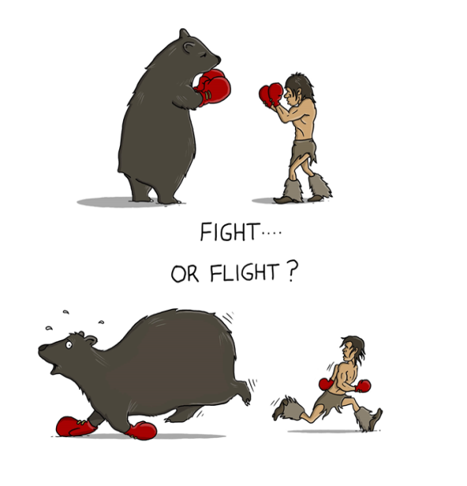
What is anxiety?
Anxiety is a feeling of worry, nervousness, or unease about something with an uncertain outcome.
It’s a normal reaction we all at times feel. It is when it persists and affects our daily life that it becomes a problem.
Notes:
Explain years ago when we were cavemen and had to hunt for our meals. We had to fight or flight from dinosaurs.

Slide 8
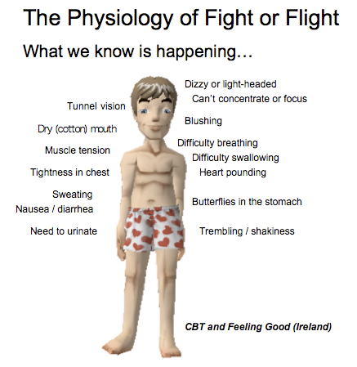
Fight or Flight

Slide 9


When Anxiety is not helpful
Notes:
So when we suffer with anxiety what we are left with is an oversensitive alarm system that keeps going off. A bit like the smoke alarm at home which goes off with every tiny thing and not when you need it.

Slide 10
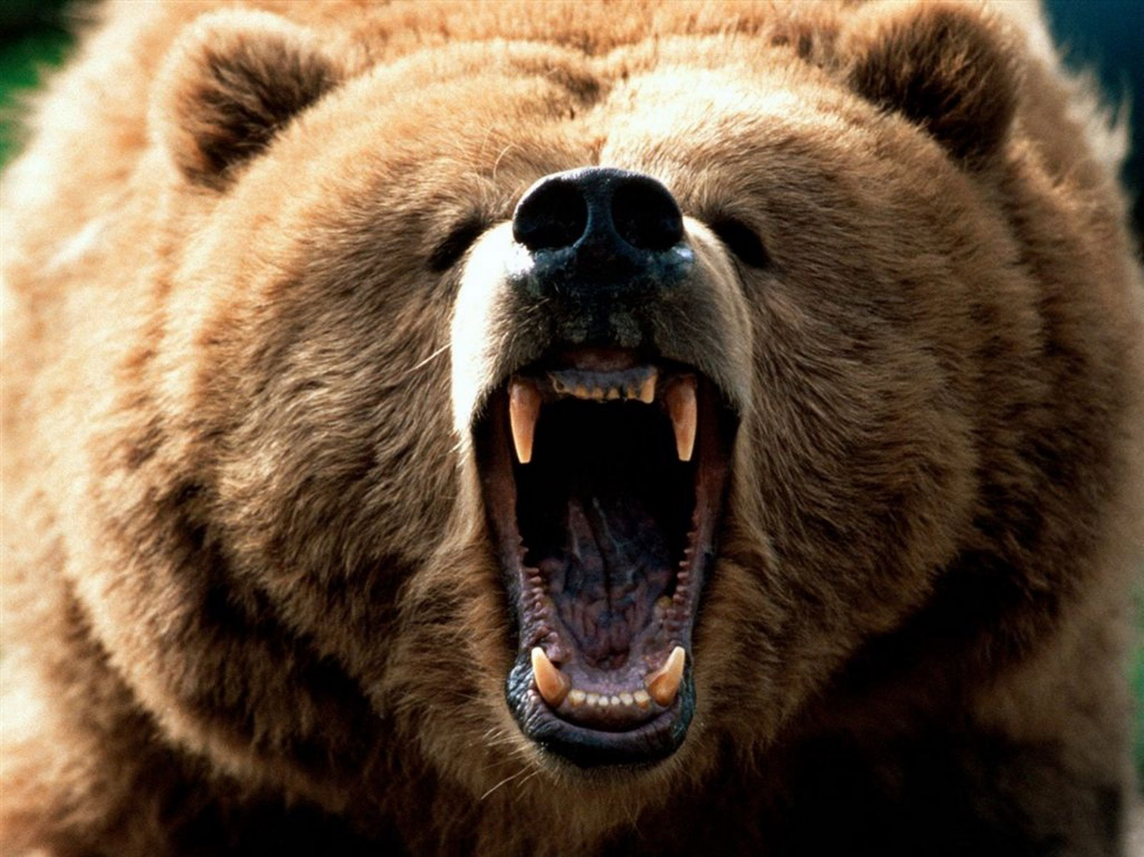
Notes:
So you’re walking through the woods and you come face to face with a grizzly bear. What do you think? What do you feel? What do you do?

Slide 11
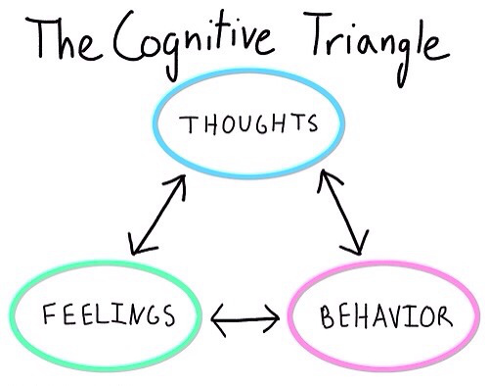
Formulate
Anxiety involves thoughts, feelings and your behaviour

Slide 12

Imagine these are people…..
Notes:
What does a non anxious child see?
What does an anxious child see?

Slide 13
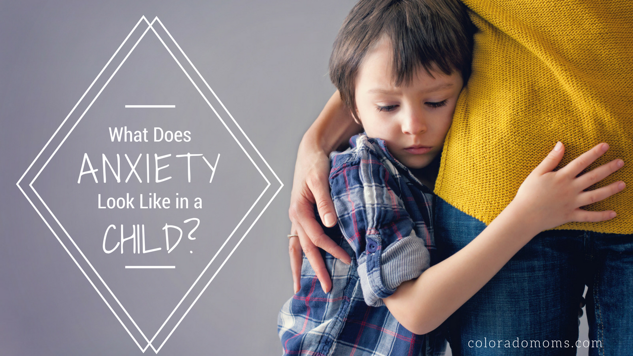

Slide title
Asdfsdf
  Fhjk

Slide 14
A child with anxiety difficulties may….
Seek reassurance often
Avoid situations they are worried or frightened of
Tell you they have a physical pain such as stomach ache
Dislike trying new things or taking risks
Get upset easily
Experience frequent emotional outbursts
Avoid talking or eye contact
Be very clingy
Repeated checking

Slide 15
As a parent you may notice your child….
Cling to you
Asks for help for things they can do themselves
Does not want to go to school
Won’t go to sleep without a parent / carer
Asks will you do it for me / or asks for reassurance a lot
Complains of feeling unwell frequently
Worries about doing things correctly
Prefers to watch than have a go
Has lots of fears
Cries over small things
Complains a lot
Sees the dangerous sides of things.

Slide 16
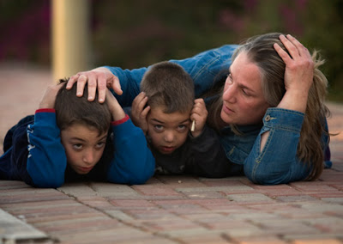
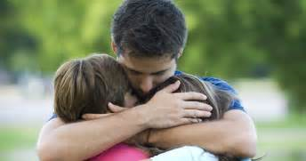
Parents / Carers
Parents are biologically programmed to protect and care for their children and to try to always make things better.
Notes:
The problem!

Slide 17
What maintains your child’s anxiety?
Allowing the child to avoid the very thing they’re frightened of
Giving constant reassurance to our child
Answering them when they constantly check things.
Reacting to anger outbursts with impatience and not looking behind the anger.
Encouraging safety behaviours
Inconsistencies
Notes:
In essence explain it is these very things we need to do the opposite of.

Slide 18

Aims
Managing anxiety in our children
Helping them to build their confidence
Build Resilience in our children
Notes:
…..

Slide 19
Development of anxiety
Factors that can cause heightened anxiety
Genes / temperament
Life events
Learnt by example
Learnt by reaction
Coping experiences

Slide 20
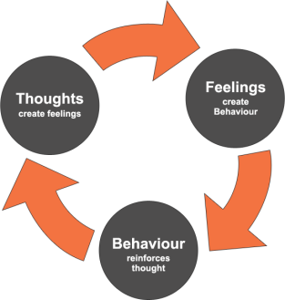
What maintains anxiety?
Things children do to protect and look after themselves
Things we do to protect and look after our children.
Anxious thinking
Misinterpretation of physical symptoms of anxiety
Anxious behaviours – avoidance, reassurance and safety behaviours.
Notes:
Anxious thinking – whether or not they are the type of child who might notice or remember things which fit into their anxious model in their head and this gets retriggers their worry time and time again. This can result in them overestimating danger and underestimating their ability to cope.

Slide 21
What others do to maintain anxiety
Demonstrate anxious behaviours
React to our children in an anxious way
Become too protective
Reassure our children
Don’t encourage them to do things and have a go
Notes:
Too protective – maybe too much
Reassure our children – maybe too much

Slide 22
We know that….
All children feel anxious at different ages.
Different ages brings different anxieties
Sometimes it make sense – sometimes it doesn’t
We need to as parents recognise their struggle and try to understand them.
Notes:
Normal

Slide 23
What can you do to manage anxiety and build confidence?
Be aware of your anxious responses to them and those around you
Get them on board to standing up to their anxiety.
Teach them about anxiety
Catch anxious thoughts
Help them to learn coping mechanisms
Help them to problem solve situations
Encourage independence
Encourage the development of their inner voice
Let the child make choices
Notes:
Get them on board – what is it stopping them from doing? What would they like to do?
Teach them about anxiety – physiological responses Its unpleasant but normal
Catch anxious thoughts – take step back. Are they realistic thoughts? Can they be thought of differently
Help them to be independent – be confident in your child and tell them so. Show them and create opportunities for them to build independendence
Encourage development of inner voice – Have a go. I can do this.

Slide 24
If your child is anxious
Try to manage your anxious behaviours
Avoid reassurance
Don’t collude with avoidance
Promote brave behaviour
Use your own strategies to help calm your child.
E.g. Counting backwards, describing things in detail, spell names of family, have a worry time etc.
Speak to school and other services for advice.
In school, we are always looking at ways to support, from Zones of regulation sessions to counselling
Notes:
Try to manage your anxious behaviours – model calm and coping
Avoid reassurance- help them to learn how to reassure themselves.
Don’t collude with avoidance – gradually help them to face their fear
What are their stratagies to calm their child when anxious?

Slide 25
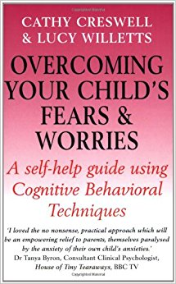
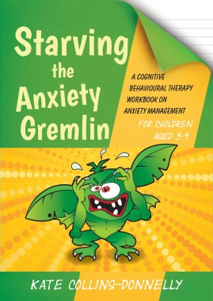
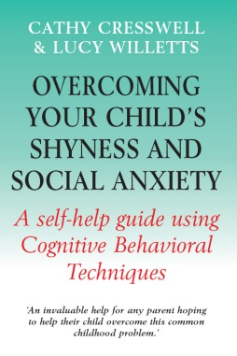
Resources
Recommended books to read with primary school children

