Slide 1

SATS and MORE!
Assessments, statutory and other throughout primary school

Slide 2
Tests and assessments
Throughout their time within primary school, pupils regularly take part in formal and informal assessment. This includes low stakes quizzes, times table texts, NFER end of term assessments, White Rose end of unit assessments and many more.
We don’t call these tests and we don’t make a big deal out of them. We call them assessments and instead, we ensure the children feel well prepared and well supported.
In addition to the daily, weekly, termly assessments, there are also DfE produced papers known as SATS.

Slide 3
What are SATs?
SATs are national tests that children take twice during their primary school life. Firstly, at the end of Key Stage 1 (KS1) in Year 2, and then secondly, at the end of Key Stage 2 (KS2) in Year 6. These standardised tests are actually known as End of Key Stage Tests and Assessments, but most people know them as SATs.

Slide 4
Why do they happen?
SATs are an indicator of the progress your child has made at school so far. They are not a measure of whether your child is passing or failing; they simply show what level your child is currently working to.
Understanding what a child can do at the end of key stage 1 is essential to ensure that they’re on the right track as they enter key stage 2.
The results published are used in performance tables so that schools can be compared and so that parents have an idea of how well children attain in a particular school. The local authority use the data to rank schools.

Slide 5
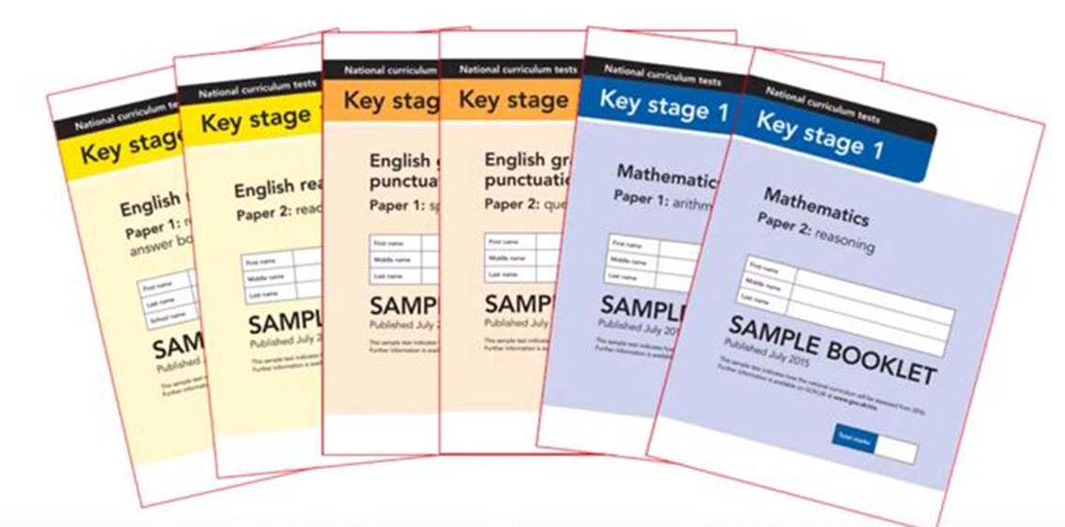
KS1 SATs (Last 2 weeks of May in Year 2)
KS1 tests are created by the government.
They are assessed and marked by their teachers and not sent away.
Children are tested in maths (arithmetic) and English (reading, spelling, punctuation and grammar).
They are not pass or fail and teachers use them alongside class work to assess pupils.

Slide 6
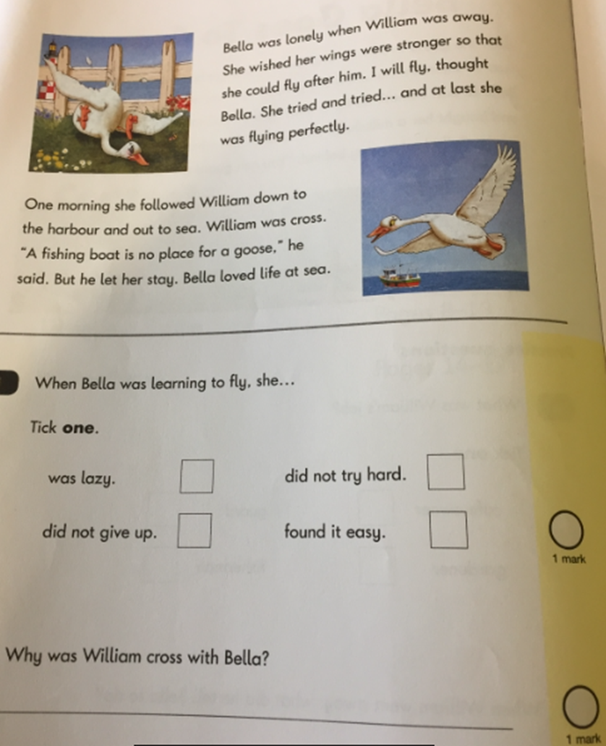
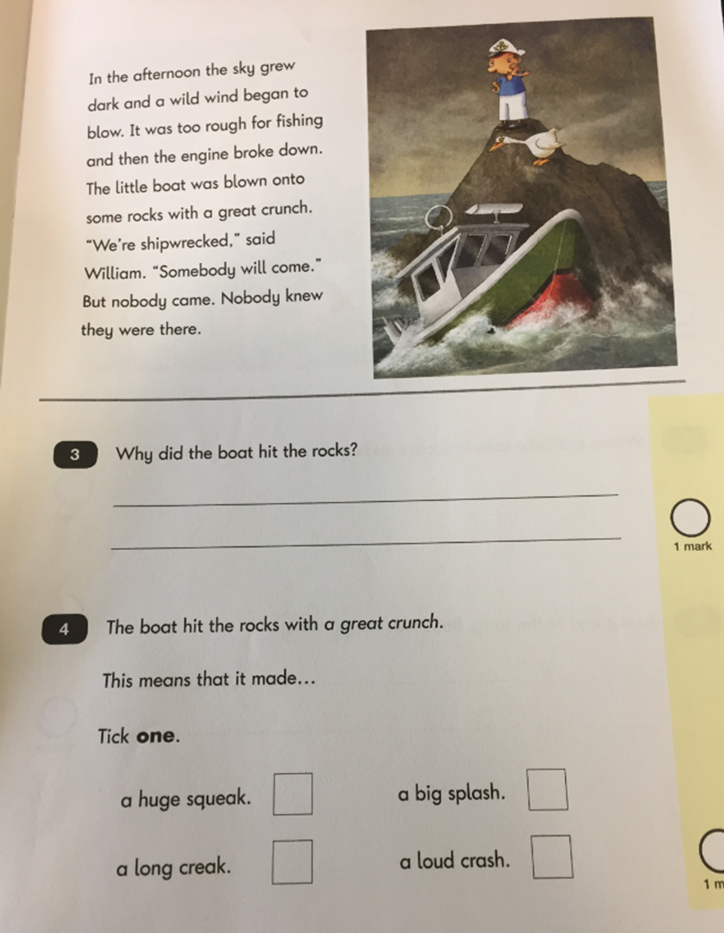
Reading Paper 1

Slide 7
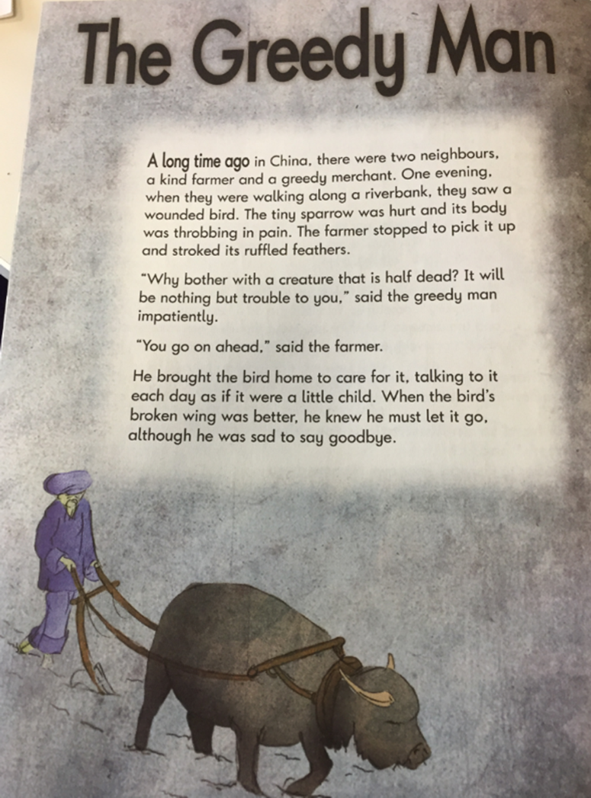
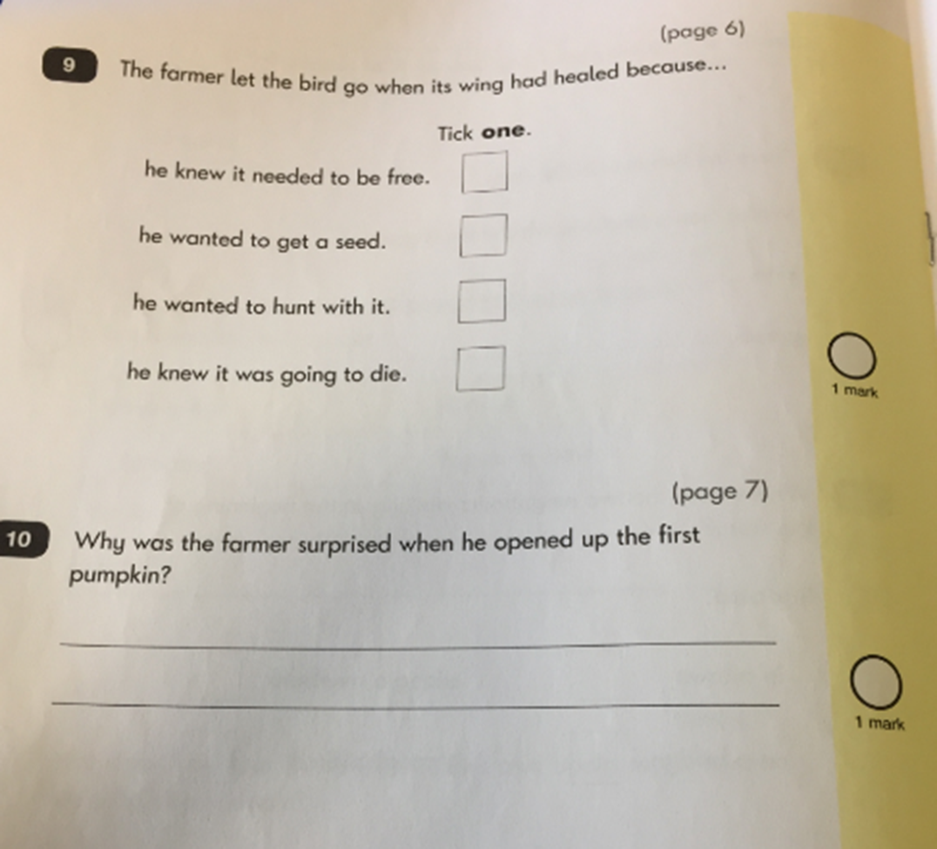
Reading Paper 2 – this is more challenging

Slide 8
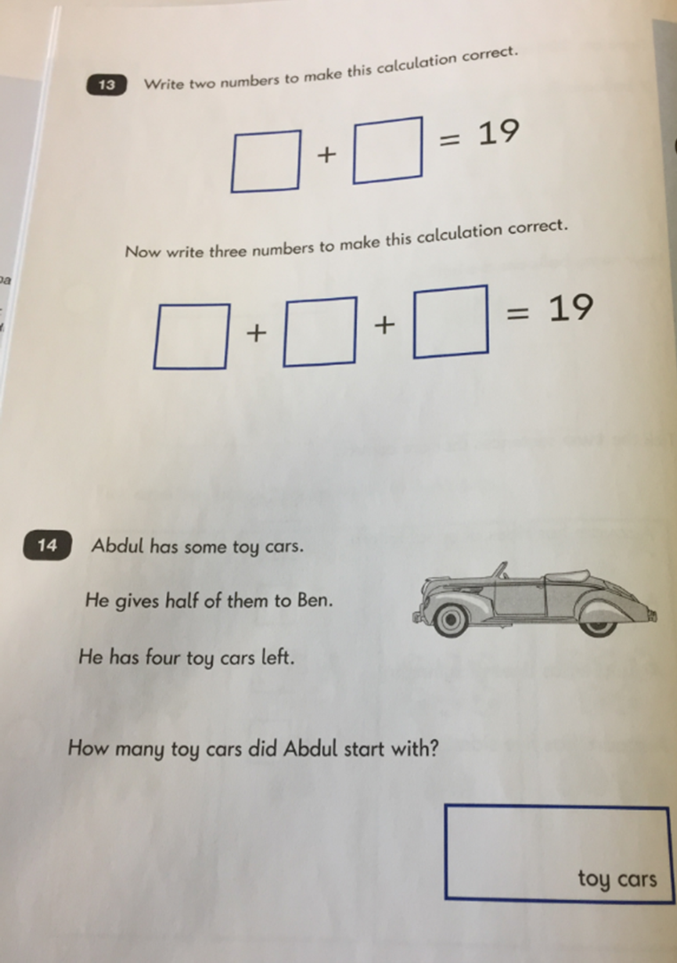
Maths Reasoning

Slide 9
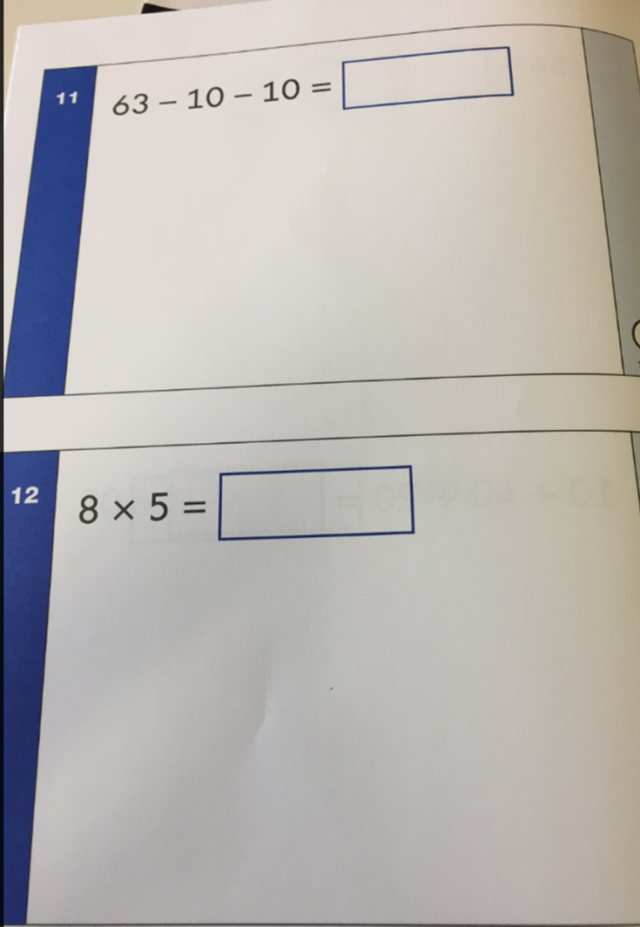
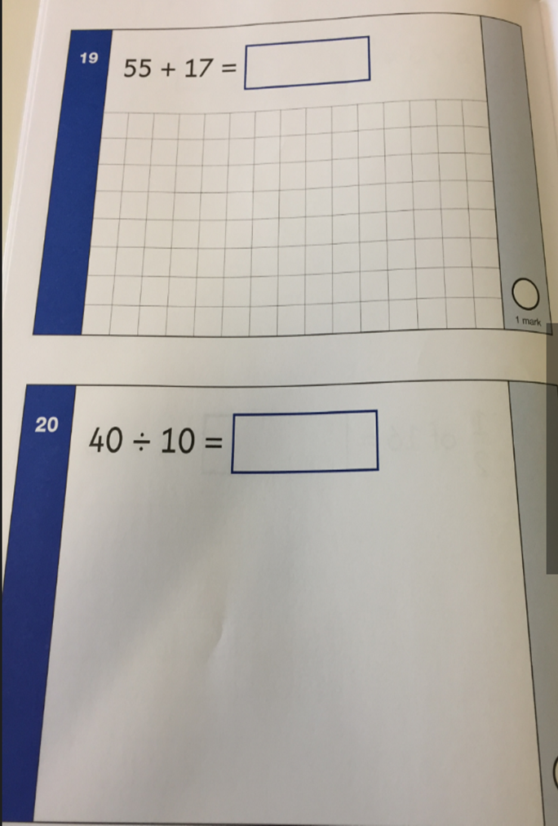
Arithmetic

Slide 10
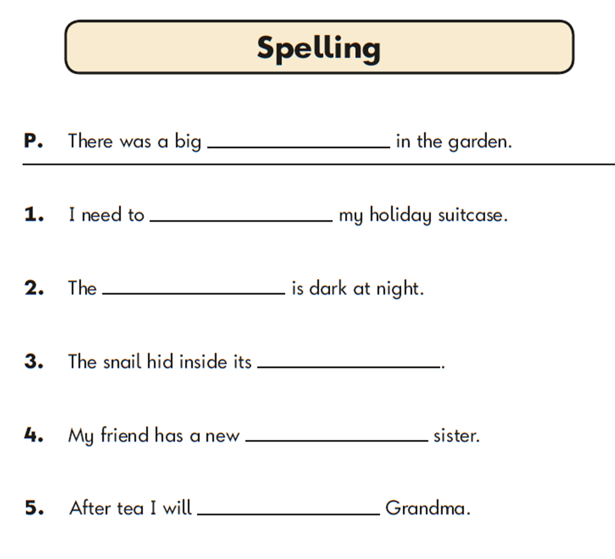
SPAG – spelling punctuation and grammar

Slide 11
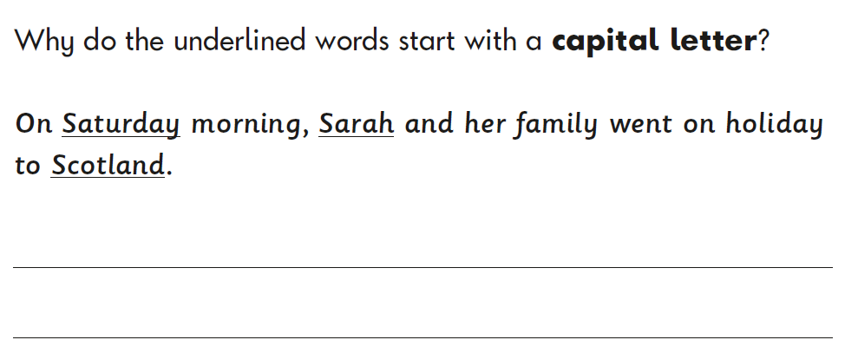
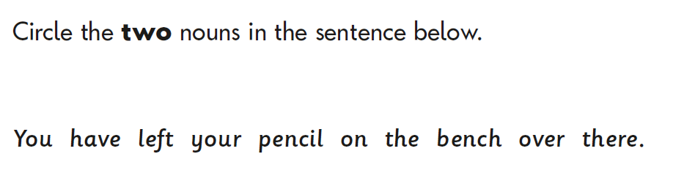

Slide 12
KS2 SATs
Pupils sit their second set of SATs in Year 6. These tests are more formal and have set exam days as well as external marking - they are packed up and marked by markers. Children will take tests in English reading comprehension, grammar, punctuation, spelling, mathematical reasoning, and arithmetic.

Slide 13
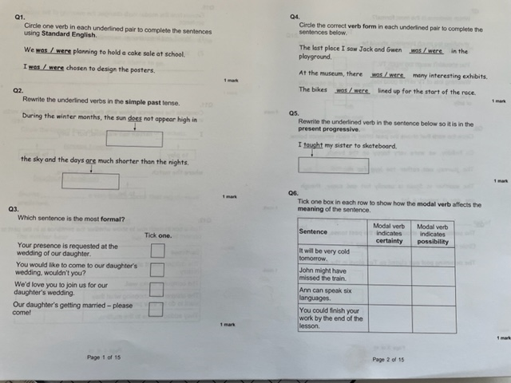
SPAG – spelling punctuation and grammar

Slide 14
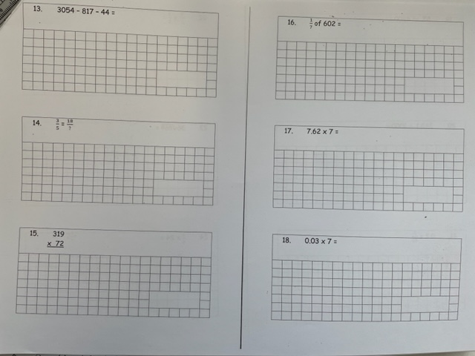
Arithmetic

Slide 15
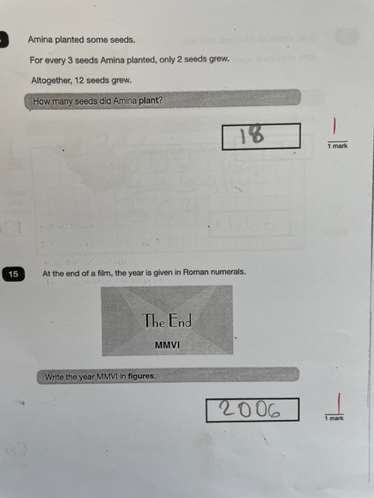
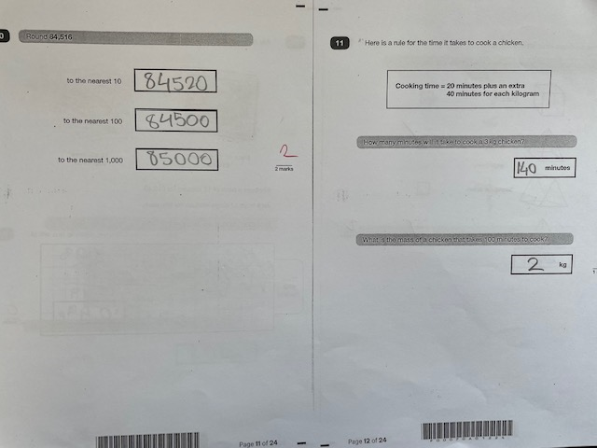
Maths Reasoning

Slide 16
Other statutory assessments in primary school that aren’t called SATs.
They take place in Reception, Y1 & Y4
Assessments happen often in all other years but are not compulsory. They are a tool to check that children have understood concepts and are making good progress.
We also have KS2 SATs in Year 6

Slide 17

Reception – Baseline Assessment
A new statutory assessment in Reception
This assessment takes place in the first 6 weeks of Reception and the focus is on Communication, Language and Literacy and Maths. It takes 30-45 minutes per child and is completed by the practitioner who best knows the child
The data will be used to judge how much progress children have made by the end of KS2.

Slide 18
Y1 Phonics Screening Week (from June 6th)
Teachers take children one at a time and children have a task to decode 40 words on word cards.
Some words are real words and some are nonsense words.
They need to use the phonic sounds they have learnt throughout Reception and Y1 to decode the words

Slide 19
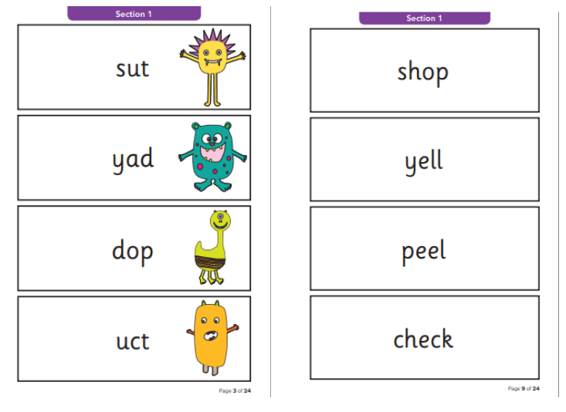

Slide 20
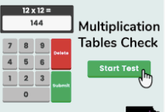
Y4 Multiplication Tables Check – 3 weeks in June
The Year 4 Times Tables Test is an online test with 25 questions; children must answer each question within a 6 seconds time limit so the whole test will take less than 5 minutes.

Slide 21
What results do the children get?
Once the KS2 SATs (end of Year 6) are complete, they will be sent away for external marking and children should receive their results towards the end of the summer term in July of Year 6.
Children are told verbally and parents receive a formal copy of the results with the end of year report. The data is transferred to the next school (KS3) who use it then to set targets for GCSE grades!

Slide 22

Is it stressful for the children?
The children are very well prepared for the tests.
They do lots of practice so they are familiar with
the format of them.
The test then looks very familiar to them
In KS1 Some children go out in small groups with a teacher.
In KS1 tests can be completed over several days.
They get lots of praise and rewards and treats!!!
Year 6 have a SATs breakfast every morning at school – hotel style!
Tests in Y6 are only in the morning

Slide 23

How you can best support your child?
Support your child with homework and champion reader from the beginning of their school life.
Lots of talk, play, games, exercise, stories, cooking, experiences and times tables songs and rhymes etc
Stay calm yourselves – the children have lots of preparation in Y2 and Y6. They do not need to do tests at home. If they need to practice some areas, reassure them and help them.
Testing week in Y6 – remove any extra pressure, no jobs/chores/tuition that week – down time at home. Lots of praise, cuddles, love. Meal plan!

